Slide 1
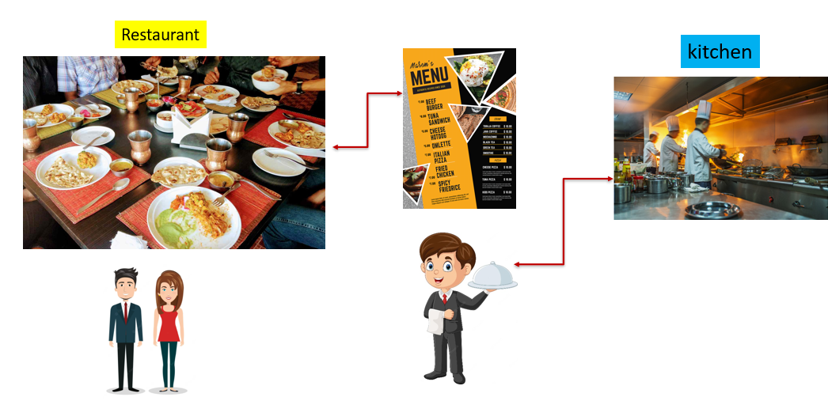
REST API Best Practices
Imagine you're at a restaurant, and you want to order some food. The restaurant has a menu with all the dishes they offer. To place an order, you follow certain steps:
Choose Your Dish: You look at the menu and decide what you want to eat.
Ask the Waiter: You call the waiter and tell them the name of the dish you want.
Wait for Your Food: The kitchen prepares your dish, and once it's ready, the waiter brings it to your table.
Now, let's translate this into the world of computers and the internet, specifically with websites and apps talking to each other:

Slide 2
REST API Best Practices
1. Choose Your "Dish" (Resource): In a REST API, there are different pieces of information or "dishes" that you can ask for. These could be details about a user, a product, a photo, or any other kind of information that the website or app provides.
2. Ask the "Waiter" (API Request): To get the information you want, your website or app sends a request to the server, just like you telling the waiter your order. This request says what "dish" you want and how you want it prepared.

Slide 3
REST API Best Practices
3. Wait for Your "Food" (API Response): The server receives your request, processes it, and prepares the information you asked for. Once it's ready, the server sends the information back to your website or app, similar to how the waiter brings your food to your table.

Slide 4
REST API Best Practices
Now, just like in a restaurant, there are some best practices to make sure this process goes smoothly and everyone is happy:
Clear Menu (Well-Defined Endpoints): The restaurant's menu should be clear and organized. Similarly, the API should have well-defined endpoints (like URLs) that clearly state what kind of information you can ask for.
Correct Ordering (HTTP Methods): In a restaurant, you order by telling the waiter what you want. In an API, you use different "verbs" (HTTP methods) to specify what you want to do: get information, create something new, update something, or delete something.
Consistent Recipe (Consistent Data Format): In a restaurant, the same dish should have the same taste and presentation every time. Similarly, the API should use a consistent data format (like JSON) to present information, so your website or app knows what to expect.

Slide 5
REST API Best Practices
Now, just like in a restaurant, there are some best practices to make sure this process goes smoothly and everyone is happy:
No Surprises (Error Handling): If something goes wrong, like the kitchen running out of ingredients, the waiter lets you know. APIs should also communicate clearly when there's a problem, so your website or app can handle it gracefully.
Efficient Service (Optimization): Just like a well-run restaurant is efficient, APIs should be designed for good performance. This means using the right tools and techniques to make sure things happen quickly and smoothly.

Slide 6
REST API Best Practices
So, REST API best practices are like a set of guidelines to ensure that when websites and apps talk to each other, they do it in a way that's organized, clear, and efficient, just like a smooth experience at a restaurant.

