Slide 1
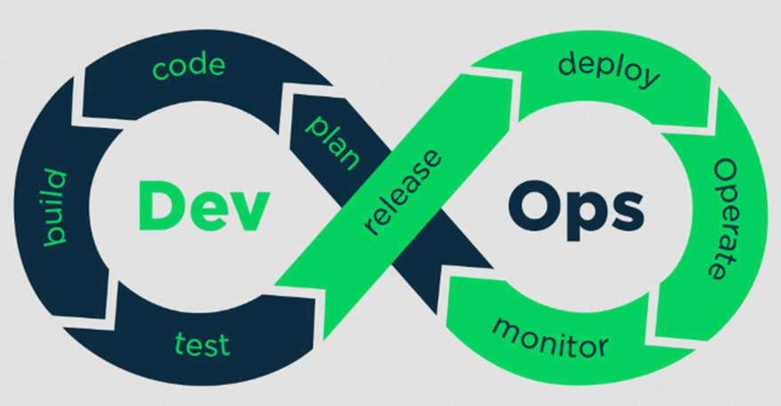
DevOps Lifecycle Explained: From Planning to Monitoring
What is DevOps Lifecycle?
Imagine you're part of a team working on a project to build and improve a smartphone app. The DevOps lifecycle is a method that helps teams like yours to efficiently and continuously deliver better versions of the app.

Slide 2
DevOps Lifecycle Explained: From Planning to Monitoring
1. Planning:
Think of this as the brainstorming phase. The team gets together to discuss new features, improvements, and bug fixes for the app. They make a plan for what needs to be done next.

Slide 3
DevOps Lifecycle Explained: From Planning to Monitoring
2. Development:
This is where the coding happens. Developers write the actual code to create new features or fix issues in the app. It's like building new rooms in a house or fixing leaks.

Slide 4
DevOps Lifecycle Explained: From Planning to Monitoring
3. Building:
Once the code is written, it needs to be put together into a working version of the app. This is like assembling all the parts of a car to make sure it runs smoothly.

Slide 5
DevOps Lifecycle Explained: From Planning to Monitoring
4. Testing:
Now, the app needs to be checked to make sure everything works as expected. Automated tests are run to find and fix any problems. It's like taking the car for a test drive to ensure it functions correctly.

Slide 6
DevOps Lifecycle Explained: From Planning to Monitoring
5. Releasing:
When the app is tested and ready, it's packaged and prepared for release. This step is like wrapping a gift and getting it ready to be given to someone.

Slide 7
DevOps Lifecycle Explained: From Planning to Monitoring
6. Deploying:
The new version of the app is then deployed to the servers where users can access it. It's like putting the car on the market so people can start driving it.

Slide 8
DevOps Lifecycle Explained: From Planning to Monitoring
7. Operating:
Once the app is live, it needs to be monitored to make sure it runs smoothly and efficiently. This is like having a team of mechanics always checking the car to ensure it works well.

Slide 9
DevOps Lifecycle Explained: From Planning to Monitoring
8. Monitoring:
Continuous monitoring is crucial to track the app's performance and user feedback. It's similar to using sensors in the car to keep an eye on its health and performance.

Slide 10
DevOps Lifecycle Explained: From Planning to Monitoring
Feedback:
User feedback and performance data are collected to understand what works well and what needs improvement. This feedback is then used to plan the next set of features or fixes, and the cycle begins again.

Slide 11
DevOps Lifecycle Explained: From Planning to Monitoring
Why DevOps Matters:
Speed: DevOps helps teams to deliver updates and new features quickly, so users always have the best version of the app.
Quality: Continuous testing and monitoring ensure that the app is reliable and high-quality.
Collaboration: DevOps fosters better teamwork between developers (who build the app) and operations (who manage the app).

Slide 12
DevOps Lifecycle Explained: From Planning to Monitoring
Summary
In essence, the DevOps lifecycle is about creating a smooth, ongoing process where your app is constantly being improved and updated efficiently. It's like having a well-oiled machine that keeps getting better with each cycle, ensuring users always have the best experience.

