Slide 1
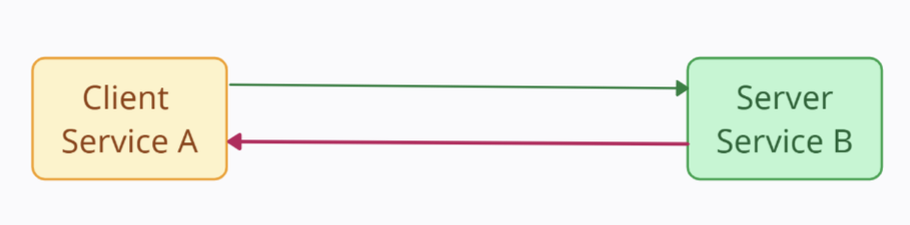
What is Service Discovery in Microservices?- Microservices Basics Tutorial
Client-Server Architecture
Host Name (www.jio.com)
192.11.30.29
Request
Response

Slide 2
What is Service Discovery in Microservices?- Microservices Basics Tutorial
192.11.13.1
192.11.10.1
Load
Balancer
Server
Service B
192.11.10.2
Client
Service A
Server
Service B
192.11.10.3
Server
Service B

Slide 3
What is Service Discovery in Microservices?- Microservices Basics Tutorial
192.11.10.1
192.11.13.1
Server
Service B
Load
Balancer
192.11.10.2
Server
Service B
Client
Service A
192.11.10.3
Server
Service B
192.11.11.5
Server
Service B

Slide 4
What is Service Discovery in Microservices?- Microservices Basics Tutorial
192.11.10.1
192.11.13.1
Server
Service B
Load
Balancer
192.11.10.2
Server
Service B
Client
Service A

Slide 5
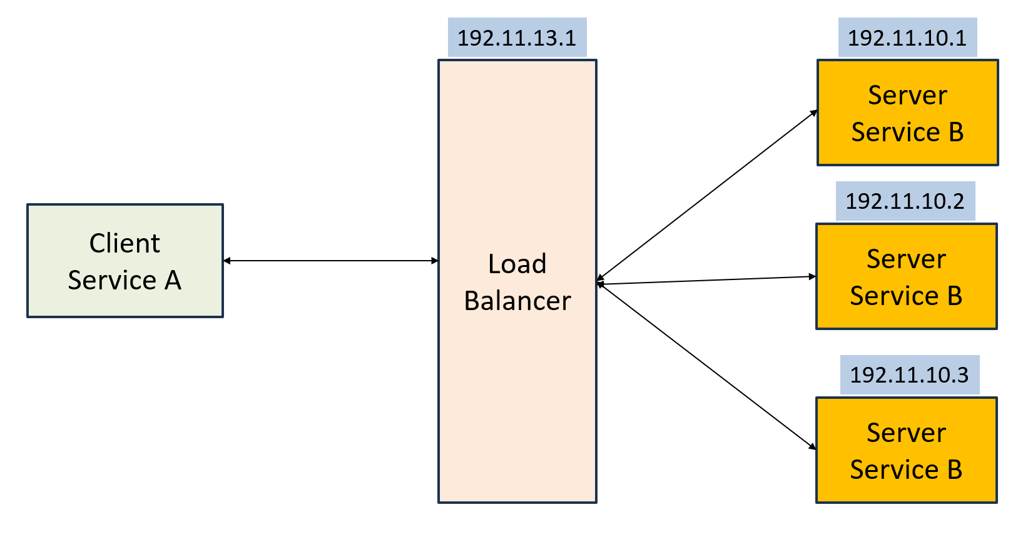
What is Service Discovery in Microservices?- Microservices Basics Tutorial
Service Name | IP Address
Service B Instance 1 | 192.11.10.1
Service B Instance 2 | 192.11.10.2
Service B Instance 3 | 192.11.10.3
Service Registry

Slide 6
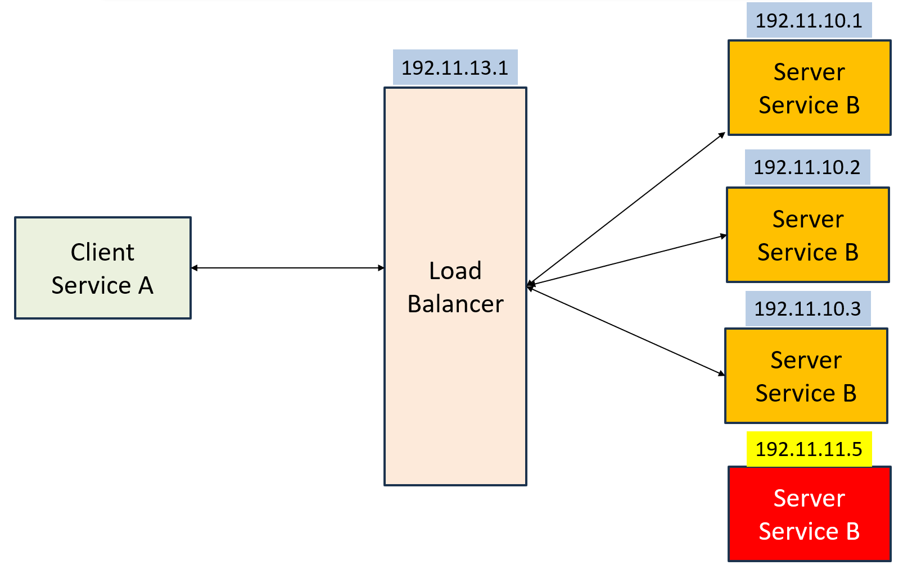
What is Service Discovery in Microservices?- Microservices Basics Tutorial
Service Name | IP Address
Service B Instance 1 | 192.11.10.1
Service B Instance 2 | 192.11.10.2
Service B Instance 3 | 192.11.10.3
Service B Instance 4 | 192.11.11.5
Service Registry

Slide 7
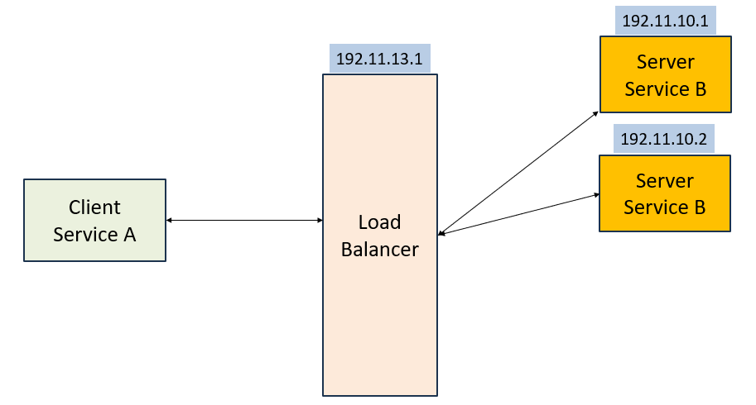
What is Service Discovery in Microservices?- Microservices Basics Tutorial
Service Name | IP Address
Service B Instance 1 | 192.11.10.1
Service B Instance 2 | 192.11.10.2
Service Registry

Slide 8
What is Service Discovery in Microservices?- Microservices Basics Tutorial
Service Name | IP Address
Service B Instance 1 | 192.11.10.1
Service B Instance 2 | 192.11.10.2
Service B Instance 3 | 192.11.10.3
Service Registry
192.11.10.1
Server
Service B
192.11.10.2
Client
Service A
Server
Service B
192.11.10.3
Server
Service B

