Slide 1
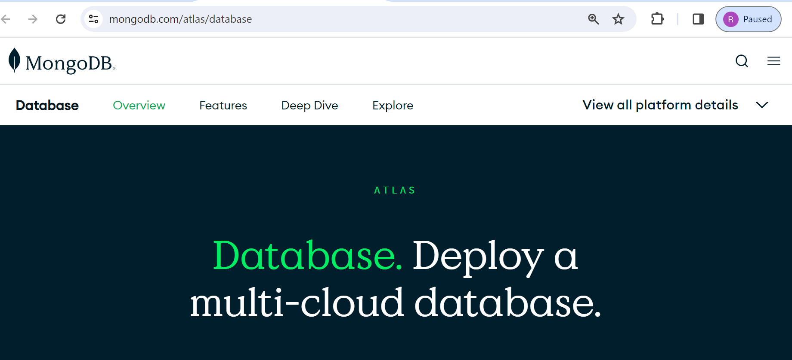
MongoDB Atlas Database | Multi-Cloud Database Service
MongoDB Atlas is a cloud-based database service offered by MongoDB, Inc.
MongoDB Atlas provides a fully managed database platform that allows users to deploy, manage, and scale MongoDB databases with ease

Slide 2
MongoDB Atlas Database | Multi-Cloud Database Service
key Features and Benefits of MongoDB Atlas
Multi-Cloud Support
Fully Managed Service
High Availability and Scalability
Security Features
Global Data Distribution
Integration with MongoDB Ecosystem
Flexible Pricing

Slide 3
MongoDB Atlas Database | Multi-Cloud Database Service
key features and benefits of MongoDB Atlas
Multi-Cloud Support: MongoDB Atlas supports deployment across multiple cloud providers, including AWS, Google Cloud Platform (GCP), and Microsoft Azure. This allows users to choose the cloud provider that best fits their requirements or adopt a multi-cloud strategy for redundancy and disaster recovery.
Fully Managed Service: MongoDB Atlas is a fully managed service, which means that MongoDB handles all aspects of database administration, including provisioning, setup, configuration, monitoring, backups, and updates. This frees users from the operational overhead of managing infrastructure, allowing them to focus on building and maintaining their applications.
High Availability and Scalability: MongoDB Atlas offers built-in features for high availability and scalability. It provides automated failover and replication across multiple nodes to ensure continuous uptime and data durability. Additionally, users can easily scale their database clusters up or down to accommodate changing workload demands.
Security Features: MongoDB Atlas includes robust security features to protect data and infrastructure. This includes network isolation, encryption at rest and in transit, role-based access control (RBAC), auditing, and integration with identity providers for authentication.

Slide 4
MongoDB Atlas Database | Multi-Cloud Database Service
key features and benefits of MongoDB Atlas
Global Data Distribution: MongoDB Atlas supports multi-region clusters, allowing users to distribute their data across multiple geographic regions for low-latency access and compliance with data residency requirements.
Integration with MongoDB Ecosystem: MongoDB Atlas seamlessly integrates with other MongoDB products and services, such as MongoDB Realm (formerly MongoDB Stitch) for serverless functions and authentication, MongoDB Charts for data visualization, and MongoDB Data Lake for data lake storage and analytics.
Flexible Pricing: MongoDB Atlas offers flexible pricing options, including pay-as-you-go pricing based on resource usage and dedicated clusters for predictable performance. Users can choose between shared clusters for development and testing or dedicated clusters for production workloads.

Slide 5
MongoDB Atlas Database | Multi-Cloud Database Service
Overall, MongoDB Atlas provides a powerful and flexible platform for building modern applications with MongoDB, offering reliability, scalability, and ease of use in a cloud-native environment.

