Slide 1


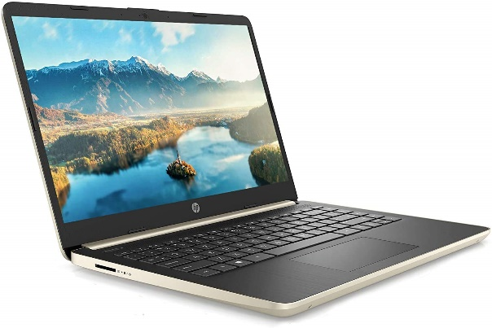

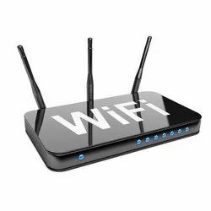
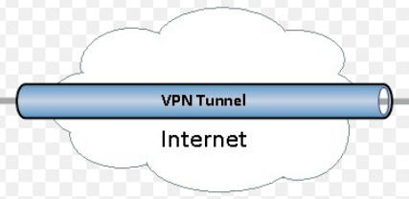

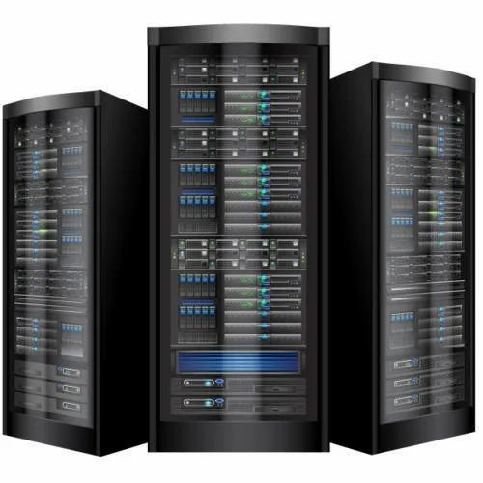
What Is a VPN: How Does It Work and Should You Use It?
Internet Service Provider
(ISP)
Public Network
Encryption
Decryption
Home Network
Company Server
Office Network

Slide 2
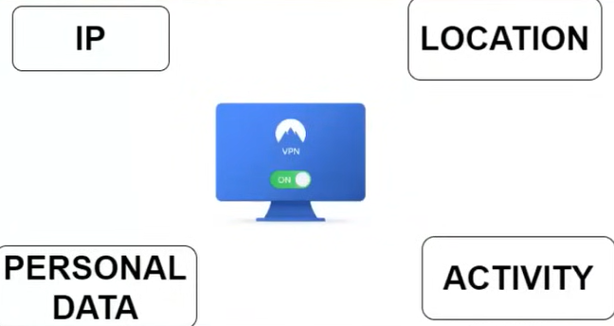
What Is a VPN: How Does It Work and Should You Use It?
VPN
Anonymity
Privacy

Slide 3

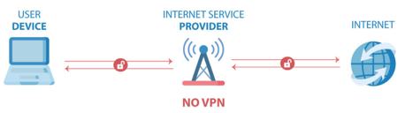
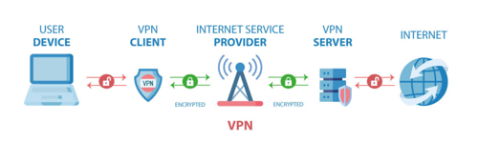
What Is a VPN: How Does It Work and Should You Use It?
Bank Username and password
Bank Username and password

Slide 4


What Is a VPN: How Does It Work and Should You Use It?

