Slide 1
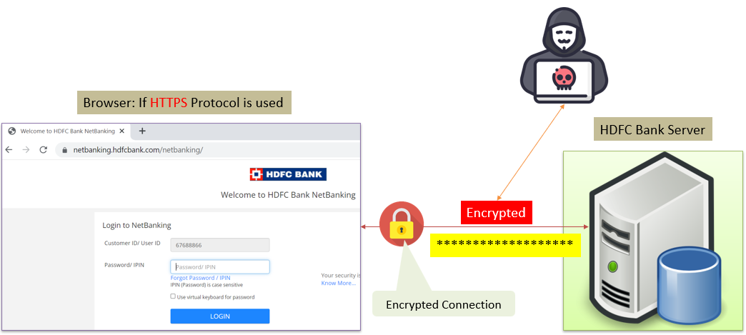
HTTPS Explained Simply: How Secure Web Browsing Works
HTTPS, which stands for HyperText Transfer Protocol Secure, is a secure version of the standard HTTP protocol used for transferring data between your web browser and the websites you visit.
HTTPS is designed to provide a secure and encrypted connection, ensuring that the data exchanged between your browser and the website remains confidential and protected from potential eavesdropping or tampering.

Slide 2
HTTPS Explained Simply: How Secure Web Browsing Works
Data Encryption: When you visit a website using HTTPS, the data exchanged between your browser and the website is encrypted. This means that even if someone intercepts the data, they won't be able to read it because it appears as a scrambled code.
Authentication: HTTPS also provides a way to verify the authenticity of the website you're visiting. When you connect to an HTTPS-enabled website, your browser checks the website's digital certificate. This certificate is issued by a trusted third party called a Certificate Authority (CA). If the certificate is valid and matches the website's domain, your browser knows that the website is legitimate.

Slide 3
HTTPS Explained Simply: How Secure Web Browsing Works
Protection Against Data Tampering: HTTPS ensures that the data you send or receive from the website has not been altered during transit. If someone tries to tamper with the data, the encryption makes it nearly impossible for them to make meaningful changes.
Trust and Security: Seeing the padlock icon or "HTTPS" in the web address (URL) of a website indicates that your connection is secure. This helps build trust between users and websites, especially when sensitive information like login credentials or credit card details are involved.

Slide 4
HTTPS Explained Simply: How Secure Web Browsing Works
In summary, HTTPS is a technology that provides a secure and private way to browse the internet and transmit data safely. It's especially crucial for protecting your personal and financial information when shopping online, logging into accounts, or sharing sensitive data.
Always look for "HTTPS" and the padlock symbol in your web browser's address bar when dealing with sensitive information online.

