Slide 1

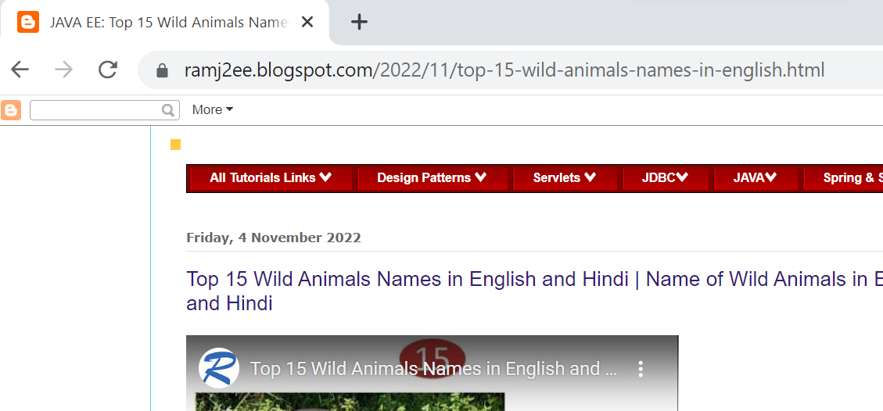
What happens when you type a URL into your browser?
Peter enters a URL into the browser and hits enter. What happens next?

Slide 2
What happens when you type a URL into your browser?
URL stands for universal resource locator
URL has four parts. First is scheme. In this example, it is http, This tells the browser to connect to the server using a protocol called HTTP. Another common scheme is HTTPS. With HTTPS, the connection is encrypted.
The second part of the URL is a domain. In this example, ramj2ee.blogspot.com.It is the domain name of the site.
The third part of the URL is path [2022/11], and the fourth is resource [top-15-wild-animals-names-in-english.html]. it is similar to directory and file in a regular file system. They together specify the resource on the server we want to load.
http://ramj2ee.blogspot.com/2022/11/top-15-wild-animals-names-in-english.html
Scheme
Domain
Path
Resource

Slide 3
What happens when you type a URL into your browser?
Peter enters a URL into the browser and hits enter.
Browser establishes TCP connection with the server
Web Server
4
Browser sends HTTP Request to the server.
3
1
5
6
Browser renders HTTP Content
Server Sends back HTTP Response
2.1
DNS Resolver
2
DNS Cache
Browser looks up IP using recursive DNS lookup
Recursive Lookup
Browser looks up IP in the Cache
DNS Server

Slide 4
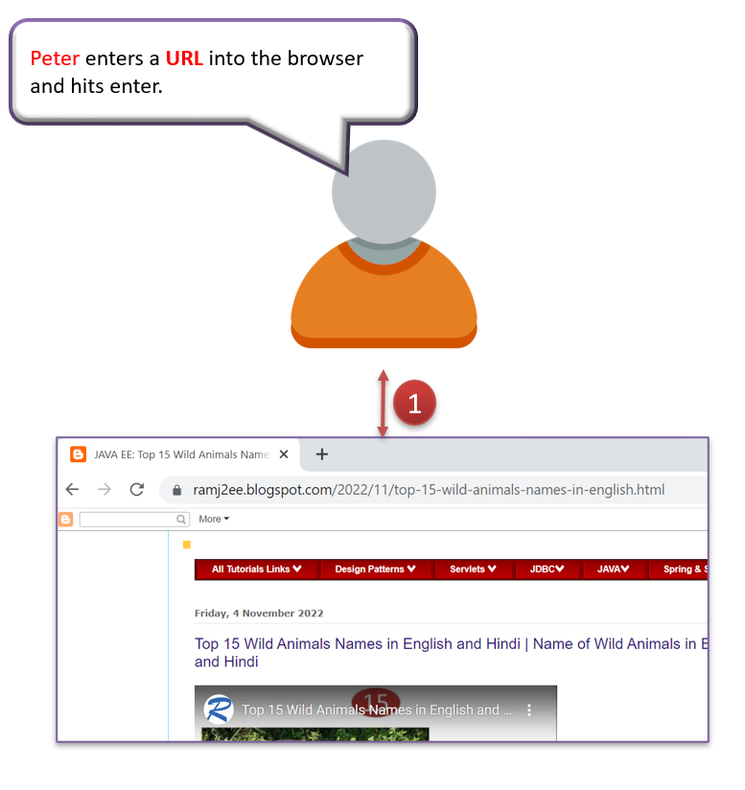
What happens when you type a URL into your browser?
Peter entered the URL into the browser. What happened next. Well, the browser needs to know how to reach the server,
in this case ramj2ee.blogspot.com. This is done with a process called DNS lookup.
DNS stands for domain name system. Think of it as a phone book of the internet.
DNS translates domain names to IP addresses so browsers can load resources.

Slide 5
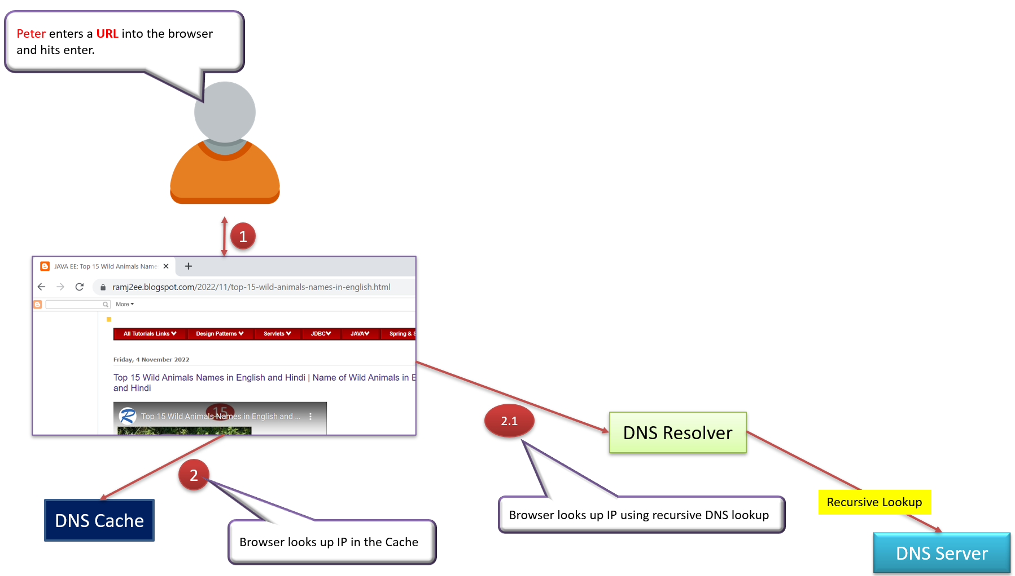
What happens when you type a URL into your browser?
Now to make the lookup process fast, the DNS information is heavily cached. First the browser itself caches it for a short period of time. And if it is not in the browser cache the browser asks the operating system for it. The operating system itself has a cache for it. which also keeps the answer for a short period of time. Now if the operating system doesn't have it, it makes a query out to the internet to a DNS Resolver. This sets off a chain of requests until the IP address is resolved. This is an elaborate and elegant process. Just to keep in mind that this process involves many servers in the DNS infrastructure and the answer is cached every step of the way.

Slide 6
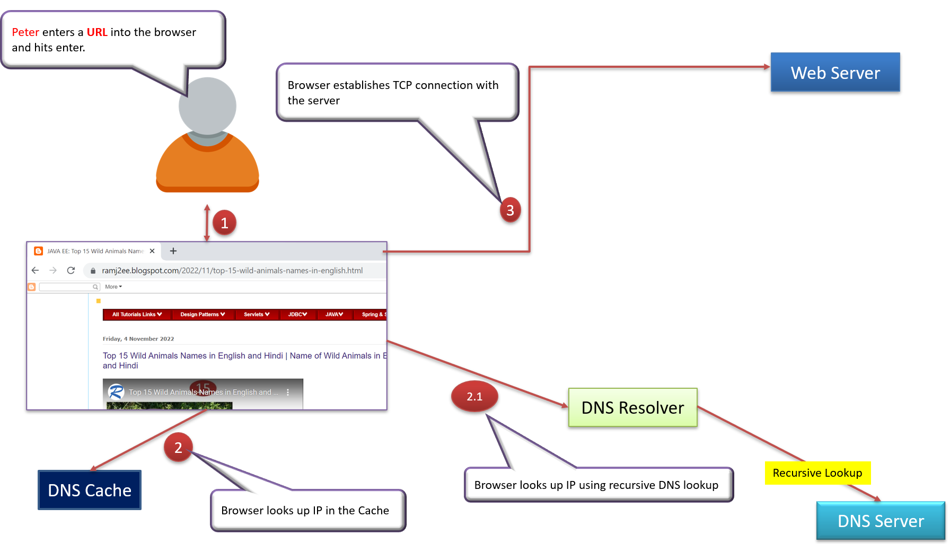
What happens when you type a URL into your browser?
Now finally the browser has the IP address of the server. In our case, again, ramj2ee.blogspot.com. Next, the browser establishes a TCP connection with the server using the IP address it got for it.
After that handshake involved in establishing a TCP connection. It takes several network round trips for this to complete.
To keep the loading process fast, modern browsers use something called a keep- alive connection to try to reuse an established TCP connection to the server as much as possible. One thing to note is that if the protocol is HTTPS, the process of establishing a new connection is even more involved. It requires a complicated process called SSL/TLS handshake to establish the encrypted connection between the browser and the server. This handshake is expensive.

Slide 7
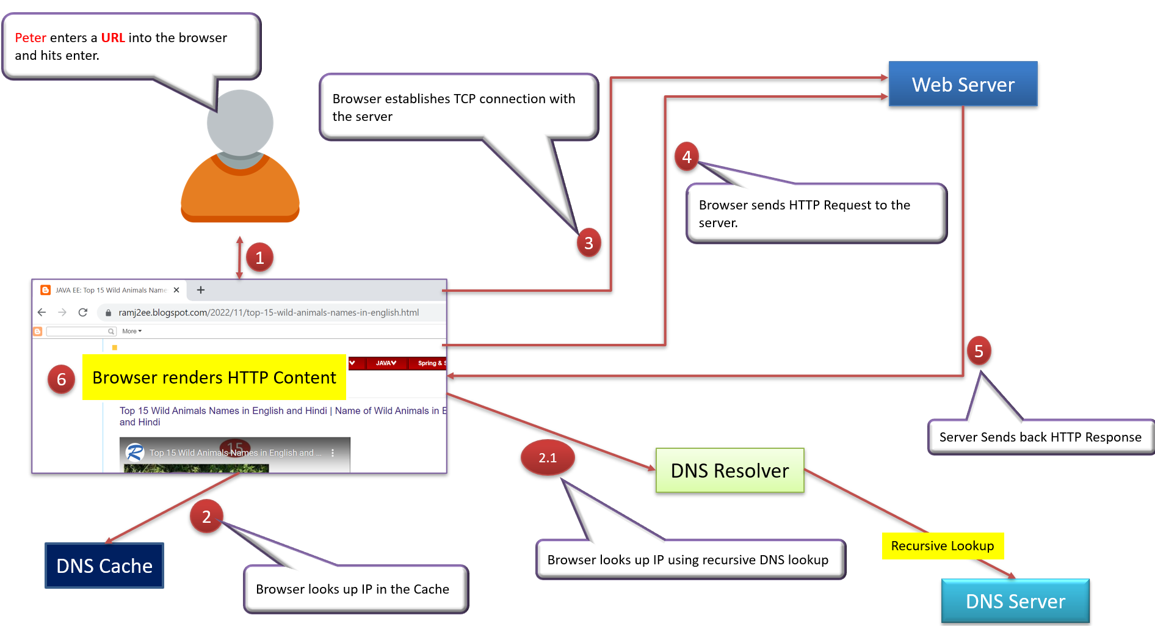
What happens when you type a URL into your browser?
Finally, the browser sends an HTTP request to the server over the established TCP connection. The Web Server processes the request and sends back a response.
The browser receives the response and renders html content. Oftentimes there are additional resources to load, like JavaScript bundles and images. The browser repeats the process above that we mentioned - making DNS lookup, establishing TCP connection, making HTTP requests - to finish fetching all the other resources.

