Slide 1
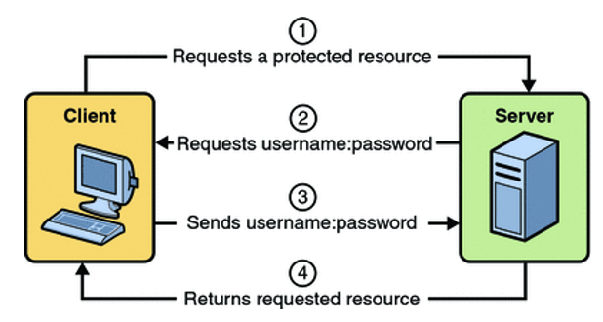
Demystifying Basic Authentication: A Beginner's Guide to Web Security
Basic Authentication is a straightforward method used to secure web resources by verifying a user's identity before allowing access to a system or application.
What is Basic Authentication? Basic Authentication is a simple security measure used on the web to protect resources. It requires users to provide a username and password to access a website, web service, or any secured content.

Slide 2
Demystifying Basic Authentication: A Beginner's Guide to Web Security
How Does it Work?
When a user attempts to access a secured resource.
The server requests their username and password.
The user enters their credentials, which are then sent to the server. These credentials are transmitted as a part of the HTTP request headers, encoded using Base64 encoding. (Note: Base64 encoding is not a form of encryption; it's a reversible encoding method.). The server receives these credentials, decodes the Base64 string, and verifies the provided username and password against its records.
If the credentials match, the server grants access to the requested resource.

Slide 3
Demystifying Basic Authentication: A Beginner's Guide to Web Security
Key Points:
Simplicity: Basic Authentication is easy to implement and understand.
Lack of Strong Security: The credentials are encoded but not encrypted, making it less secure, especially if transmitted over an unsecured connection (HTTP instead of HTTPS).
Sending Credentials with Every Request: With Basic Authentication, credentials need to be sent with each request to access protected resources.

Slide 4
Demystifying Basic Authentication: A Beginner's Guide to Web Security
Security Considerations:
Limited Security: Basic Authentication lacks advanced security features and might not be suitable for sensitive or high-security applications.
Use of HTTPS: It's strongly recommended to use HTTPS (SSL/TLS) along with Basic Authentication to encrypt the transmission of credentials, enhancing security against interception.

Slide 5
Demystifying Basic Authentication: A Beginner's Guide to Web Security
Where is Basic Authentication Used?
Basic Authentication is commonly employed in web applications, APIs, or any service requiring a straightforward authentication method.
It serves as a starting point for understanding authentication mechanisms but may not be ideal for critical systems handling highly sensitive data due to its security limitations.
In summary, Basic Authentication is an uncomplicated way to control access to web resources by requiring users to provide their credentials. However, it's essential to consider more robust authentication methods for applications handling sensitive information due to its security limitations.

