Slide 1

What is API gateway?
Imagine you're at a big concert, and there's a famous singer on stage. Now, the singer wants to interact with the audience, but he can't individually talk to each person in the crowd. So, what they do is they have a spokesperson, let's call them the "Gateway Host," who stands at the edge of the stage.
When someone from the audience wants to say something to the singer or request something, they go to the Gateway Host and tell them what they want. The Gateway Host then passes that message to the singer and brings back the singer's response or whatever the audience member asked for. This way, the singer can focus on performing, and the audience can communicate with them through this Gateway Host.
Big Concert

Slide 2
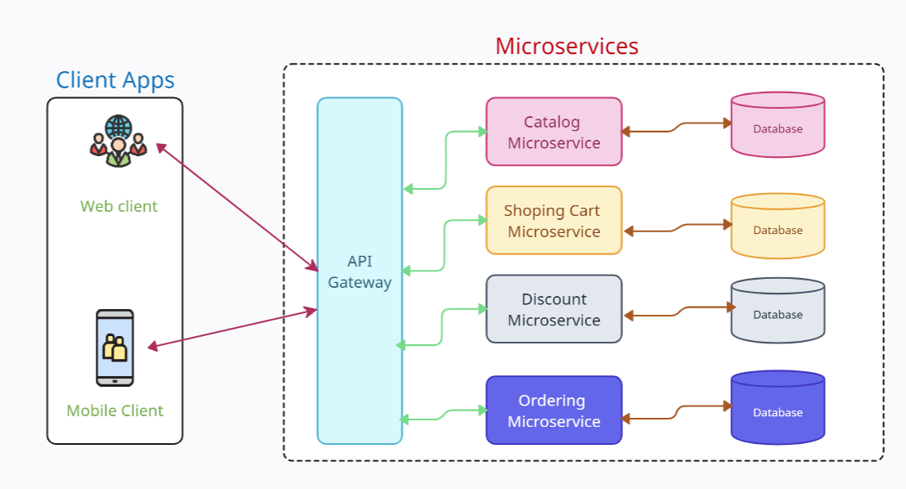
What is API gateway?
In the world of computers, an API Gateway is like that Gateway Host at the concert. It's a special computer program that acts as a bridge between different software applications or services. Instead of applications directly talking to each other, they communicate through the API Gateway.
When one application wants to get information or do something with another application, it sends a request to the API Gateway. The API Gateway then takes that request, passes it to the right place, and gets back the information or action that the first application wanted. This helps different programs work together smoothly without needing to understand all the technical details of each other. Just like the Gateway Host makes it easier for the audience to talk to the singer, the API Gateway makes it easier for different computer programs to communicate with each other.
API Gateway
=
Host in the Concert

