Slide 1
What is REST API? | RESTful Web Services | Concepts & Real Life Example
API – Application Programing Interface
API is a piece of software using that two or more applications can communicate with each other.
All Applications are connected because of API
Application 1
Application 2

Slide 2
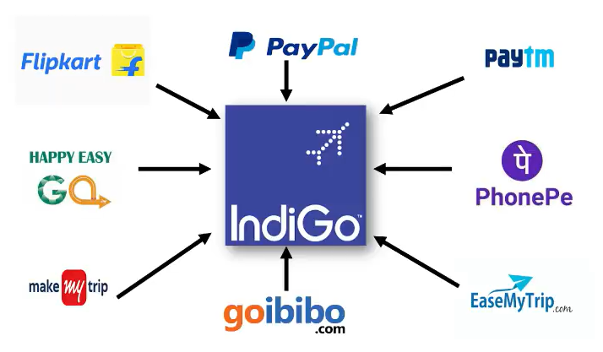
What is REST API? | RESTful Web Services | Concepts & Real Life Example

Slide 3
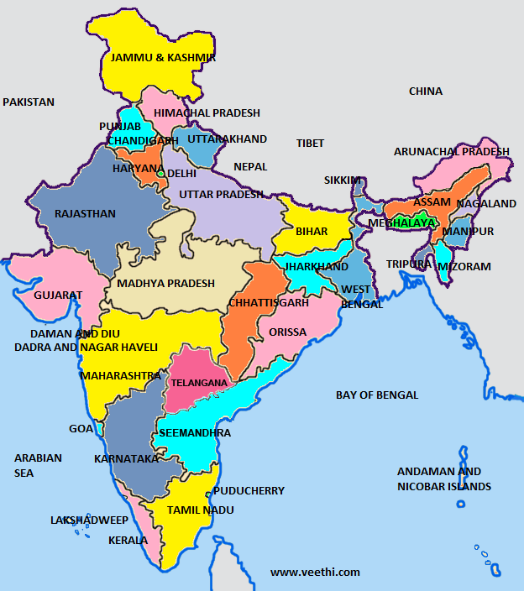

What is REST API? | RESTful Web Services | Concepts & Real Life Example
Weather Report
Installing Temp Sensor in
Different Region. but we have to
Spend lot of money and time.
API

Slide 4
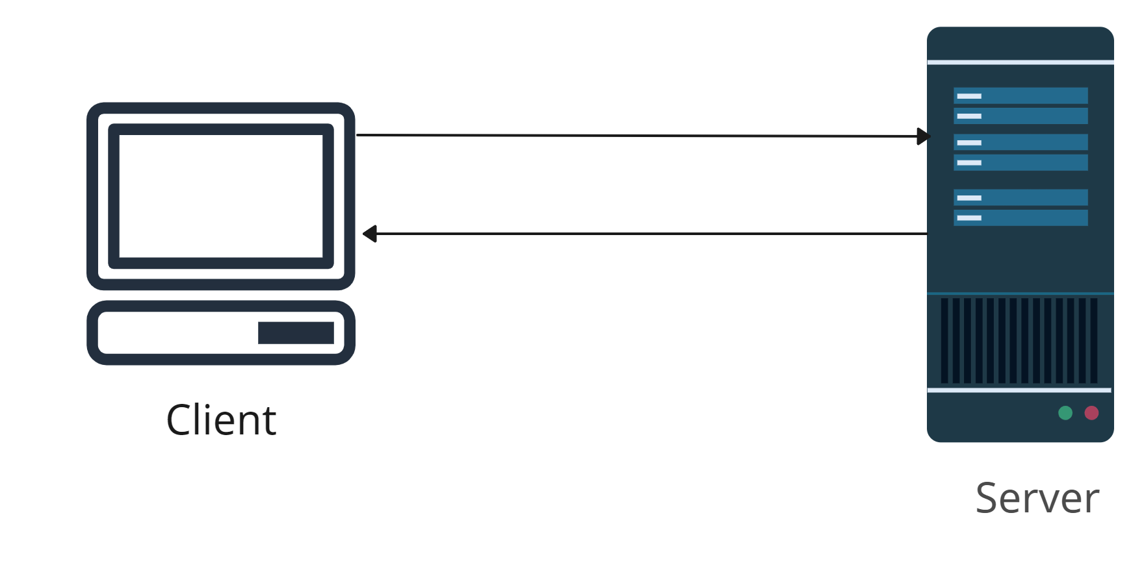
What is REST API? | RESTful Web Services | Concepts & Real Life Example
Who has the data
Who wants the data
Request
API
Response

Slide 5
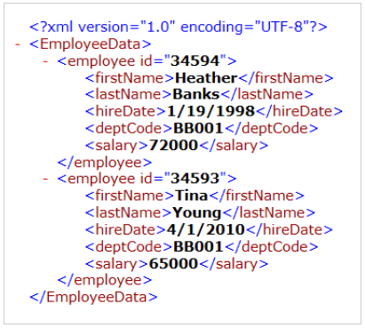
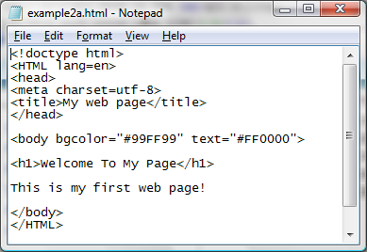
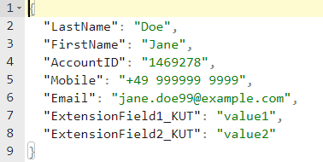
What is REST API? | RESTful Web Services | Concepts & Real Life Example
Response
HTML
XML
JSON

Slide 6
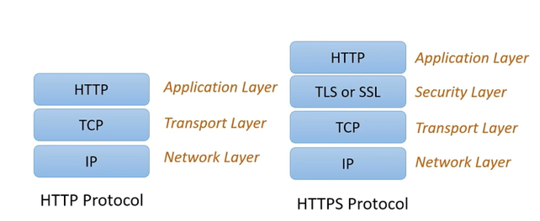
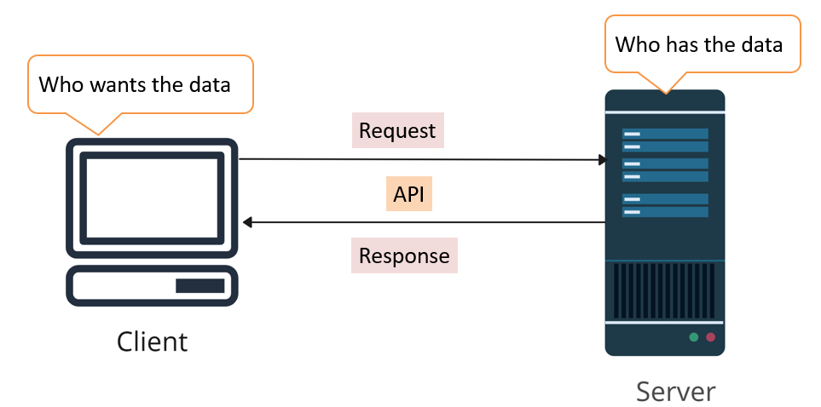
What is REST API? | RESTful Web Services | Concepts & Real Life Example
REST API

Slide 7
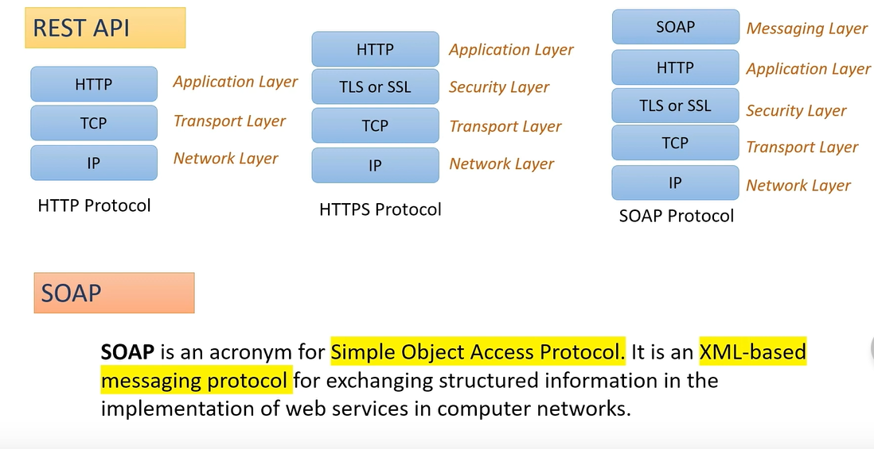
What is REST API? | RESTful Web Services | Concepts & Real Life Example

Slide 8
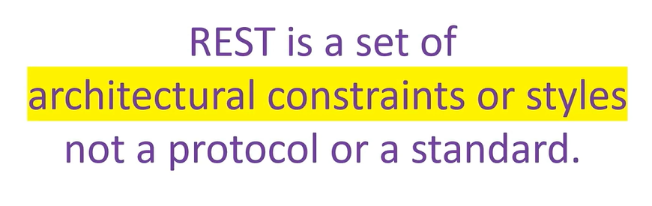
What is REST API? | RESTful Web Services | Concepts & Real Life Example
REST is an acronym for REpresentational State Transfer

Slide 9
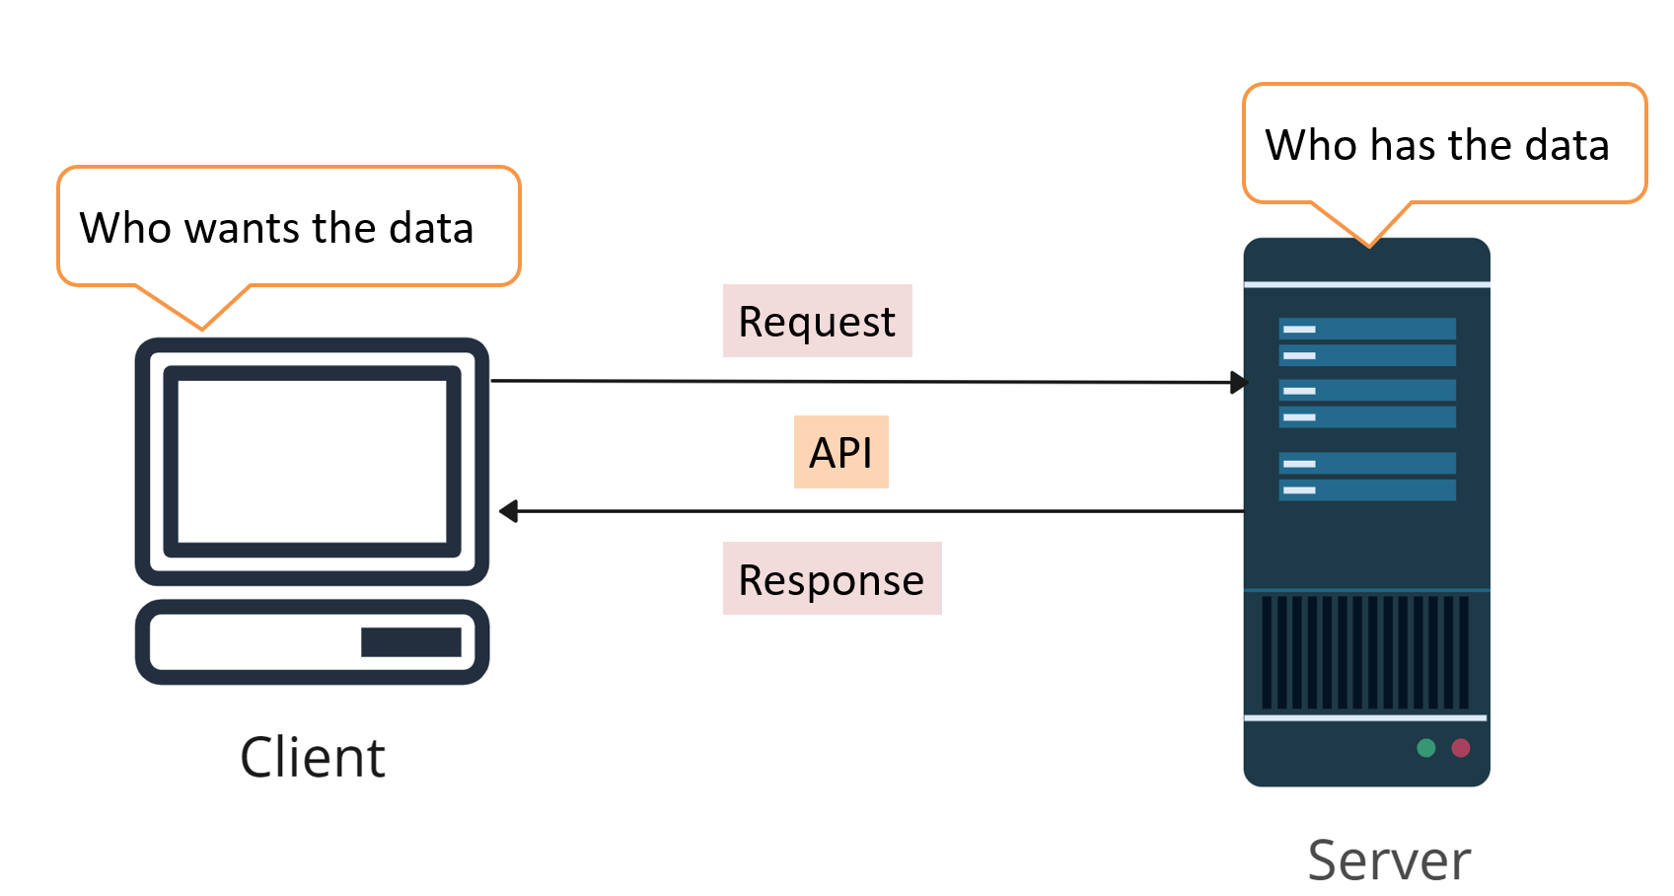
What is REST API? | RESTful Web Services | Concepts & Real Life Example
REpresentational State Transfer
Resources

Slide 10
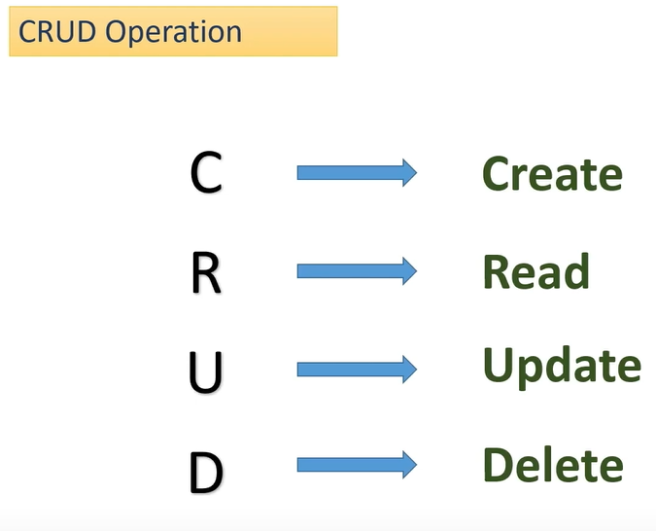
What is REST API? | RESTful Web Services | Concepts & Real Life Example

Slide 11
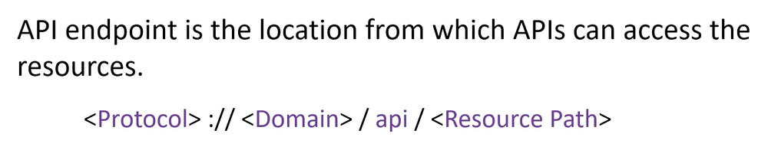
What is REST API? | RESTful Web Services | Concepts & Real Life Example
API Endpoint
https://www.google.com/api/users
https://www.google.com/api/users/1
https://www.google.com/api/users?limit=20

Slide 12
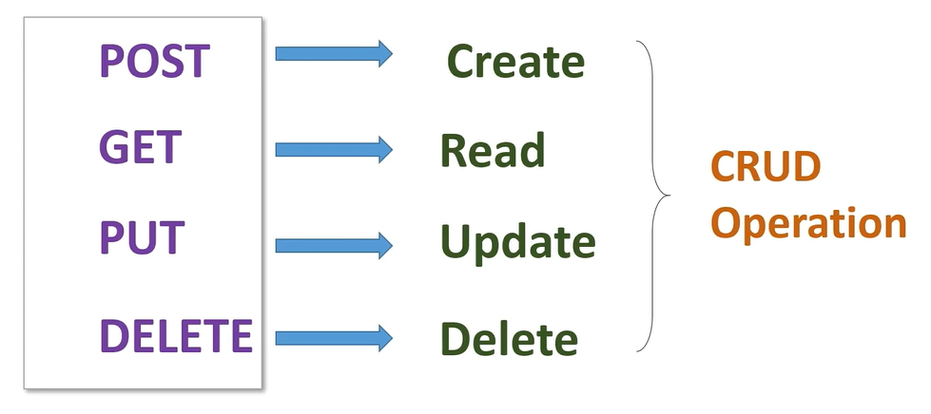

What is REST API? | RESTful Web Services | Concepts & Real Life Example
HTTP Method
GET - https://www.google.com/api/users

Slide 13
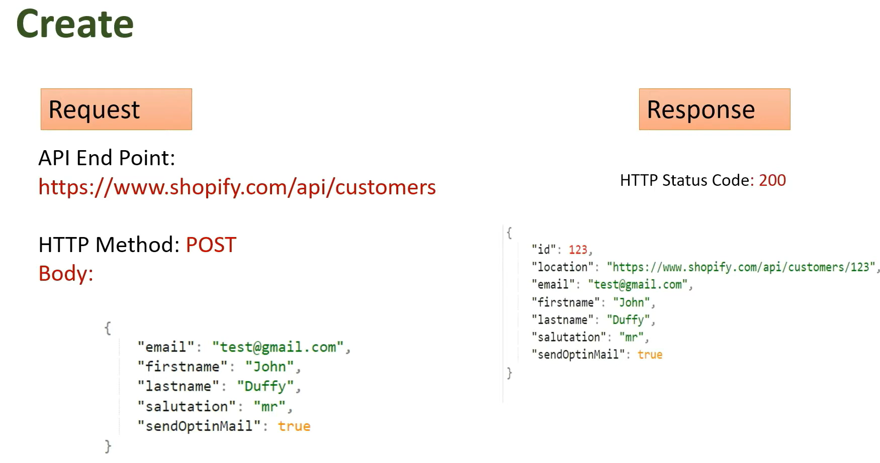
What is REST API? | RESTful Web Services | Concepts & Real Life Example
https://www.google.com/api/users
“https://www.google.com/api/users/123”

Slide 14
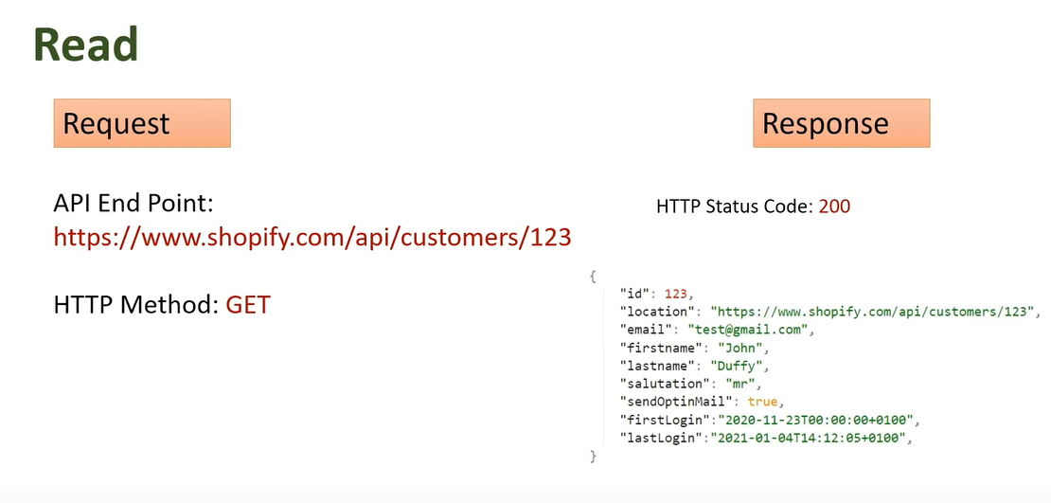
What is REST API? | RESTful Web Services | Concepts & Real Life Example
https://www.google.com/api/users/123
“https://www.google.com/api/users/123”

Slide 15
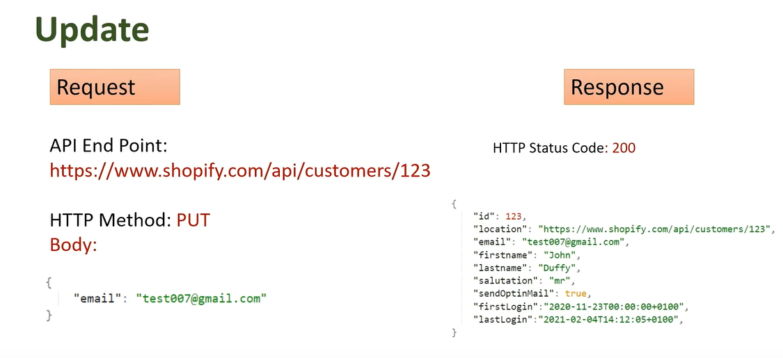
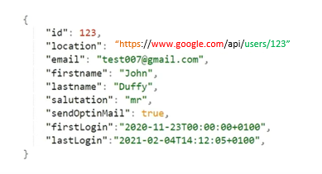
What is REST API? | RESTful Web Services | Concepts & Real Life Example
https://www.google.com/api/users/123
“https://www.google.com/api/users/123”

Slide 16
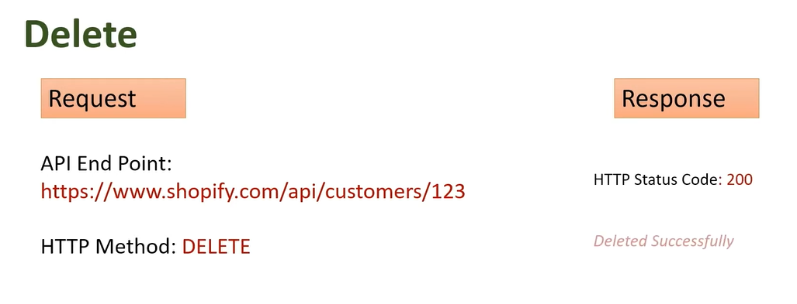

What is REST API? | RESTful Web Services | Concepts & Real Life Example
https://www.google.com/api/users/123

Slide 17
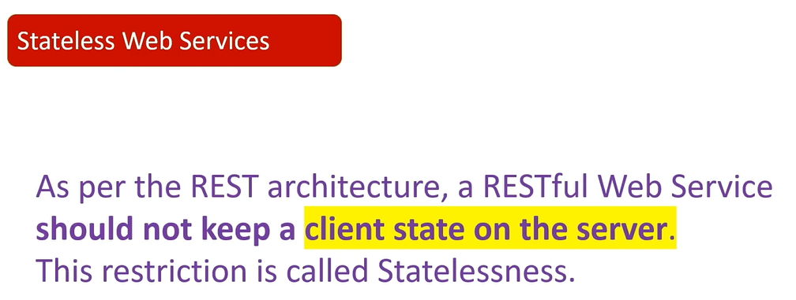
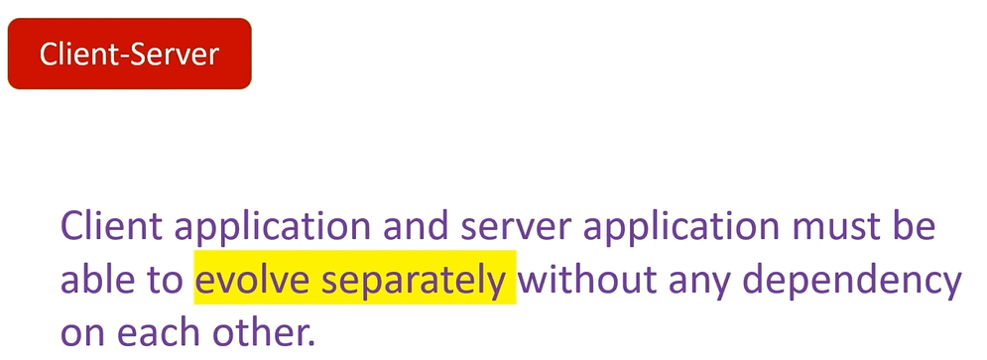
What is REST API? | RESTful Web Services | Concepts & Real Life Example

Slide 18
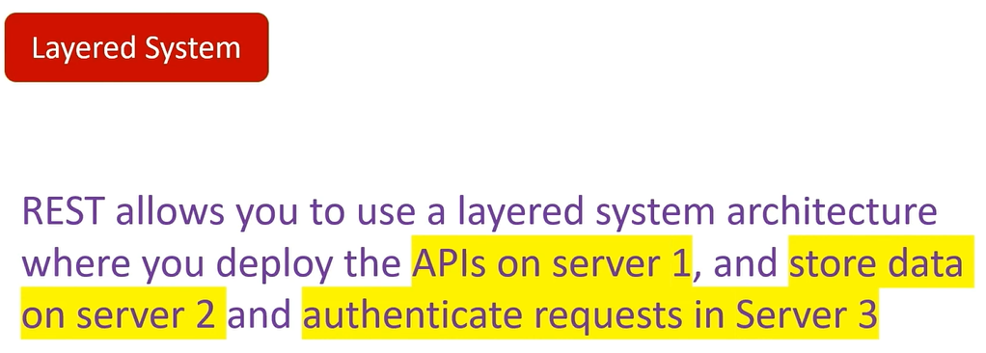
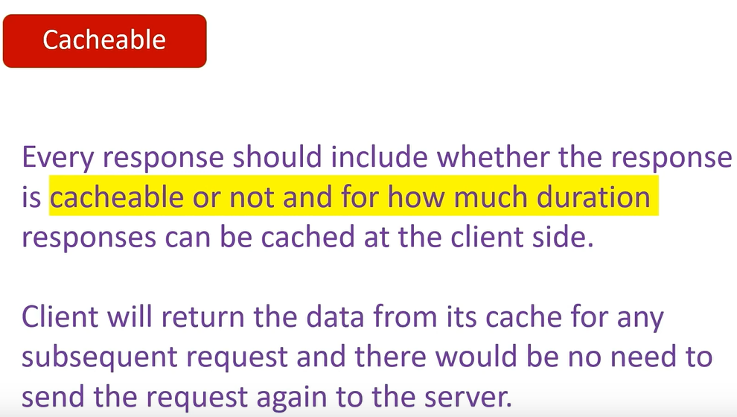
What is REST API? | RESTful Web Services | Concepts & Real Life Example

Slide 19
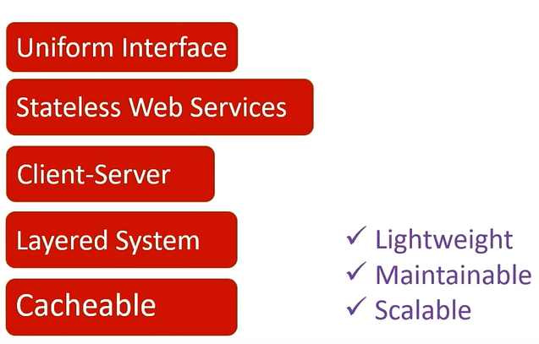
What is REST API? | RESTful Web Services | Concepts & Real Life Example

