Slide 1
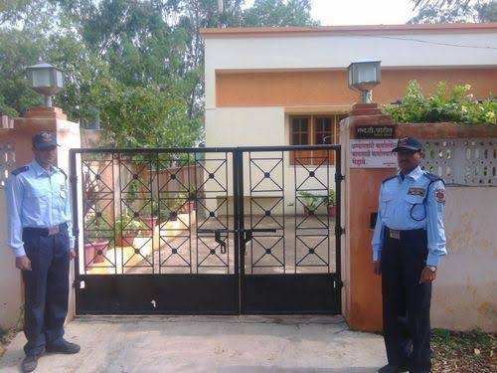
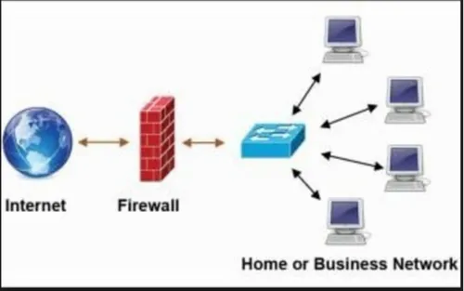
Firewall Explained: Your Digital Security Guard
A firewall is like a security guard for your computer or network. Imagine your computer or network as a house, and the firewall as a protective barrier that decides who is allowed to come in and who should stay out.
House with Security Guard
Computer Network with Firewall

Slide 2
Key points
Firewall Explained: Your Digital Security Guard
Security Barrier:
A firewall acts as a barrier between your computer or network and the internet. It monitors and controls incoming and outgoing network traffic based on predetermined security rules.
Filtering Traffic:
Just like a security guard checks IDs at the entrance, a firewall examines data packets (small units of data) traveling between your computer and the internet. It decides whether to allow or block these packets based on specific criteria.
House with Security Guard
Computer Network with Firewall

Slide 3
Key points
Firewall Explained: Your Digital Security Guard
3. Types of Firewalls:
There are hardware firewalls (devices that sit between your computer and the internet) and software firewalls (programs that run on your computer). Some routers also have built-in firewalls to protect your entire network.
4. Protection Against Threats:
Firewalls are essential for protecting your computer or network from unauthorized access, malicious software (like viruses and malware), and potential cyber threats. They help prevent hackers and cybercriminals from gaining access to your personal information.
House with Security Guard
Computer Network with Firewall

Slide 4
Key points
Firewall Explained: Your Digital Security Guard
5. Rule-Based Control:
Firewalls use rules to determine whether to allow or block traffic. These rules can be set by you or your network administrator. For example, you might set a rule to block certain types of websites or restrict access during specific hours.
6. Invisible Shield:
While a firewall works behind the scenes, it's like an invisible shield that helps keep your digital space safe. It's always vigilant, watching for any signs of suspicious or harmful activity.
House with Security Guard
Computer Network with Firewall

Slide 5
Key points
Firewall Explained: Your Digital Security Guard
7. Configurability:
Depending on your needs, firewalls are customizable. You can configure them to provide more or less strict protection, depending on the level of security you require.
House with Security Guard
Computer Network with Firewall

Slide 6
Firewall Explained: Your Digital Security Guard
Summary
A firewall is your computer's digital bouncer, making sure that only the good stuff gets in while keeping the bad stuff out. It's a crucial element in maintaining the security and integrity of your digital space, whether it's a single computer or an entire network.
House with Security Guard
Computer Network with Firewall

