Slide 1
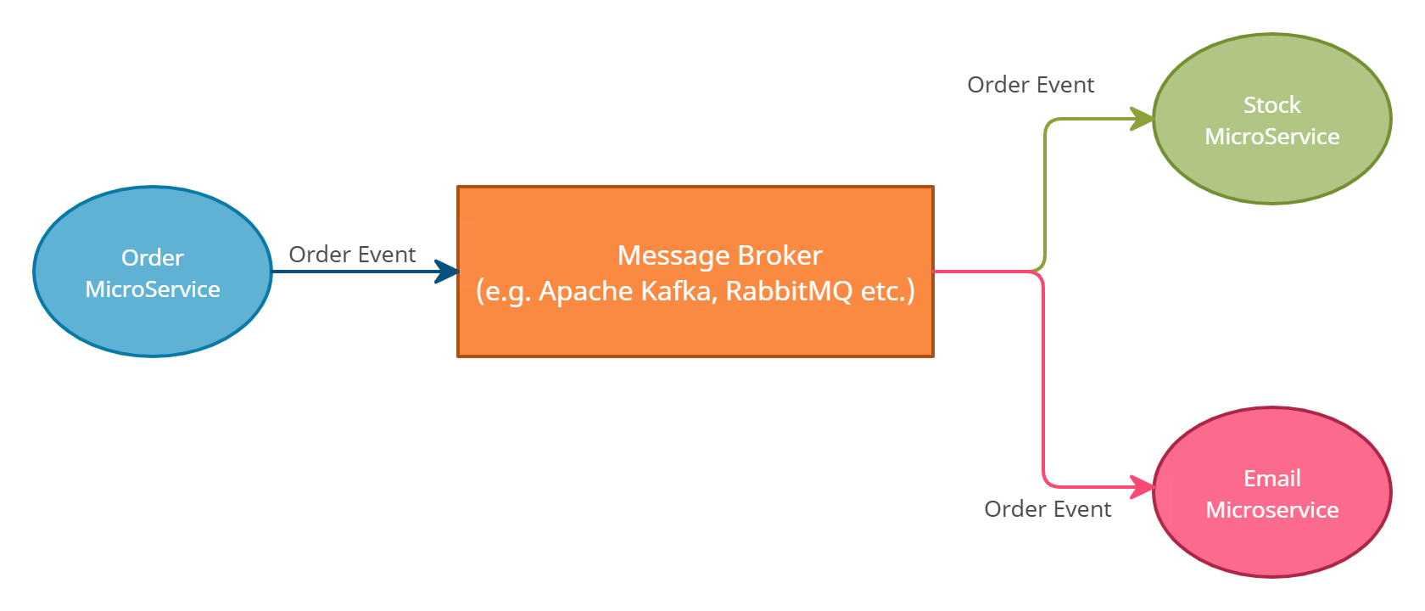
JMS Explained: Java Message Service for Beginners
JMS, which stands for Java Message Service, is a technology that allows different software applications to communicate and exchange information asynchronously through messages. Imagine sending messages between two people without needing them to be online at the same time to receive or send messages.
JMS provides a way for software components, often called "clients," to send and receive messages reliably and efficiently.

Slide 2
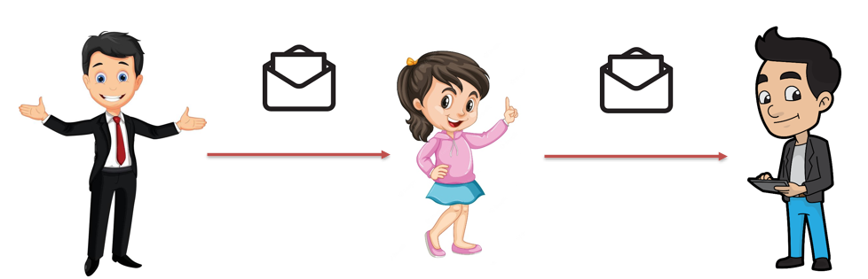
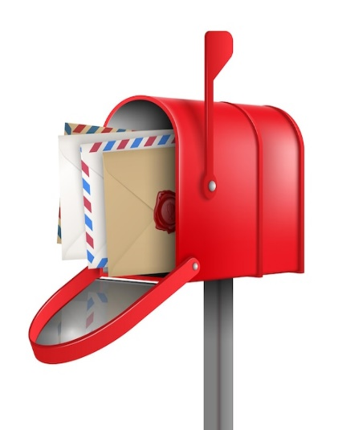
JMS Explained: Java Message Service for Beginners
Scenario: Sending Physical Mail
Think of JMS like sending physical mail between two people. One person sends a letter, and the other receives it. They don't have to be present at the same time for this communication to happen. Similarly, in JMS:
Messaging System: JMS acts like a postal system for software applications. It provides a way for different parts of an application to send messages to each other, just like sending letters.
Messages: Messages in JMS are like letters. They contain information that needs to be sent from one part of the application to another. Messages can be simple data or more complex structures.

Slide 3
JMS Explained: Java Message Service for Beginners
Producers: Producers are like the people who send letters. They create and send messages to a destination (like a mailbox).
Destinations: Destinations are like mailboxes. They are predefined places where messages are sent. They can be topics (broadcast-like) or queues (one-to-one communication).

Slide 4
JMS Explained: Java Message Service for Beginners
Consumers: Consumers are like the people who receive and read the letters. They listen to destinations and retrieve messages from them.
Asynchronous: JMS communication is asynchronous, which means that the sender and receiver don't need to be actively connected at the same time. Just like physical mail, the receiver can check the mailbox whenever they are ready.

Slide 5
JMS Explained: Java Message Service for Beginners
Reliable: JMS ensures that messages are reliably delivered to the destination. If a receiver is not available, the message is stored until the receiver is ready to read it.
Message Types: JMS supports different types of messages, such as text messages, object messages, and more. This versatility allows applications to send various kinds of data.
In a nutshell, JMS is like a messaging system for software applications, allowing them to send and receive messages asynchronously and reliably, similar to how people send and receive physical mail.

