Slide 1
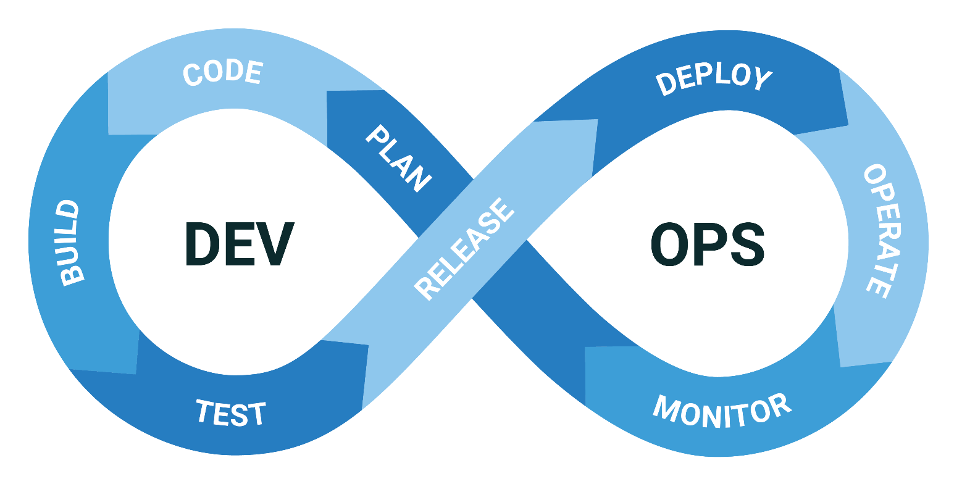
DevOps Lifecycle for Beginners: An Easy Overview
What is DevOps Lifecycle?
The DevOps lifecycle is a series of stages that help software development and
IT operations teams work together to create, test, and release software more quickly and reliably.

Slide 2

DevOps Lifecycle for Beginners: An Easy Overview
1. Planning: This is where it all starts. Teams come together to brainstorm and decide what features or updates they want to add to the software. They create a roadmap and set goals for what needs to be accomplished.

Slide 3
DevOps Lifecycle for Beginners: An Easy Overview
2. Coding: In this stage, developers write the code for the new features or updates. They use programming languages to create the functionality that was planned in the previous stage.

Slide 4
DevOps Lifecycle for Beginners: An Easy Overview
3. Building: Once the code is written, it needs to be combined and compiled into a format that can be executed by a computer. This stage involves integrating different pieces of code and ensuring they work together.

Slide 5
DevOps Lifecycle for Beginners: An Easy Overview
4. Testing: Testing is crucial to ensure the software works correctly and is free of bugs. Automated tests are run to quickly find and fix any issues. This helps maintain the quality of the software.

Slide 6
DevOps Lifecycle for Beginners: An Easy Overview
5. Releasing: After the software passes all tests, it's ready to be released. This stage involves deploying the software to a production environment where it can be accessed by users.

Slide 7
DevOps Lifecycle for Beginners: An Easy Overview
6. Deploying: Deployment involves actually putting the new code into the live environment. Automation tools help make this process smooth and fast, reducing downtime and errors.

Slide 8
DevOps Lifecycle for Beginners: An Easy Overview
7. Operating: Once deployed, the software is up and running. During this stage, the operations team monitors the system to ensure everything is working as expected and to manage any issues that arise.

Slide 9
DevOps Lifecycle for Beginners: An Easy Overview
8. Monitoring: Continuous monitoring is essential to catch any problems early. Tools are used to keep an eye on the software's performance and user experience, ensuring any issues are promptly addressed.

Slide 10
DevOps Lifecycle for Beginners: An Easy Overview
Feedback: Finally, feedback from users and performance data are gathered to understand how well the software is performing and what improvements can be made. This feedback is then used in the next planning stage, and the cycle starts over again.

Slide 11
DevOps Lifecycle for Beginners: An Easy Overview
Summary
By following this lifecycle, DevOps teams can deliver software faster, more reliably, and with better quality. The key to DevOps is collaboration and continuous improvement, making sure that the development and operations teams work together seamlessly throughout the entire process.

