Slide 1
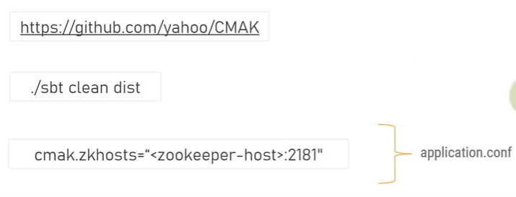
How to install and use the CMAK (Cluster Manager for Apache Kafka) or Kafka Manager?
CMAK (previously known as Kafka Manager) is a tool for managing Apache Kafka clusters.
CMAK or Kafka Manager is Graphical User Interface to view the Kafka cluster, using this we can view all the topics, all the partitions, number of offsets and which consumers assigned to what and all topics etc.

Slide 2
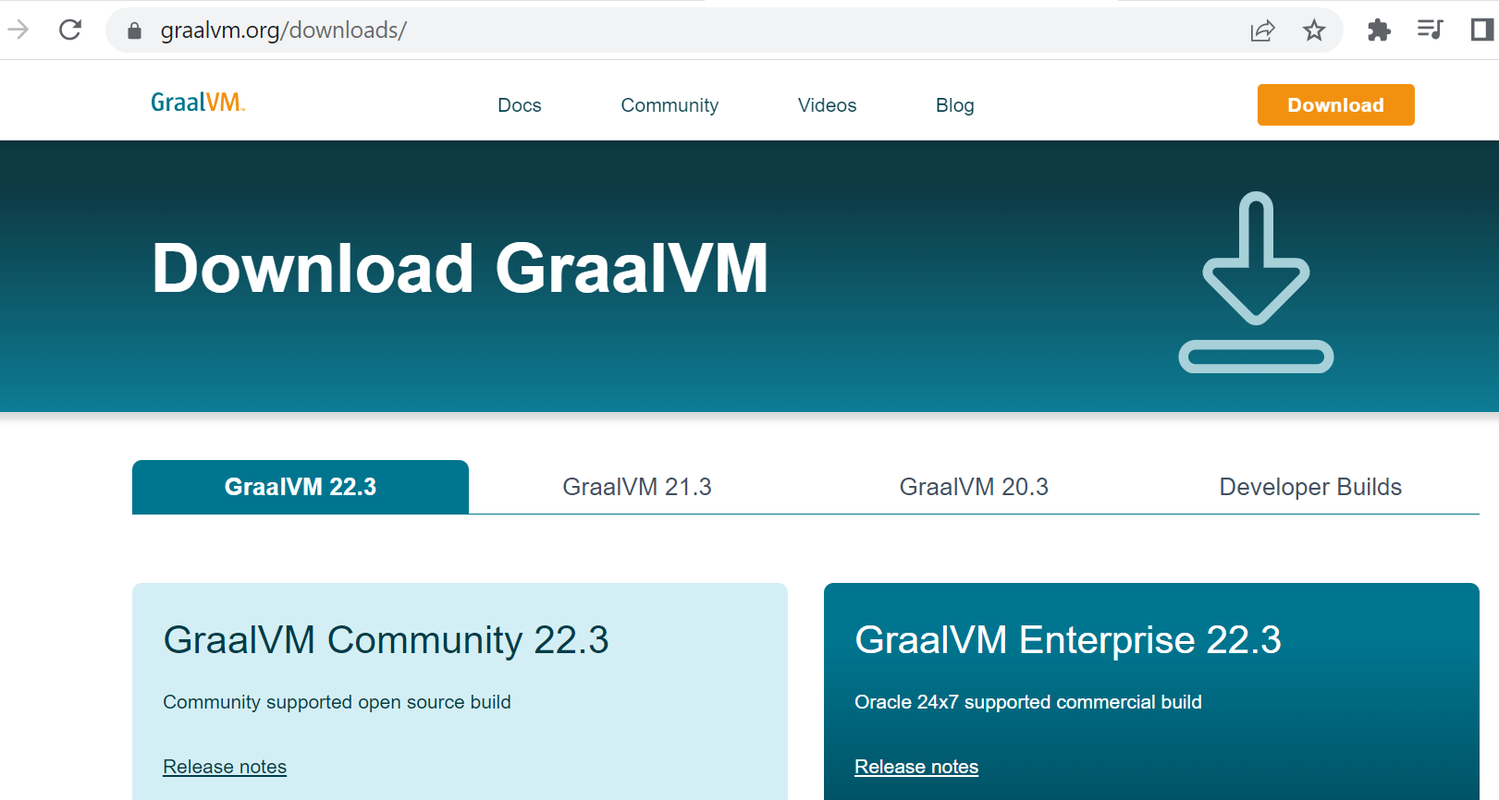
How to install and use the CMAK (Cluster Manager for Apache Kafka) or Kafka Manager?
https://www.graalvm.org/downloads/

Slide 3
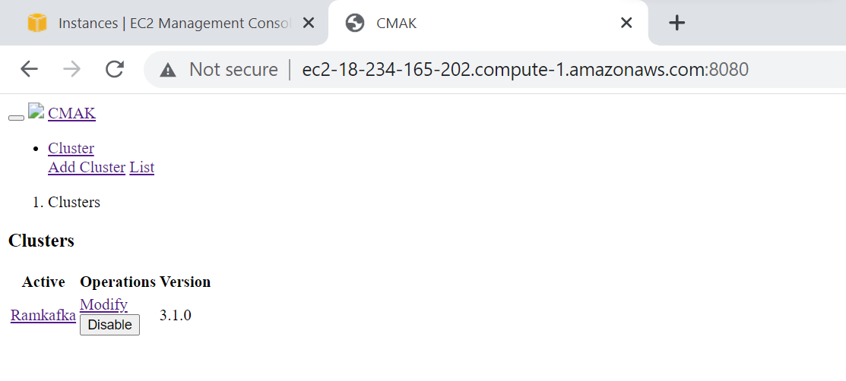
How to install and use the CMAK (Cluster Manager for Apache Kafka) or Kafka Manager?
http://ec2-18-234-165-202.compute-1.amazonaws.com:8080/

