Slide 1
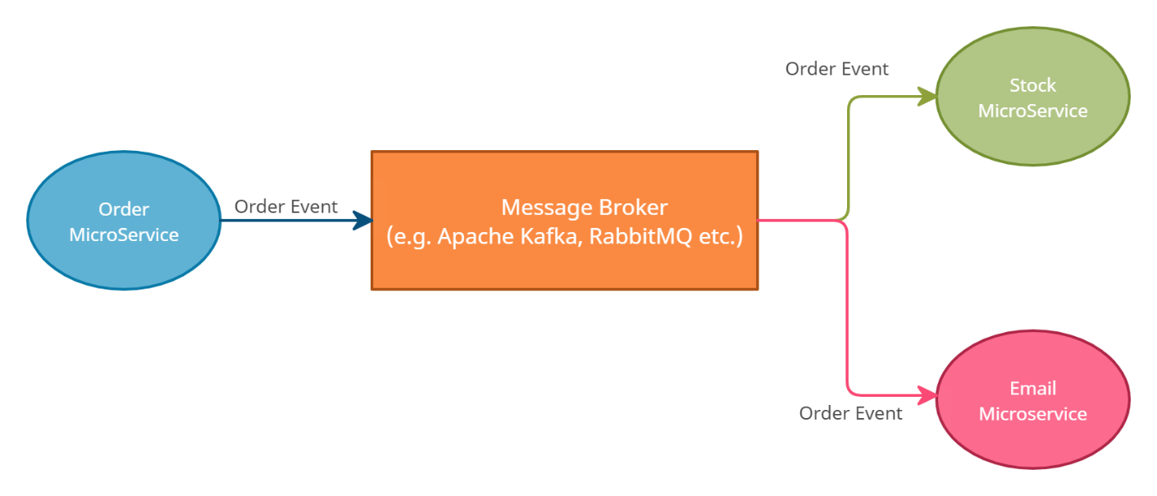
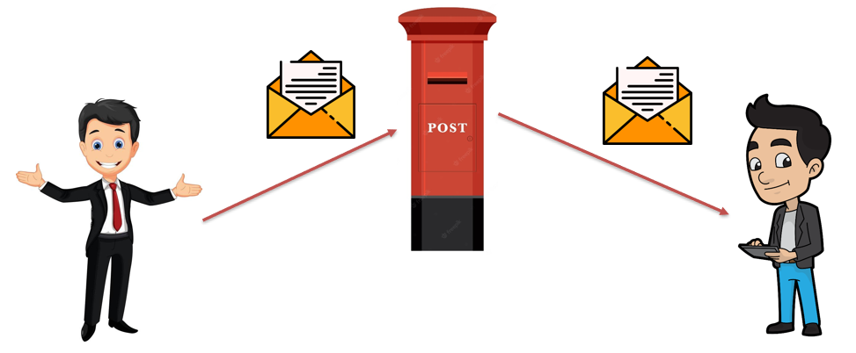
JMS Explained: Java Message Service for Beginners
"JMS" stands for Java Message Service, and it's a technology that allows different software applications to communicate with each other using messages. Imagine you have two friends, Alice and Bob, who want to exchange information, but they can't meet in person. Instead, they use a mailbox system to send and receive messages.
In the world of software, applications often need to talk to each other, even if they're running on different computers or servers. JMS acts as a virtual mailbox system for software applications.

Slide 2
JMS Explained: Java Message Service for Beginners
Messages: Just like Alice and Bob send messages to each other, applications send messages to communicate. These messages can contain information like text, data, commands, or anything that needs to be shared between the applications.
Queue and Topic: JMS has two main communication models:
Queue: This is like a one-to-one communication. An application sends a message to a queue, and another application reads it from there. It's similar to sending a private message.
Topic: This is more like a one-to-many communication. An application sends a message to a topic, and all the applications that are interested in that topic can receive and process the message. It's like sending out a broadcast message that multiple friends can listen to.

Slide 3
JMS Explained: Java Message Service for Beginners
Message Producer and Consumer: In JMS, the application that sends the message is called the "message producer," and the application that receives and processes the message is called the "message consumer.“
Message Broker: Just like a real mailbox system needs a central place to manage mailboxes and messages, JMS uses a component called a "message broker." This broker is responsible for receiving messages from producers and delivering them to consumers. It ensures that messages are delivered reliably and in the right order.
Asynchronous Communication: JMS enables asynchronous communication, which means applications don't have to wait for each other to respond. They can continue their work while messages are being exchanged.

Slide 4
JMS Explained: Java Message Service for Beginners
Overall, JMS is a way for software applications to talk to each other efficiently, reliably, and without direct connections. It's like having a digital mailbox system that helps applications share information, commands, and data, even if they're located far apart.
Imagine Alice and Bob, who are two software applications, sending messages back and forth through a digital mailbox managed by JMS, and you've got a basic understanding of how JMS works!

