Slide 1


Kafka Producer Callbacks - Producer with Keys
Apache Kafka Server is running on Amazon ec2 instance
Apache Kafka Ecosystem
Send Message
Kafka Cluster
Broker 1
Topic A
Topic B
Producer
(Callback method)
Broker 2
Topic X
Topic Z
KafkaProducerDemo
Zookeeper

Slide 2
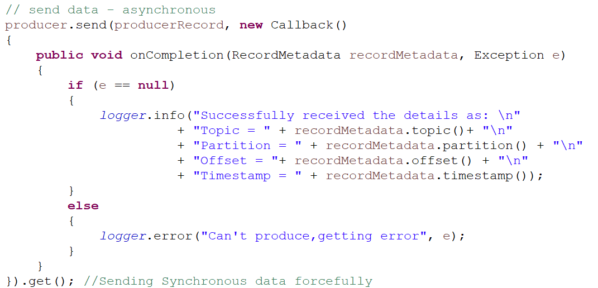
Kafka Producer Callbacks - Producer with Keys
In the previous video, we saw how a producer sends data to Kafka. We can use callbacks to understand, whether the data was correctly produced, where it was produced, about its offset and partition value, etc.
For performing the callbacks, the user needs to implement a callback function. This function is implemented for asynchronously handling the request completion. That's why it's return type will be void. This function will be implemented in the block where the producer sends data to the Kafka. The callback function used by the producer is the onCompletion(). Basically, this method requires two arguments:
Metadata of the Record: Metadata of the record means fetching the information regarding the partition and its offsets. If it is not null, an error will be throw
Exception: There are following exceptions which can be thrown while processing:
1) Retriable exception: This exception says that the message may be sent.
2) Non-retriable exception: This exception throws the error that the message will never be sent.
At the end, a get() function is used when the data is sent to the Kafka. This method sends the data synchronously and forcefully.

Slide 3
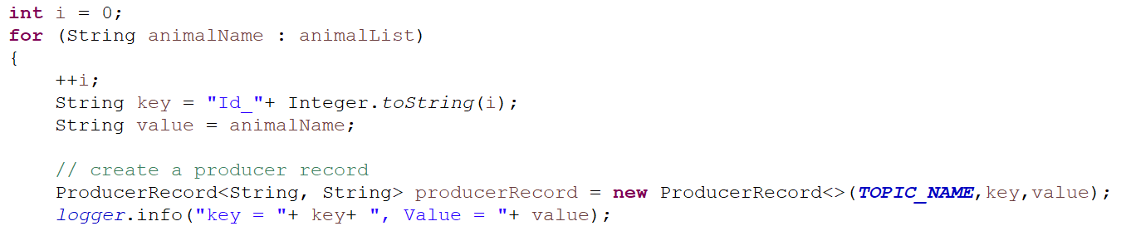
Kafka Producer Callbacks - Producer with Keys
Keys become useful when a user wants to send the message to the same partition. In order to send the data, the user need to specify a key.
The key will uniquely identify the partition from the other partitions.
The user needs to send synchronous messages to the Kafka.
Here we have specified the topic name, its value, and the key. While creating the ProducerRecord, three of them are passed as the parameters.

