Slide 1
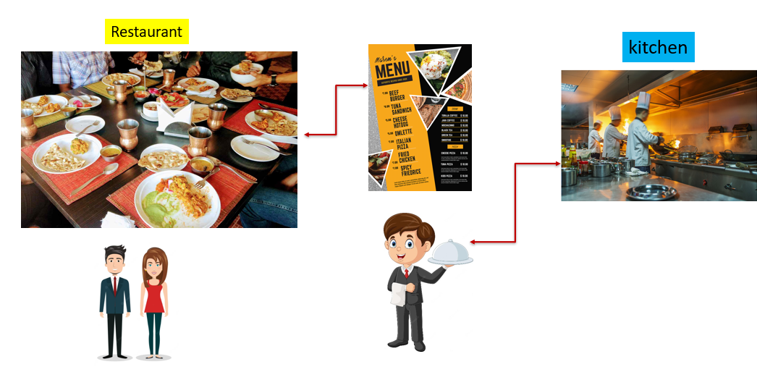
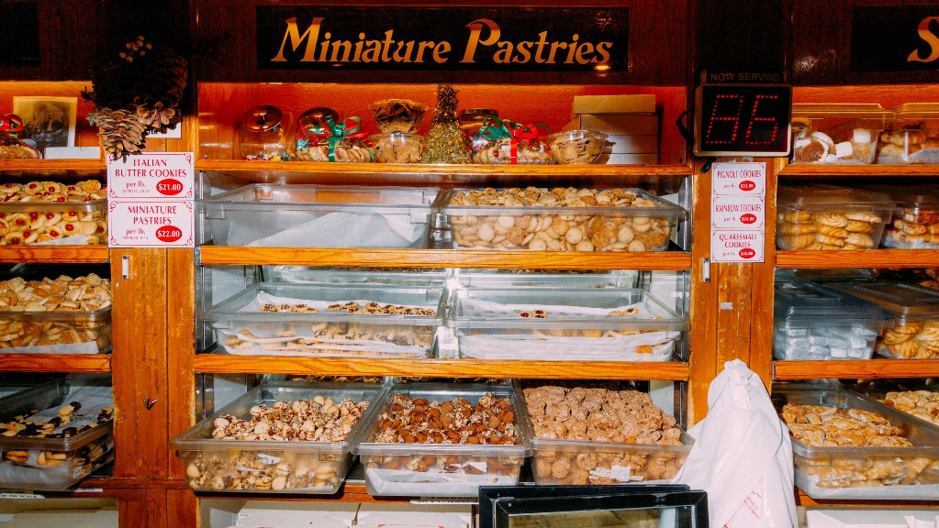
REST API Best Practices
Imagine you're in a bakery, and you want to order some pastries. You tell the baker what you want, and they give you exactly what you asked for – it's a simple and efficient process. In a similar way, when computers communicate with each other over the internet, they use something called APIs (Application Programming Interfaces) to ask for and exchange information.
Now, think of a REST API like a menu in a restaurant. When you go to a restaurant, the menu lists all the dishes you can order, along with a description of each dish. A REST API provides a menu of actions that other computer programs can use to ask for or share information.

Slide 2
REST API Best Practices
Here are some "best practices," or good ways to create and use REST API
Clear and Consistent Menu: Just like a restaurant menu should be easy to read and understand, a REST API should have clear and consistent names for its actions. This helps programmers know exactly what they can ask for and how to ask for it.
Use of Verbs: In a restaurant menu, dishes are often listed with verbs like "Order," "Request," or "Ask for." Similarly, REST APIs use verbs like "GET," "POST," "PUT," and "DELETE" to describe what actions you want to perform. For example, "GET" is like asking for information, and "POST" is like sending new information.
Ingredients and Format: When you order a dish at a restaurant, the menu often tells you what ingredients are in it. A REST API should clearly explain what kind of information it needs or provides, and in what format. This helps both sides (the program asking and the program providing) understand each other better.
No Surprises: Imagine if you ordered a pizza and got a sandwich instead. That wouldn't be great! In the same way, a REST API should give you what you expect. If you ask for a list of names, you should get a list of names, not something completely different.

Slide 3
REST API Best Practices
Here are some "best practices," or good ways to create and use REST API
Security: Just like a good restaurant takes care to keep your food safe, a REST API should make sure the information you send and receive is secure. This might involve using passwords, encryption, or other techniques to protect the data.
Efficiency: When you order food, you want it to arrive quickly and without wasting resources. Similarly, a well-designed REST API should work quickly and efficiently, so you don't have to wait too long for your information.
Documentation: Ever looked at a restaurant menu and had no idea what some of the dishes were? That's why good menus have descriptions. Similarly, a REST API should come with clear instructions (documentation) that explain how to use it. This helps programmers understand how to interact with the API correctly.

Slide 4
REST API Best Practices
So, think of REST API best practices as a set of guidelines that help make sure computer programs can talk to each other smoothly, just like how a well-organized menu ensures you get the food you want without any surprises or confusion.

