Slide 1
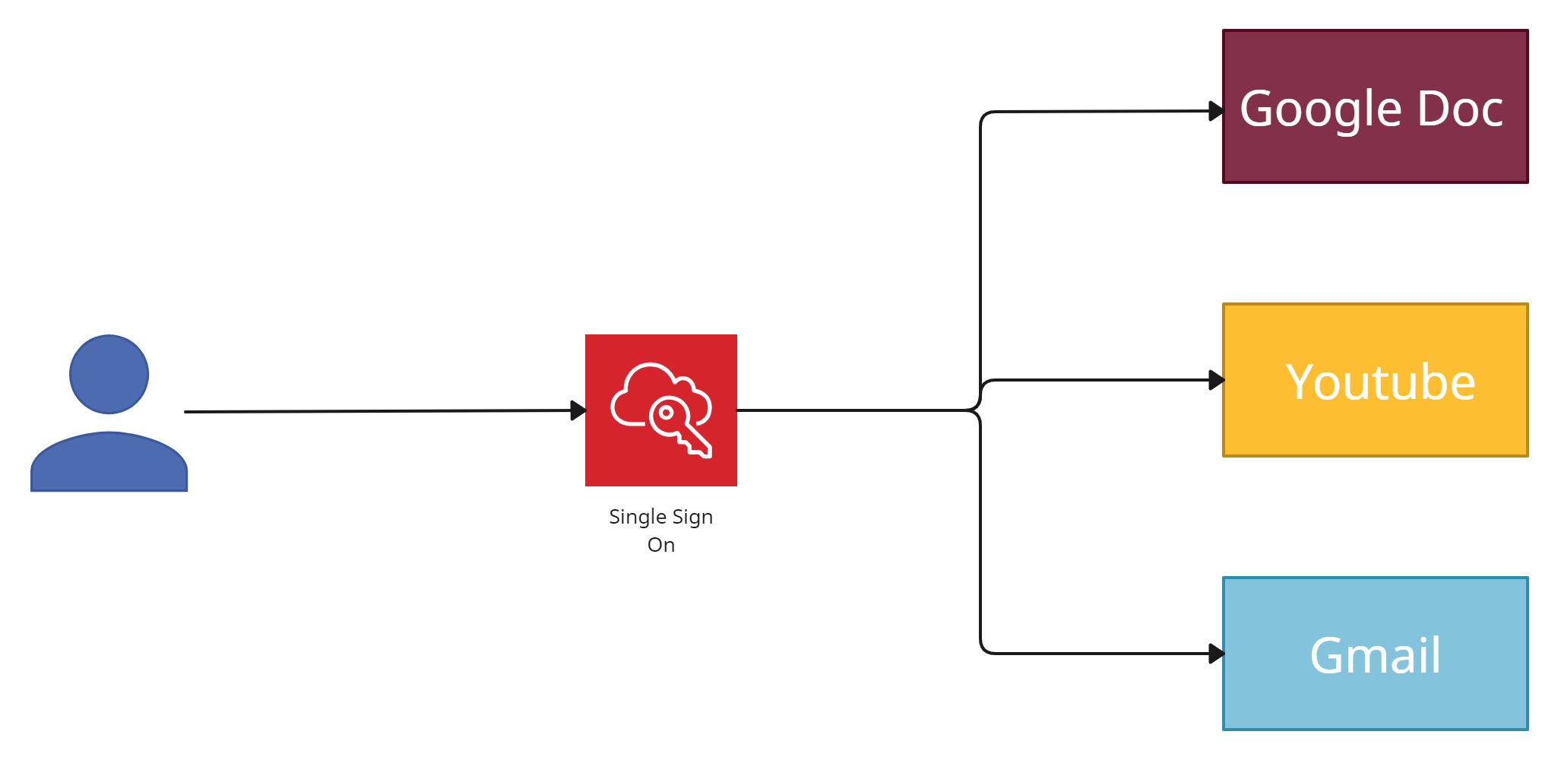
What is Single Sign-On (SSO) | Why do we need SSO?
Single Sign On (SSO) is an authentication scheme where users can securely authenticate and gain access to multiple applications and websites by only logging in with a single username and password.
For example, logging in to your Google account once will allow you to access Google applications such as Google Docs, Gmail, and Google Drive.
Username and Password

Slide 2
What is Single Sign-On (SSO) | Why do we need SSO?
Without SSO solution, the website maintains a database of login credentials – username and passwords. Each time the user login to the website, it checks the user’s credentials against its database and authenticates the user.
With the SSO solution, the website does not store login credentials in its database. Instead, SSO makes use of a shared cluster of authentication servers where users are only required to enter their login credentials once for authentication. With this feature of one login and multiple access, it is crucial to protect login credentials in SSO systems. Hence it is highly recommended to integrate SSO with other strong authentication means such as smart tokens or one-time passwords to achieve multi-factor authentication.
Username and Password

Slide 3
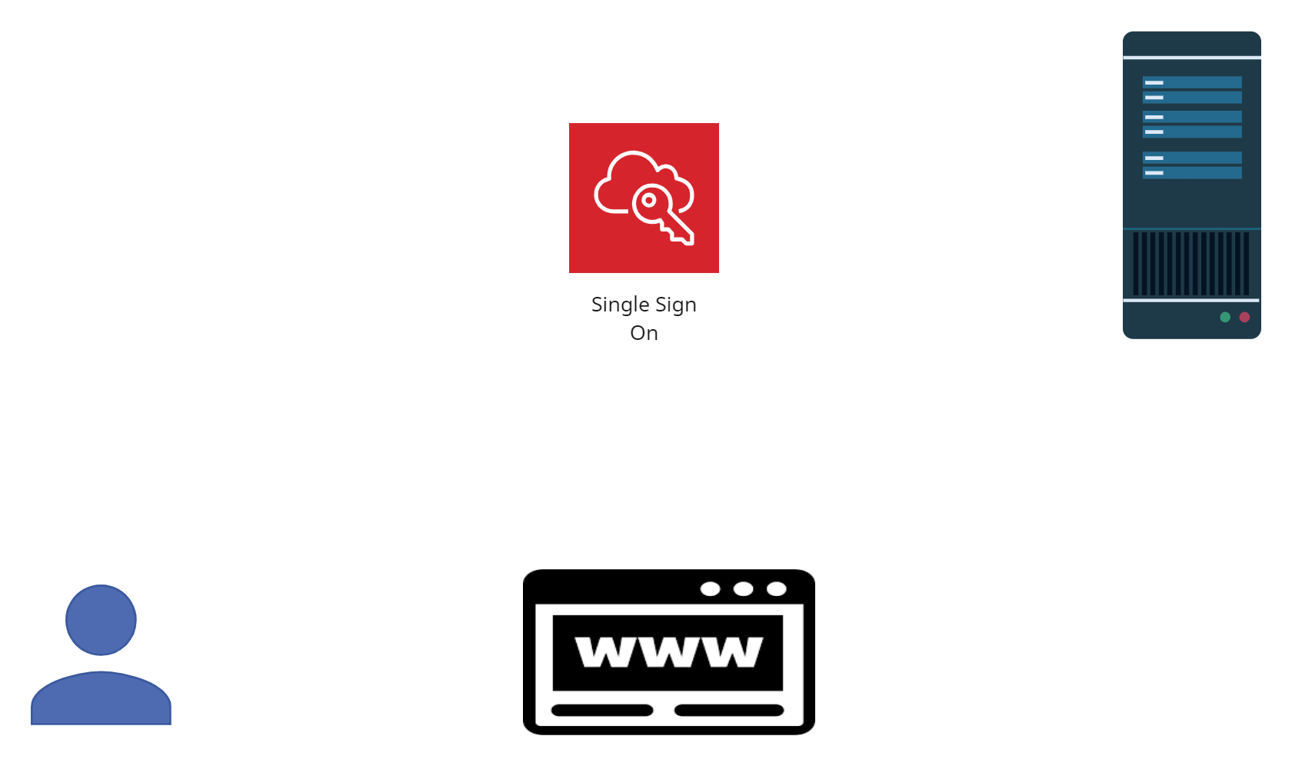
What is Single Sign-On (SSO) | Why do we need SSO?
1. User enters login credentials on the website and the website checks to see if the user has already been authenticated by SSO solution. If so, the SSO solution would give the user access to the website. Otherwise, it presents the user with the SSO solution for login.
2. The user enters username and password on the SSO solution.
IDP
1.SSO Login Page
2.Enter Login Credential

Slide 4
What is Single Sign-On (SSO) | Why do we need SSO?
3.The user’s login credentials are sent to SSO solution.
4.The SSO solution seeks authentication from the identity provider, such as an Active Directory, to verify the user’s identity. Once the user’s identity is verified, the identity provider sends a verification to the SSO solution.
IDP
4.Request Authentication
1.SSO Login Page
3.Send Credentials to
SSO Solution
2.Enter Login Credential

Slide 5
What is Single Sign-On (SSO) | Why do we need SSO?
5.The authentication information is passed from the SSO solution to the website where the user will be granted access to the website.
6. Upon successful login with SSO, the website passes authentication data in the form of tokens as a form of verification that the user is authenticated as the user navigates to a different application or web page.
IDP
4.Request Authentication
1.SSO Login Page
3.Send Credentials to
SSO Solution
5.Pass Authentication Data
2.Enter Login Credential
6.Access granted

Slide 6
What is Single Sign-On (SSO) | Why do we need SSO?
Advantages of SSO
Increased convenience for users as they only need to remember and key in login information once.
Reduce IT costs for managing customer’s username and passwords.
Disadvantages of SSO
Authentication systems must have high availability as loss of availability can lead to denial of service for applications using a shared cluster of authentication systems.

