Slide 1



Spring Boot Kafka Producer Example
Apache Kafka Ecosystem
Consume Messages
Send Messages
Kafka Cluster
Broker 1
Topic A
Topic B
Broker N
Producer
Consumer
Topic X
Topic Z
SpringbootKafkaProducerDemo
SpringbootKafkaConsumerDemo
Zookeeper

Slide 2
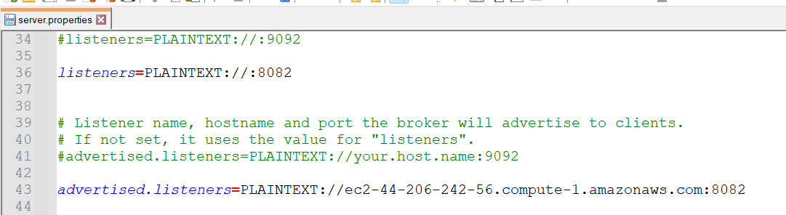
Spring Boot Kafka Producer Example

Slide 3
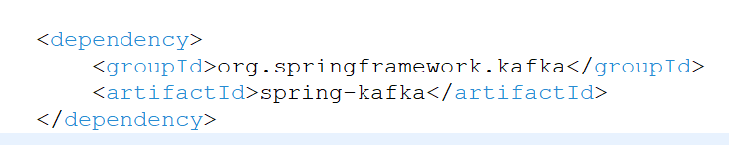
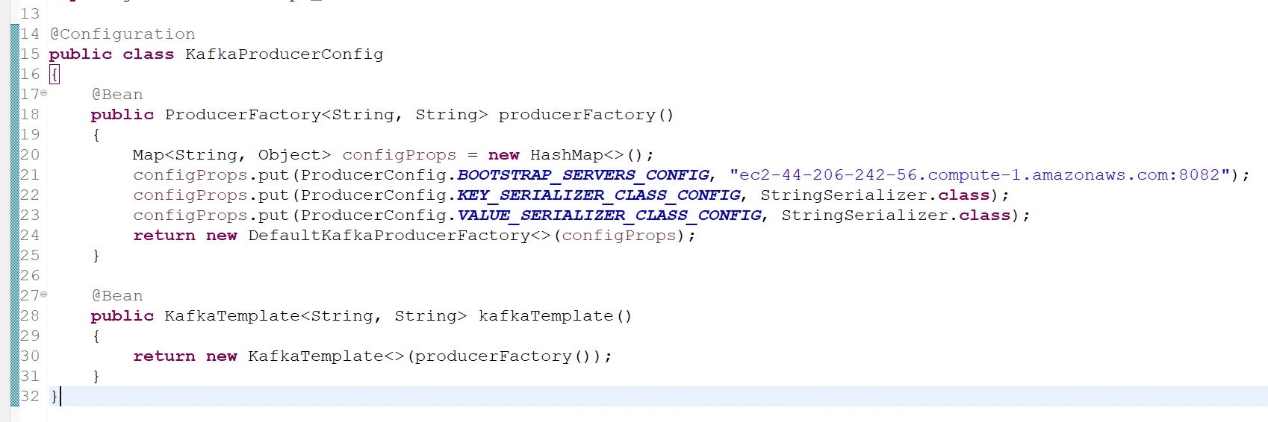
Spring Boot Kafka Producer Example

Slide 4
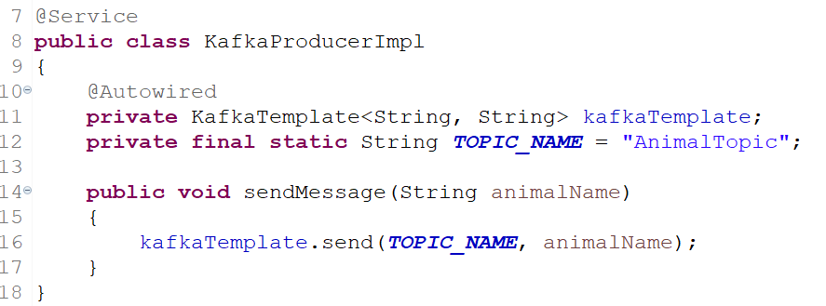
Spring Boot Kafka Producer Example
To publish a message, auto wire the Kafka Template object and produce the message

Slide 5
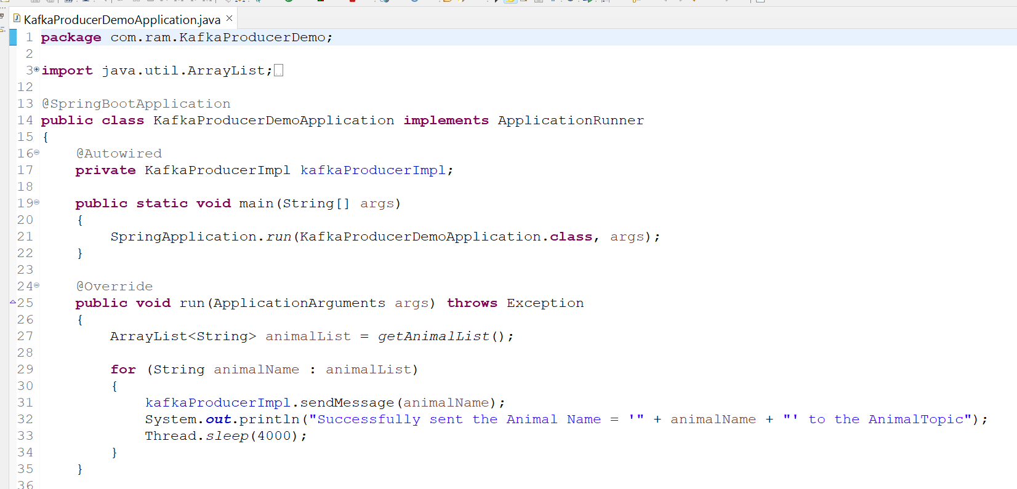
Spring Boot Kafka Producer Example

