Slide 1
What is an API?
API – Application Programing Interface
API stands for Application Programming Interface.
API is a set of rules and protocols that allows different software applications to communicate with each other.
APIs define the methods, data formats, and conventions that developers should follow to interact with a particular software component, service, or platform.
Software Application (Java)
Software Application (.Net)

Slide 2
What is an API?
APIs enable different systems or applications to interact and exchange data seamlessly.
API provide a way for developers to access the functionality of another software component or service without having to understand the complex inner workings of that component. Instead, developers can use predefined functions and data structures provided by the API to perform specific tasks or access specific information.
Software Application (Java)
Software Application (.Net)

Slide 3


What is an API?
APIs are commonly used in web development, where they allow developers to integrate third-party services or data sources into their applications.
For example, social media platforms like Facebook or Twitter provide APIs that allow developers to access user data, post updates, or retrieve information from those platforms.
APIs can be used for a variety of purposes, such as retrieving data from a remote server, sending data to a service for processing, integrating different software systems, and much more. They are widely used in web development, mobile app development, and various other software projects.

Slide 4
What is an API?
APIs can be classified into 3 different types,
Web APIs (which are accessed over HTTP)
Library APIs (which are used within a programming language)
Operating system APIs (which provide access to the underlying OS functionality).
Web APIs
Library APIs
Operating System APIs

Slide 5
What is an API?
APIs can be classified into different types based on their purpose and the protocols they use.
Web APIs: These APIs are designed to allow web applications to communicate with each other or access data and services over the internet. They often use HTTP protocols and can return data in various formats such as JSON or XML.
REST APIs: Representational State Transfer (REST) APIs are a type of web API that follows specific architectural principles. They use standard HTTP methods like GET, POST, PUT, and DELETE to perform operations on resources and are widely used for building web services.
SOAP APIs: Simple Object Access Protocol (SOAP) APIs are another type of web API that uses XML for communication. They provide a more structured and standardized way of exchanging data between applications and often involve more complex protocols and specifications.
Library or Framework APIs: Many software libraries and frameworks provide their own APIs to allow developers to interact with their features and functionality. These APIs are typically specific to the library or framework being used and provide a way to access and control their underlying capabilities.
Operating System APIs: These APIs are provided by operating systems to allow developers to access and utilize the underlying functionality of the operating system. They enable tasks such as file management, network communication, process control, and hardware interaction.
Database APIs: These APIs provide a way for applications to interact with databases. They allow developers to perform operations such as querying, inserting, updating, and deleting data from a database.

Slide 6
What is an API?
APIs are typically documented to provide developers with instructions on how to use them, including the available endpoints, parameters, and expected responses.
Common formats for API documentation include OpenAPI (formerly known as Swagger), RAML, and API Blueprint.
APIs are often documented and provided by software developers or organizations as part of their services. They specify the available endpoints, request/response formats, authentication mechanisms, and any other relevant details necessary for integration. Developers can then use these APIs to leverage the functionality of existing software components or services, saving time and effort in the development process.

Slide 7
What is an API?
Overall, APIs play a crucial role in modern software development, enabling interoperability, integration, and the development of complex applications by leveraging the functionality of existing services and components.
In recent years, APIs have become increasingly important due to the rise of cloud computing, microservices architecture, and the need for interoperability between different applications and services. They have played a crucial role in enabling the development of complex and interconnected software ecosystems.

Slide 8
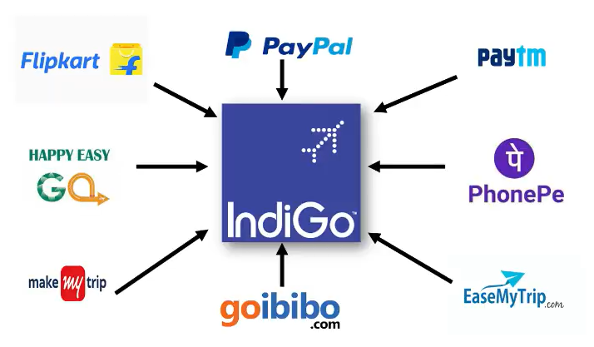
What is an API?
API

Slide 9


What is an API?
Airline ticket booking API
Airline or Flight Reservation System

Slide 10
What is an API?
1.Authentication and Authorization
2.Flight Search
3.Flight Availability and Pricing
4.Passenger Details and Selection
5.Reservation and Booking
6.Payment Processing
7.Booking Confirmation
8.Manage Booking and Modifications
Airline ticket booking APIs

Slide 11
What is an API?
Authentication and Authorization:
Developers need to obtain authentication credentials (API key, access token, or username/password) from the airline or the flight reservation system.
The API credentials are used to authenticate and authorize access to the booking API.
Flight Search:
Developers use the API to search for available flights based on criteria such as origin, destination, departure date, and passenger details.
The API allows for flexible search parameters and provides options like one-way, round-trip, or multi-city itineraries.
Flight Availability and Pricing:
The API returns flight availability and pricing information based on the search parameters.
It provides details like flight numbers, departure and arrival times, airline names, seat availability, fare classes, and ticket prices.
Passenger Details and Selection:
Once a flight is chosen, developers can use the API to collect passenger details such as names, contact information, and passport details.
The API validates and processes the passenger information and allows for seat selection or preference customization.
Reservation and Booking:
Developers submit a booking request via the API, which includes the selected flight, passenger details, and payment information.
The API handles the reservation process, checks seat availability, and confirms the booking by issuing a unique reservation code or ticket number.
Payment Processing:
The API may integrate with a payment gateway or provide payment processing functionality.
Developers pass the payment details to the API, which securely processes the payment and confirms the booking upon successful payment authorization.
Booking Confirmation:
The API responds with a booking confirmation that includes essential details such as the reservation code, flight itinerary, passenger details, and e-ticket information.
Developers can display this information to the user and provide options to download or email the e-ticket.
Manage Booking and Modifications:
The API may offer functionality to modify or cancel bookings.
Developers can use the API to retrieve booking details, make changes (if permitted by the airline's policies), or initiate cancellation requests.

Slide 12
What is an API?
This example illustrates how an airline ticket booking API can provide developers with the necessary tools to search for flights, retrieve availability and pricing, manage passenger details, process payments, and confirm bookings.
The API streamlines the booking process and enables integration with various applications, such as travel agency websites, mobile apps, or other platforms that require airline ticket booking capabilities.
Airline ticket booking API
Airline or Flight Reservation System

