Slide 1
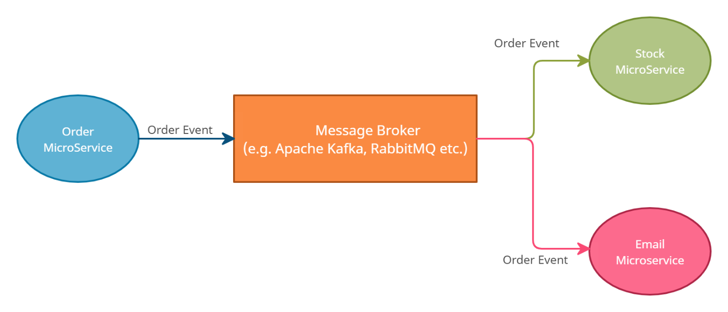

What is Event-Driven Architecture?
Imagine you're at a party where many people are mingling and having conversations. At some point, someone decides to announce that it's time for cake. This announcement serves as an event that triggers different reactions from the partygoers. Some people might start heading towards the cake table, while others continue chatting or dancing.
In a similar way, an event-driven architecture in technology is like this party scenario. Instead of people, we have different parts of a software system that communicate with each other. These parts can be like small programs or functions or microservices, and they can send out events just like the cake announcement.
Birthday Party

Slide 2
What is Event-Driven Architecture?
When one part of the software system sends out an event, other parts that are interested in that event can react to it. They might perform certain actions or tasks based on the event they received. This communication and reaction between different parts of the software happen without those parts having to constantly check each other.
So, event-driven architecture is like a way for different parts of a software system to communicate and coordinate with each other by sending and receiving events. It's a bit like how people at a party react to announcements without needing to keep an eye on each other all the time. This approach can make software systems more flexible, efficient, and responsive, just like a well-organized party!
Birthday Party

