Slide 1
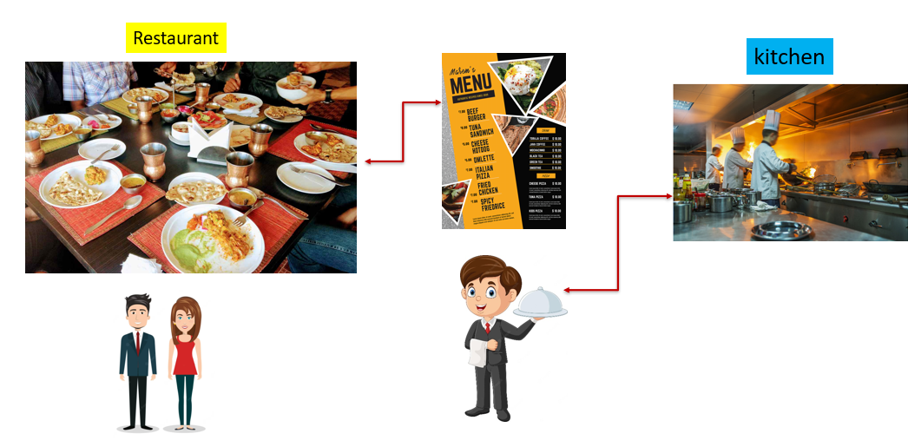
REST API Best Practices
Imagine you're in a restaurant and you want to order some food. The waiter takes your order, sends it to the kitchen, and then brings your food back to you. In this scenario, the waiter is like a messenger between you and the kitchen, making sure everything happens smoothly.
Now, think of a computer system or a website that wants to share information with other computer systems or websites. They can't just talk to each other like we do; they need a special way to communicate. That's where a REST API comes in.
A REST API is like a set of rules that computers follow to talk to each other over the internet. It's like a menu that tells them how to ask for things and how to give things back. Just like the waiter in the restaurant, the REST API makes sure that different systems understand each other and exchange information correctly.

Slide 2
REST API Best Practices
Now, let's talk about "REST API Best Practices." These are like tips to make sure the communication between computer systems using a REST API goes really well
Clear Menu (URLs): Just like a menu in a restaurant, the web addresses (URLs) should be clear and organized. This helps the systems know exactly what they're asking for.
Proper Orders (HTTP Methods): When you order food, you might say "I want a burger." Computers also have different ways to ask for things. The most common ones are like saying "GET me this" or "POST this new thing." Using the right method for the right request is important.
Fresh Ingredients (Data): When you order food, the kitchen needs to know what you want on it. Computers also exchange information called data. Making sure the data is correct and well-organized is like having fresh ingredients for your order.
Responses (Status Codes): After you order, the waiter might say "Here's your food!" Computers also send back messages to tell each other what happened. These messages have numbers (status codes) that explain if everything went well or if there's a problem.

Slide 3
REST API Best Practices
Now, let's talk about "REST API Best Practices." These are like tips to make sure the communication between computer systems using a REST API goes really well
No Mixing (Separation of Concerns): In a restaurant, the kitchen only worries about cooking, and the waiter takes care of serving. Similarly, in a REST API, different parts should handle different jobs. This makes things organized and easier to manage.
Security (Authentication and Authorization): Imagine the waiter making sure you're the right person before giving you your order. Computers also need to make sure they're talking to the right systems and that those systems are allowed to get the information they're asking for.
Consistency (Naming and Structure): Think of the menu having a consistent format and style. Similarly, the way the API is designed should be consistent, so everyone understands how things work.
Versioning (Updates): Just like a restaurant might change its menu over time, an API might get updated. It's important to have a way to tell which version of the API you're using, so things don't break unexpectedly.

Slide 4
REST API Best Practices
So, "REST API Best Practices" are like guidelines to help computer systems communicate smoothly and effectively, just like a waiter and a kitchen team working together to make sure you get your food just the way you want it!

