Slide 1
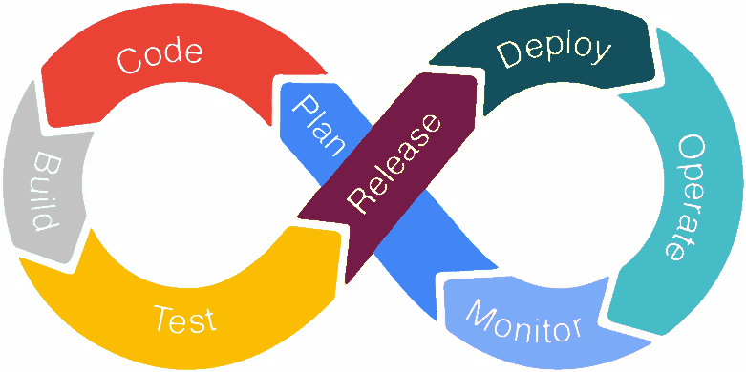
DevOps Lifecycle Explained: A Beginner's Guide
What is DevOps Lifecycle?
The DevOps lifecycle is a series of stages that software development and IT operations teams follow to develop, deploy, and manage applications more efficiently.
DevOps combines "Development" and "Operations" to create a culture and set of practices that improve collaboration and productivity by automating and integrating the processes between software development and IT teams.

Slide 2
DevOps Lifecycle Explained: A Beginner's Guide
1. Planning:
What Happens: Teams define the requirements, goals, and tasks for the project.
Tools Used: Jira, Trello, Asana.
Goal: Establish a clear roadmap and ensure everyone understands the project's scope and objectives.

Slide 3
DevOps Lifecycle Explained: A Beginner's Guide
2. Coding:
What Happens: Developers write the code for the application.
Tools Used: Git, GitHub, GitLab.
Goal: Create high-quality code that meets the requirements set during the planning stage.

Slide 4
DevOps Lifecycle Explained: A Beginner's Guide
3. Building:
What Happens: The written code is compiled and converted into executable files or binaries.
Tools Used: Maven, Gradle, Jenkins.
Goal: Ensure that the code compiles correctly and is ready for the next stages.

Slide 5
DevOps Lifecycle Explained: A Beginner's Guide
4. Testing:
What Happens: The application is rigorously tested to find and fix bugs.
Tools Used: Selenium, JUnit, TestNG.
Goal: Identify any issues early in the lifecycle to ensure a stable and reliable product.

Slide 6
DevOps Lifecycle Explained: A Beginner's Guide
5. Releasing:
What Happens: The application is packaged and prepared for deployment.
Tools Used: Jenkins, Bamboo, CircleCI.
Goal: Ensure the application is ready for deployment to production environments.

Slide 7
DevOps Lifecycle Explained: A Beginner's Guide
6. Deploying:
What Happens: The application is deployed to a production environment.
Tools Used: Kubernetes, Docker, AWS, Azure.
Goal: Make the application available to end-users with minimal downtime.

Slide 8
DevOps Lifecycle Explained: A Beginner's Guide
7. Operating:
What Happens: The application runs in the production environment, and users interact with it.
Tools Used: Datadog, New Relic, Nagios.
Goal: Monitor the application's performance and ensure it runs smoothly.

Slide 9
DevOps Lifecycle Explained: A Beginner's Guide
8. Monitoring:
What Happens: Continuous monitoring of the application’s performance and user activity.
Tools Used: Prometheus, Grafana, ELK Stack.
Goal: Gather data to identify any issues and areas for improvement.

Slide 10
DevOps Lifecycle Explained: A Beginner's Guide
Benefits of the DevOps Lifecycle
Increased Collaboration: DevOps encourages better communication between development and operations teams.
Faster Time to Market: Automation and continuous integration/continuous deployment (CI/CD) pipelines speed up the release process.
Improved Quality: Continuous testing and monitoring ensure higher quality and more reliable software.
Enhanced Flexibility: DevOps practices allow teams to adapt quickly to changes and new requirements.

Slide 11
DevOps Lifecycle Explained: A Beginner's Guide
Conclusion
The DevOps lifecycle is a structured approach to software development that emphasizes collaboration, automation, and continuous improvement. By following these stages, teams can deliver better software faster and more efficiently.

