Slide 1

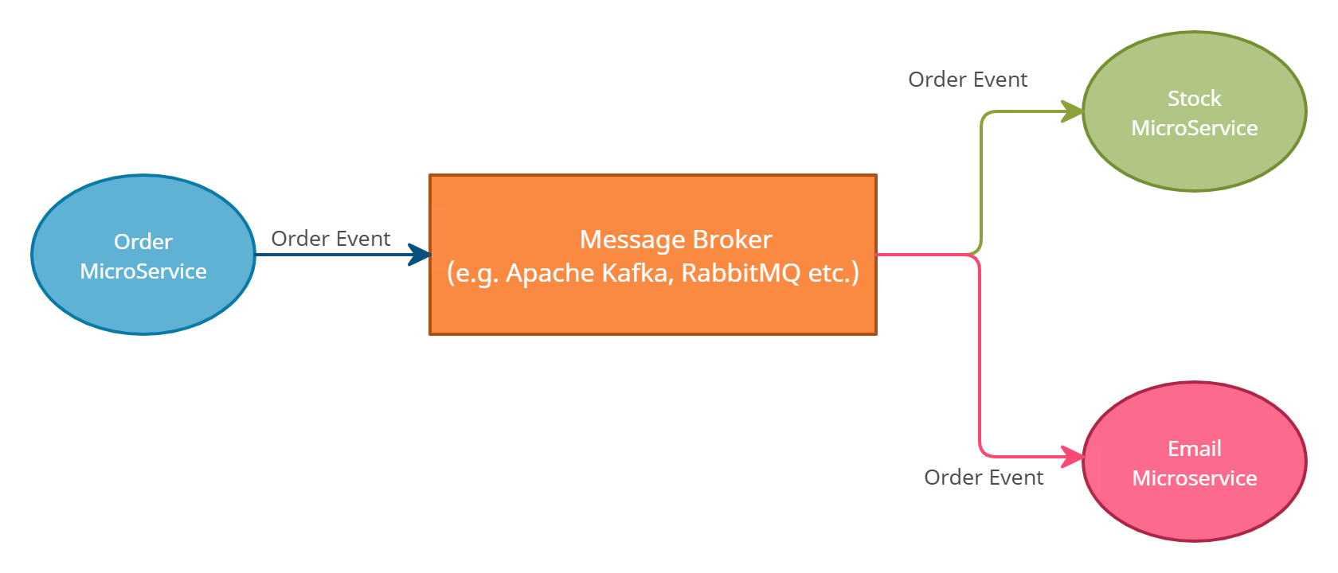
What is Event-Driven Architecture?

Slide 2

What is Event-Driven Architecture?

