Slide 1
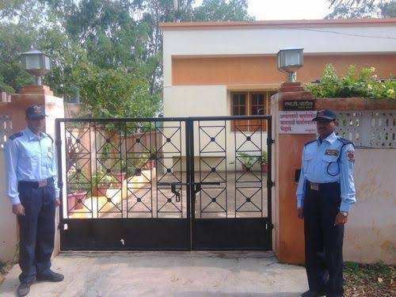
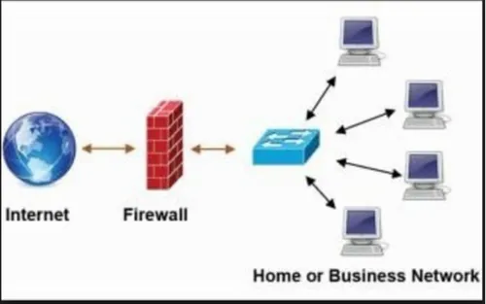
Firewall Explained: Your Digital Security Guard
Imagine a firewall as a protective barrier that sits between your computer or network and the outside world, like a security guard at the entrance of a building.
Firewall’s main job is to monitor and control the incoming and outgoing traffic based on a set of rules to protect your system from unauthorized access and potential threats.
House with Security Guard
Computer Network with Firewall

Slide 2
Firewall Explained: Your Digital Security Guard
Here's a simplified explanation:
Security Guard: Just like a security guard, a firewall monitors all the traffic coming in and going out of your network or computer.
Rules: The firewall follows a set of rules or policies that you define. These rules determine what traffic is allowed to pass through and what should be blocked. For example, you might allow web browsing and email traffic while blocking incoming connections from unknown sources.
House with Security Guard
Computer Network with Firewall

Slide 3
Firewall Explained: Your Digital Security Guard
Protection: The primary goal of a firewall is to protect your system from unauthorized access and potential threats. It acts as a barrier, preventing hackers, malware, and other malicious entities from gaining access to your network or computer.
Types of Firewalls: There are different types of firewalls, including network-based firewalls that protect entire networks, and host-based firewalls that protect individual computers. Some firewalls are hardware-based, while others are software-based and run on your computer or network devices.
House with Security Guard
Computer Network with Firewall

Slide 4
Firewall Explained: Your Digital Security Guard
Monitoring and Logging: In addition to blocking unwanted traffic, firewalls also monitor and log network activity. This allows you to track and analyze traffic patterns, identify potential security incidents, and make adjustments to your firewall rules as needed. In essence, a firewall acts as a gatekeeper for your computer or network, allowing safe traffic to pass through while blocking anything that could harm your system. It's an essential component of cybersecurity, providing an important layer of defense against online threats.
House with Security Guard
Computer Network with Firewall

