Slide 1
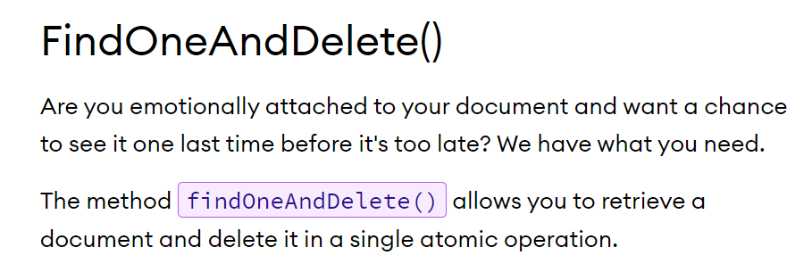

How to Get and Select a Collection and delete one document in the collection using findOneAndDelete method?
Java Program

