Slide 1
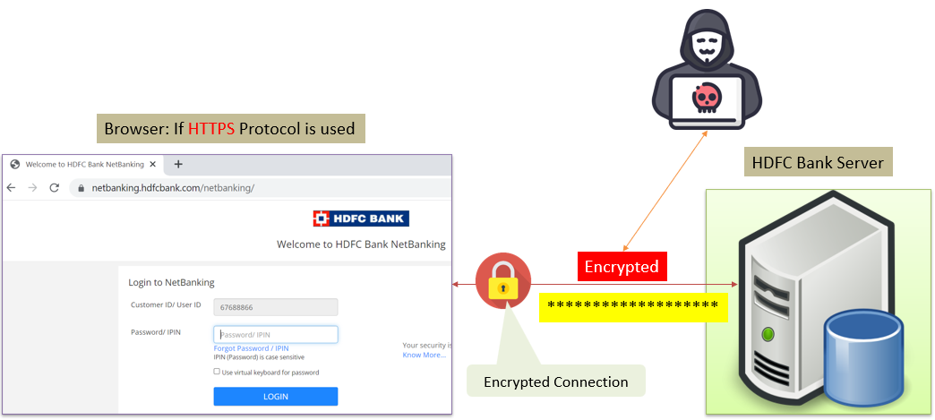
HTTPS Explained Simply: How Secure Web Browsing Works
HTTPS, or Hypertext Transfer Protocol Secure, is a fundamental technology used for secure communication over the internet.
HTTPS is designed to protect the privacy and integrity of data exchanged between a user's web browser and a website or web application.

Slide 2
HTTPS Explained Simply: How Secure Web Browsing Works
HTTP vs. HTTPS:
  HTTP (Hypertext Transfer Protocol): This is the standard protocol used for transferring data between a user's web browser and a web server. However, it's not secure, which means that any data exchanged can potentially be intercepted or tampered with by malicious actors.
  HTTPS (Hypertext Transfer Protocol Secure): This is the secure version of HTTP. It provides a layer of encryption and security on top of the standard HTTP protocol to ensure that data remains private and unaltered during transmission.
Encryption: HTTPS uses encryption to scramble the data being sent and received. This encryption makes it extremely difficult for unauthorized parties to decipher the information, even if they manage to intercept it.

Slide 3
HTTPS Explained Simply: How Secure Web Browsing Works
Secure Socket Layer (SSL) or Transport Layer Security (TLS): HTTPS relies on protocols like SSL or TLS to establish a secure connection between the user's browser and the web server. These protocols ensure that data is encrypted before transmission and decrypted only when it reaches its intended destination.
Data Integrity: HTTPS also provides data integrity, which means that the data sent by the server remains unchanged when received by the user's browser. If anyone attempts to tamper with the data during transit, it will be detected, and the connection will be terminated.

Slide 4
HTTPS Explained Simply: How Secure Web Browsing Works
Authentication: HTTPS verifies the authenticity of the website or web application by using digital certificates. When you see a padlock symbol in your browser's address bar, it indicates that the website's identity has been verified, and the connection is secure.
Benefits of HTTPS:
  Privacy: It protects the privacy of users by encrypting sensitive information like login credentials, personal details, and payment information.
  Data Integrity: It ensures that the data received by the user is the same as what was sent by the server.
  Trustworthiness: Users are more likely to trust websites that use HTTPS, especially for e-commerce, online banking, and other secure transactions.

Slide 5
HTTPS Explained Simply: How Secure Web Browsing Works
How to Identify HTTPS: You can identify an HTTPS website by looking for "https://" in the URL instead of just "http://". Modern browsers also display a padlock symbol in the address bar to indicate a secure connection.

Slide 6
HTTPS Explained Simply: How Secure Web Browsing Works
In summary, HTTPS is a crucial technology that ensures secure and private communication on the internet. It uses encryption, data integrity checks, and authentication to protect user data from unauthorized access and tampering. Whenever you provide sensitive information online, such as when making online purchases or logging into your accounts, it's essential to ensure that the website is using HTTPS to safeguard your data.

