Slide 1
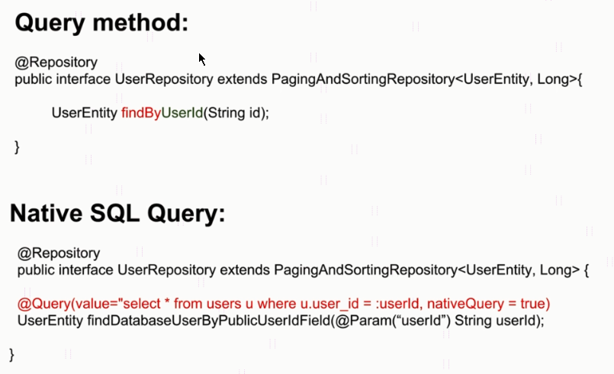
Spring Boot - Using Native SQL Queries

Slide 2
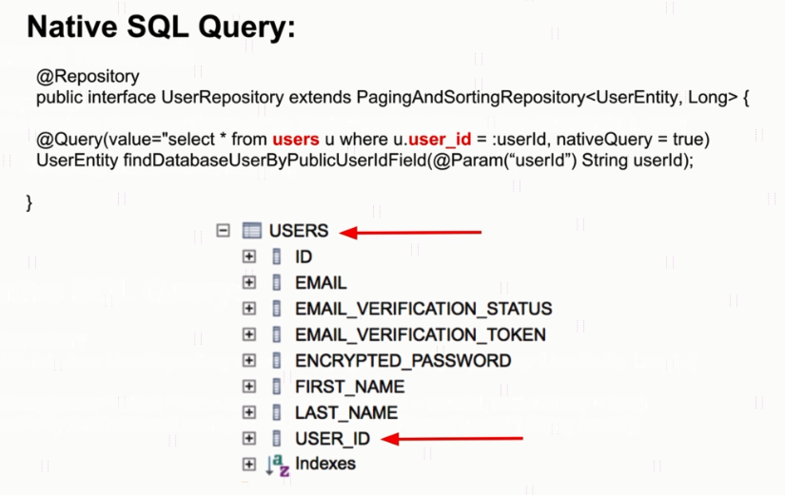
Spring Boot - Using Native SQL Queries

Slide 3

Spring Boot - Using Native SQL Queries
Native SELECT SQL Query Example
Native SQL Query with Positional Parameters

Slide 4

Spring Boot - Using Native SQL Queries
Native SQL Query with Named Parameters
Log SQL Queries and Their Values in the Console

Slide 5
Spring Boot - Using Native SQL Queries
Using Advanced LIKE Expressions
Select Specific Columns from a Table

Slide 6
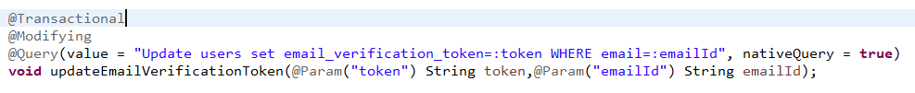
Spring Boot - Using Native SQL Queries
UPDATE SQL Query Example

