Slide 1
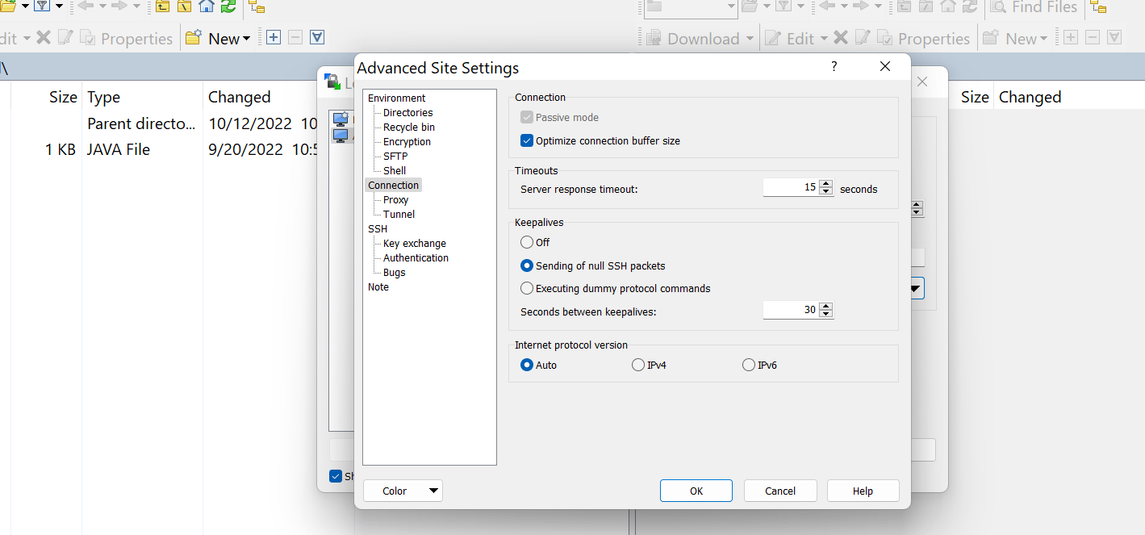
How do I stop WinSCP inactive? | How do you fix WinSCP inactive? | How to keep SSH connections alive?

