Slide 1
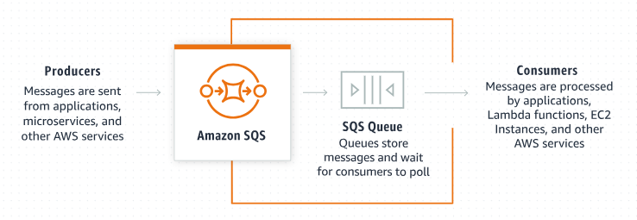
Amazon SQS Dead-Letter Queue: A Beginner's Guide
What is Amazon SQS?
Amazon SQS is a fully managed message queuing service that enables you to decouple and scale microservices, distributed systems, and serverless applications. It allows different parts of a system to communicate and process messages asynchronously.

Slide 2
Amazon SQS Dead-Letter Queue: A Beginner's Guide
What is a Dead-letter Queue (DLQ)?
In message queuing systems, sometimes messages can't be processed successfully. These messages can cause issues if they stay in the main queue. A Dead-letter Queue (DLQ) is a special queue used to store messages that can't be processed (or "consumed") successfully after a certain number of attempts.
Why Use a DLQ?
Error Handling: When a message fails to be processed repeatedly, it's moved to the DLQ. This prevents it from being retried endlessly and allows you to analyze the issue separately.
Debugging: You can inspect messages in the DLQ to understand why they failed and take corrective actions.
Resilience: It helps in building resilient applications by ensuring that failed messages don't disrupt the processing flow.

Slide 3

Amazon SQS Dead-Letter Queue: A Beginner's Guide
How Does It Work?
Create Queues: First, you create a primary queue (where messages are sent) and a DLQ.
Configure DLQ: Configure the primary queue to use the DLQ. You specify a Maximum Receives threshold, which is the number of times a message can be processed unsuccessfully before it's moved to the DLQ.
Message Processing: Messages are sent to the primary queue and processed by consumers.
Failure Handling: If a message fails processing, it’s returned to the primary queue for another attempt. After exceeding the Maximum Receives threshold, it is automatically moved to the DLQ.
Analyze DLQ: You can then inspect the DLQ to understand why these messages failed and decide how to handle them.
Stores messages that could not be processed successfully
Primary Queue (Maximum Receives = 3)
Consumer
DLQ

Slide 4
Amazon SQS Dead-Letter Queue: A Beginner's Guide
Example Scenario
Primary Queue: OrdersQueue
DLQ: OrdersDLQ
Configuration: Set Maximum Receives to 3.
Messages in OrdersQueue are processed by your application. If a message fails processing (e.g., due to a temporary issue with a downstream service) and this happens 3 times, the message is moved to OrdersDLQ. You can then review the OrdersDLQ to see which orders failed and why.
Stores messages that could not be processed successfully
Order Queue
(Maximum Receives = 3)
Application(Consumer)
OrderDLQ

Slide 5
Amazon SQS Dead-Letter Queue: A Beginner's Guide
Benefits
Improved Reliability: Ensures that failed messages do not block other messages from being processed.
Easier Troubleshooting: Simplifies the identification and resolution of problematic messages.
Flexible Handling: Allows for different handling strategies for failed messages, such as logging, alerting, or reprocessing after a fix.

Slide 6
Amazon SQS Dead-Letter Queue: A Beginner's Guide
Key Points to Remember
DLQ is associated with a primary queue.
Messages move to DLQ after a set number of processing failures.
DLQ helps in isolating and troubleshooting failed messages.
By using Dead-letter queues, you can build more robust and fault-tolerant systems.

