Slide 1
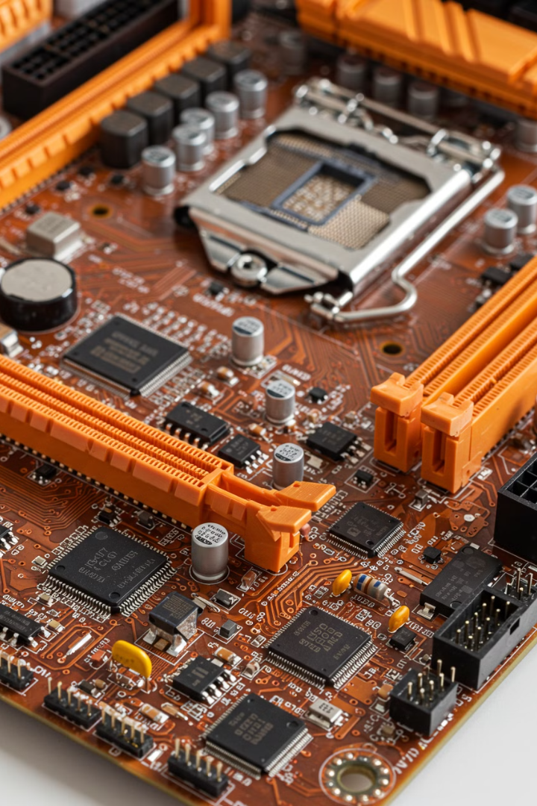

Motherboard:
Simple Explanation
A Motherboard is the main circuit board inside a computer. It connects all the important parts of the computer, like the
CPU (processor), RAM (memory), storage (hard drive or SSD),
and other components. It allows them to communicate and work together.
by Ram N Java

Slide 2
Main Functions of a Motherboard
1
Holds the CPU
2
Connects Memory (RAM)
The CPU (Central Processing Unit) is the brain of the computer, and the motherboard provides a socket for it.
RAM is temporary storage that helps the computer work faster.
3
Supports Storage Devices
4
Provides Expansion Slots
It connects Hard Drives or SSDs where all data and files are stored.
Allows adding graphics cards, sound cards, or other upgrades.
5
Has Input/Output Ports
6
Controls Power Distribution
Includes USB ports, audio jacks, network ports, and HDMI/VGA ports to connect devices like a keyboard, mouse, speakers, and monitor.
It manages electricity flow to different parts of the computer.

Slide 3
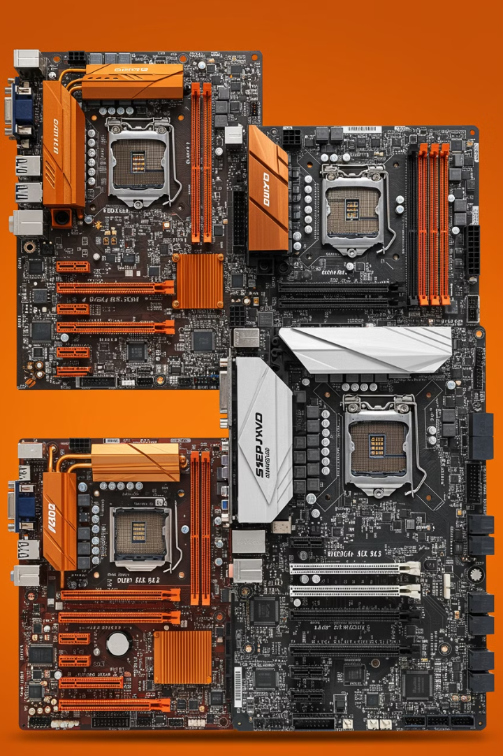
Types of Motherboards
Desktop Motherboards
Laptop Motherboards
Used in
personal computers (PCs).
Smaller and designed specifically for laptops.
Server Motherboards
Powerful motherboards used in big computer systems (servers).

Slide 4
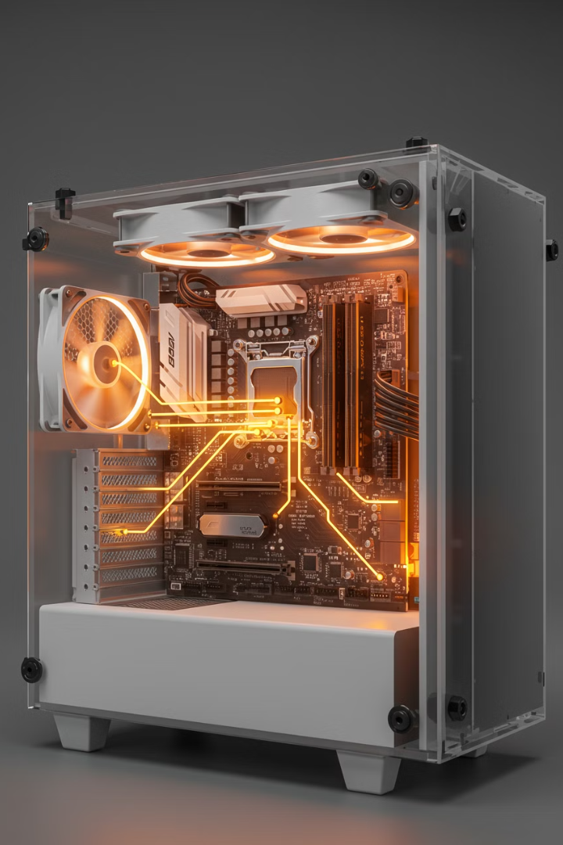


Why is the Motherboard Important?
The Motherboard is like the backbone of a computer. Without it, no other part can work because they all need a way to communicate with each other.
A good motherboard means a more powerful and upgradeable computer! 🚀

