Slide 1
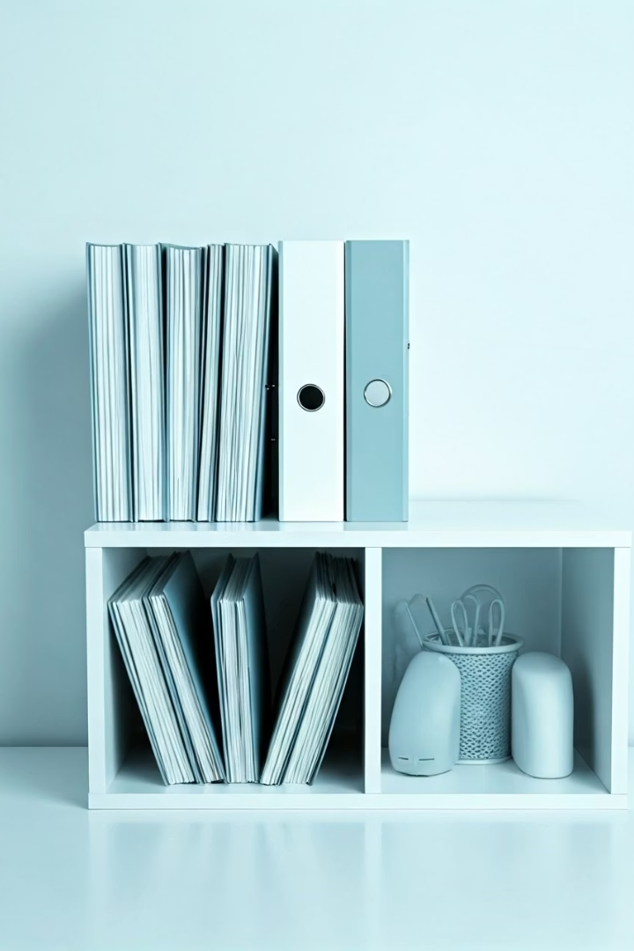

File Management:
Organizing Files & Folders Like a Pro!
What is File Management?
File management means keeping your documents, pictures, videos, and other files organized on your computer. It helps you find files quickly, avoid clutter, and keep your work safe.
by Ram N Java

Slide 2

Use Folders to Stay Organized
Create Folders
Main Categories
Subfolders
Create folders to group similar files together.
For example, make folders like Work, School, Photos, or Music.
Inside those, you can create more folders like 2024 Projects or Vacation Photos.

Slide 3
Name Files Clearly
Clear Naming
Date Format
Use clear and simple names for your files.
Use Dates in File Names
Instead of "doc1.pdf", name it Math_Assignment_April2025.pdf.
Add dates to your file names for easy sorting.
Example: Resume_2025_04_04.docx
This makes it easier to know what the file is
without opening it.
This helps you keep track of the latest version.

Slide 4



Keep Your System Clean
Delete Unused Files
Remove old or unnecessary files often.
This frees up space and keeps things tidy.
Don't forget to empty the Trash or Recycle Bin.
Do Not Use Desktop Only for Temporary Files
Don't store everything on your desktop.
It can become messy and slow down your computer.
Move files to the right folders after use.

Slide 5



Protect Your Files
Backup Your Files
Save a copy of your important files to an external hard drive or cloud storage like Google Drive, iCloud, or OneDrive.
This protects your work if something goes wrong.
Search When You Need To
Use the search bar on your computer to find files by name or type.
This is helpful if you forget where you saved something.

Slide 6





Use File Types to Identify Files
.docx
.jpg or .png
.mp4
.pdf
Word documents
Images
Videos
Read-only documents
Know the file types. This helps you know what kind of file you are opening.

Slide 7

Make File Management a Habit
Pin Important Folders
You can pin folders you use a lot, so you don't have to search for them every time.
Most systems let you do this in File Explorer (Windows) or Finder (macOS).
Regular Maintenance
Spend a few minutes every week organizing your files.
Keep folders clean and update file names as needed.
Build the Habit
The more you do it, the easier it gets!

