Slide 1
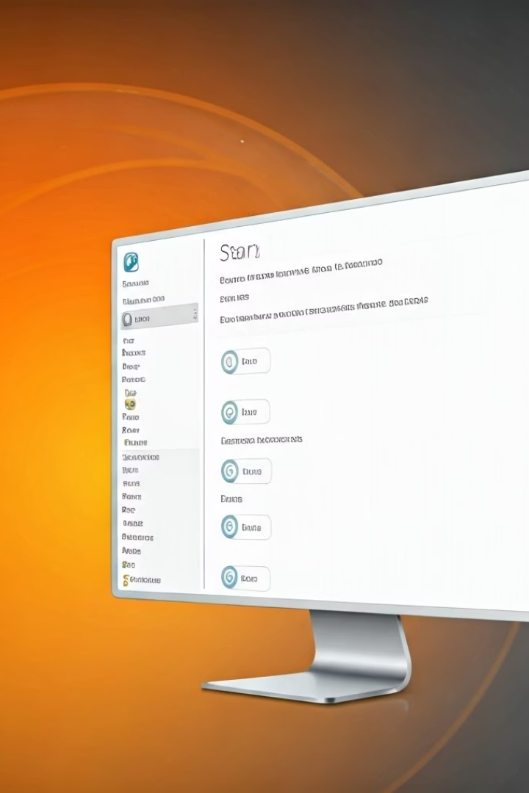

How to Navigate Windows: Start Menu & Settings
What is the Start Menu?
The Start Menu is your main tool to find and open apps, search your computer, and access important features.
To open it:
Click the Windows icon at the bottom-left corner of your screen.
Or press the Windows key on your keyboard.
by Ram N Java

Slide 2
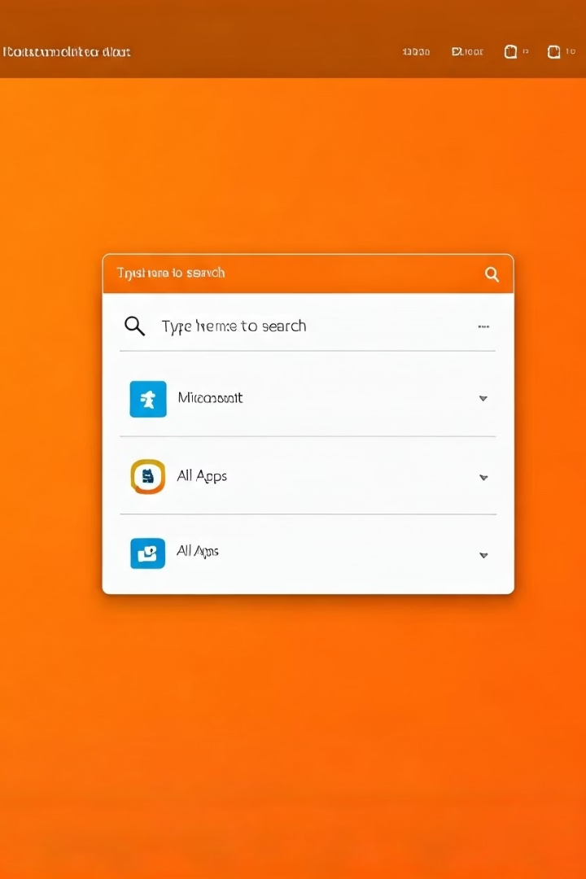




Parts of the Start Menu
Search Bar
At the top, you'll see a search box. You can type here to find apps, files, or settings quickly.
Pinned Apps
These are the apps you use most. You can click them to open, or right-click to remove or move them.
All Apps
Click "All apps" to see every program installed on your computer, in alphabetical order.
Power Button
At the bottom of the Start Menu, click the power icon to shut down, restart, or put your computer to sleep.

Slide 3
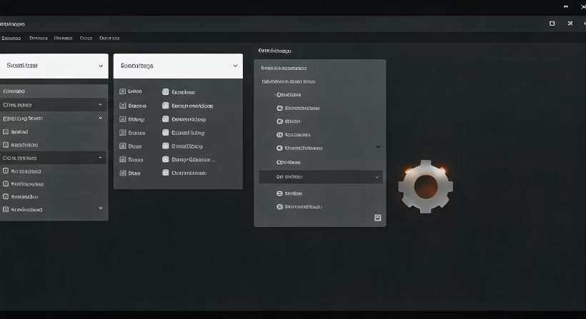
How to Use Windows Settings
Settings is where you go to change how your
computer looks or works.
To open Settings:
Click the Start Menu, then click the gear icon (or type Settings in the search box).
Or press Windows key + I on your keyboard.

Slide 4









Main Sections in Settings
System
Devices
Network & Internet
Personalization
Change display, sound, battery, and notifications.
Add or remove printers, Bluetooth devices, and more.
Set up Wi-Fi, mobile hotspot, or troubleshoot internet problems.
Change your background, theme, and colors.
Apps
See what's installed, remove or reset apps.
Accounts
Manage user profiles, passwords, and login options.
Time & Language
Set your date, time, and language preferences.
Privacy & Security
Control app permissions and protect your data.
Update & Security
Check for Windows updates, backup, or recovery options.

Slide 5

Tips for Beginners
Customize Your Experience
Access Frequently Used Apps
Visit Settings if you want to customize anything or fix an issue.
Use the Search Bar
Use the Start Menu daily to open your most-used apps.
If you don't know where something is, just type it in the search bar.

