Slide 1
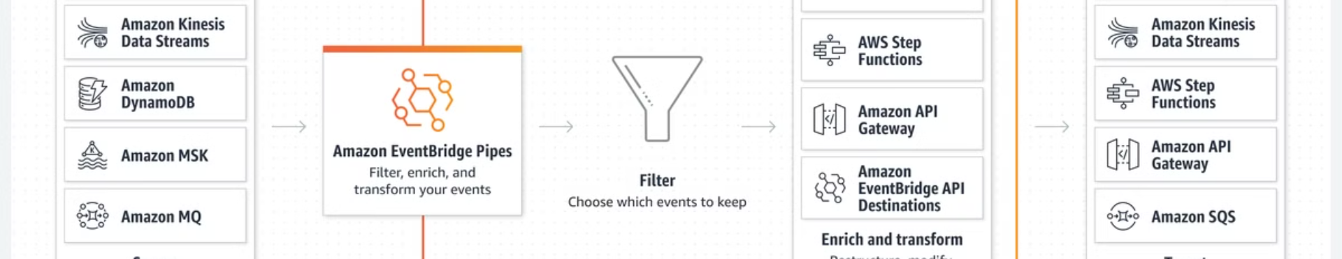

What are S3 Event Notifications?
S3 Event Notifications are like alarms that go off when something specific happens to your files in S3.
For example:
If someone uploads a new file to your S3 bucket.
If someone deletes a file.
If someone copies a file.
When these actions happen, S3 can send a notification to let you or another system know about it.
by Ram N Java

Slide 2
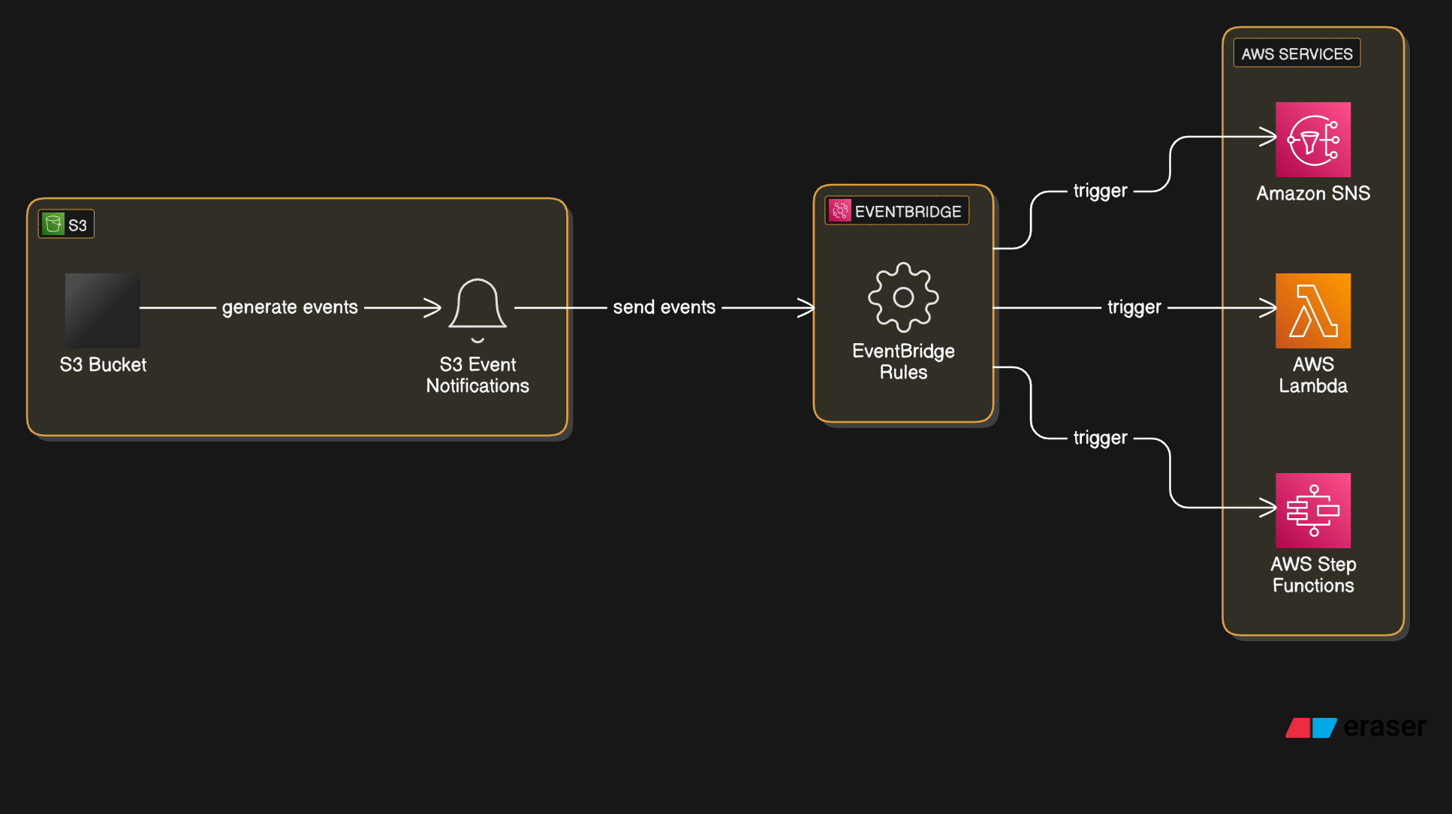

Slide 3



What is Amazon EventBridge?
Message Delivery
Event Handling
Service Integration
Amazon EventBridge is a service that helps you connect different parts of your AWS applications.
Think of it as a postman that delivers messages (events) from one place to another.
It can take events (like S3 notifications) and send them to other AWS services or even external apps.

Slide 4
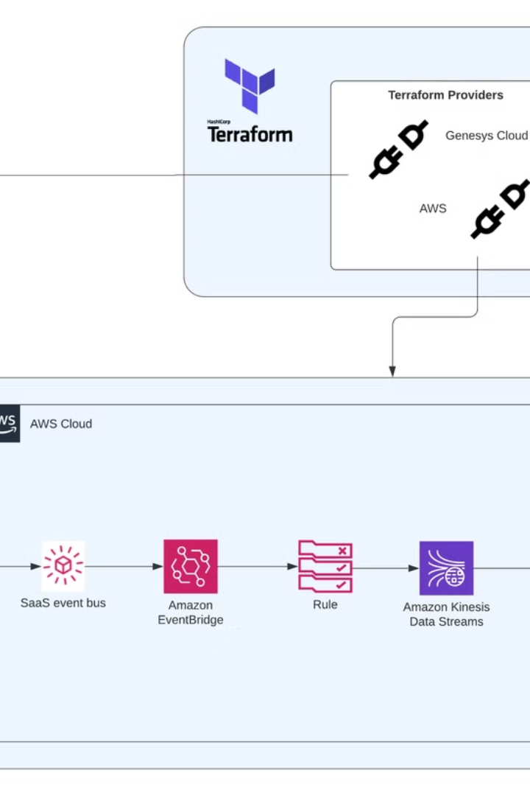




How do S3 Event Notifications and EventBridge work together?
Something happens in S3
For example, a new file is uploaded to your S3 bucket.
S3 sends an event
S3 creates a notification (event) about this action.
EventBridge gets the event
The event is sent to Amazon EventBridge.
EventBridge takes action
EventBridge can then trigger other services based on the event. For example:
Send an email using Amazon SNS
Start a workflow in AWS Step Functions
Run a function in AWS Lambda

Slide 5
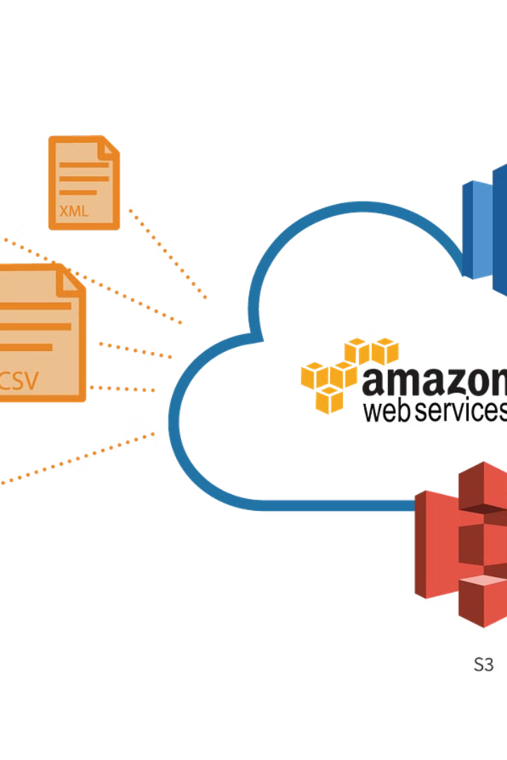
Why is this useful?
Automation
Real-time updates
Automatically process files in your S3 bucket without manual checking.
Get instant alerts when anything changes in your bucket.
Integration
Easily connect S3 with other AWS services to create smarter applications.

Slide 6
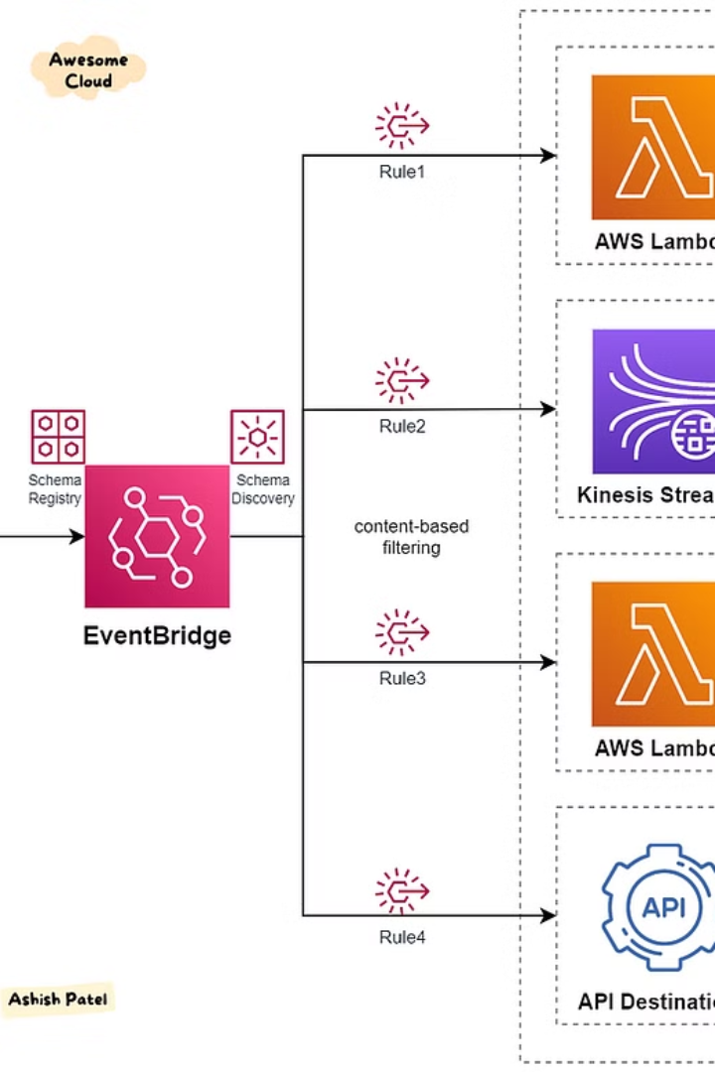
Key Points to Remember
S3 Event Notifications
Amazon EventBridge
Amazon EventBridge is a messenger that takes those notifications and sends them to other services.
S3 Event Notifications tell you when something happens in your S3 bucket.
Combined Benefits
Together, they help you automate workflows and react to changes in real-time.

