Slide 1
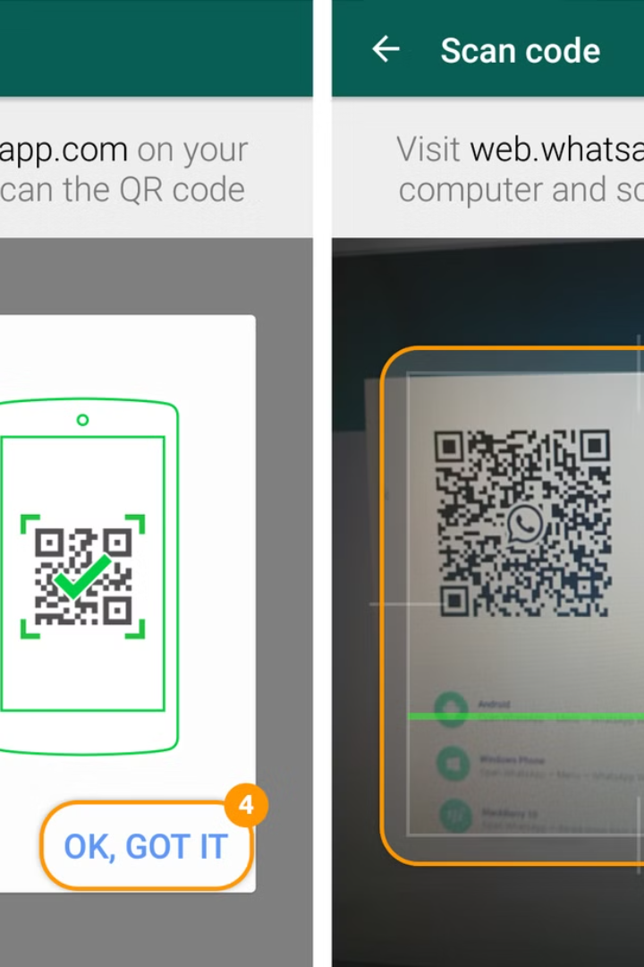

Use WhatsApp Web
(No Installation)
1
Open a Browser:
Open Chrome, Edge, or any browser.
2
Visit WhatsApp Web:
Go to https://web.whatsapp.com.
3
Scan the QR Code:
Open WhatsApp on your phone. Go to
Settings > Linked Devices. Tap Link a Device and scan the QR code on the browser.
by Ram N Java

