Slide 1


AWS DynamoDB
What is AWS DynamoDB?
DynamoDB is a database service provided by Amazon Web Services (AWS). It is used to store and retrieve data quickly. You can think of it as a digital filing cabinet that keeps your data safe and ready to use anytime.
by Ram N Java

Slide 2






Key Features of DynamoDB
Fully managed
Fast and scalable
Serverless
You don't have to install or manage servers.
It can handle small or very large amounts of data.
You only pay for what you use. No need to worry about hardware.
NoSQL database
Automatic scaling
It stores data in a flexible way (not like traditional rows and tables).
It can grow or shrink based on how much data you have.

Slide 3

How Does DynamoDB Store Data?
Data Structure
Example
DynamoDB uses tables to store data.
Let's say you are building an online store.
A table contains items, and each item is like a row.
You can create a table called Products. Each item can store one product. Each item has attributes like:
Each item has attributes, which are like columns.
Every item has a unique ID (primary key) for quick lookups.
ProductID
ProductName
Price
StockQuantity

Slide 4








How to Access Data?
Add
Read
items
items
Delete
Update
items
items
You can also query to find specific items using keys.

Slide 5
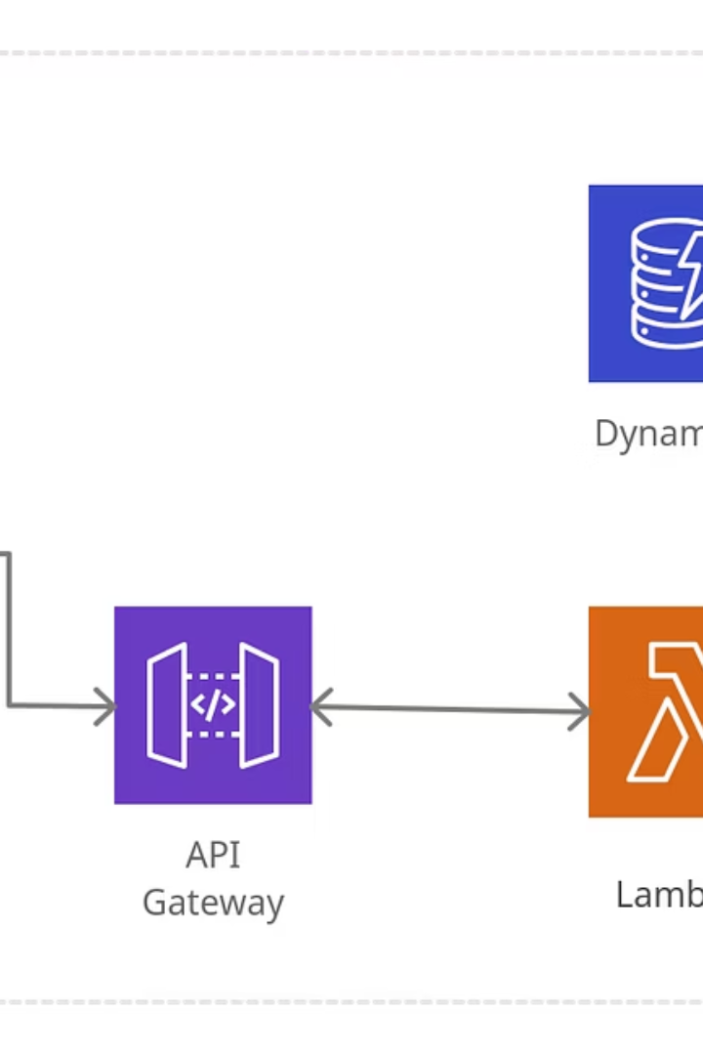
What Makes DynamoDB Special?
Very fast performance
Even with millions of users.
Highly available
Your data is safe even if something goes wrong.
Scalable
Good for small apps and large companies.
AWS Integration
Works well with other AWS services like Lambda, API Gateway, and S3.

Slide 6





When Should You Use DynamoDB?
Web & Mobile Apps
Gaming
IoT (Internet of Things)
Handles fast, frequent updates (like player scores).
Great for apps with millions of users.
Stores real-time sensor data efficiently.
Ad Tech & E-commerce
Manages high-speed transactions (like shopping carts).

Slide 7

DynamoDB vs Traditional Databases
Feature
DynamoDB
Traditional SQL (MySQL, PostgreSQL)
Structure
Flexible (NoSQL)
Fixed tables (SQL)
Scaling
Automatic
Manual setup required
Speed
Super fast for simple queries
Slower for large-scale reads/writes
Use Case
High-traffic apps, real-time data
Complex queries, reports

Slide 8






Summary
Fast
High-performance data access
Serverless
No infrastructure to manage
NoSQL Database
Flexible data storage
DynamoDB is a fast, serverless, and easy-to-use NoSQL database from AWS. It helps you store, manage, and access data without worrying about servers or slow performance.

