Slide 1
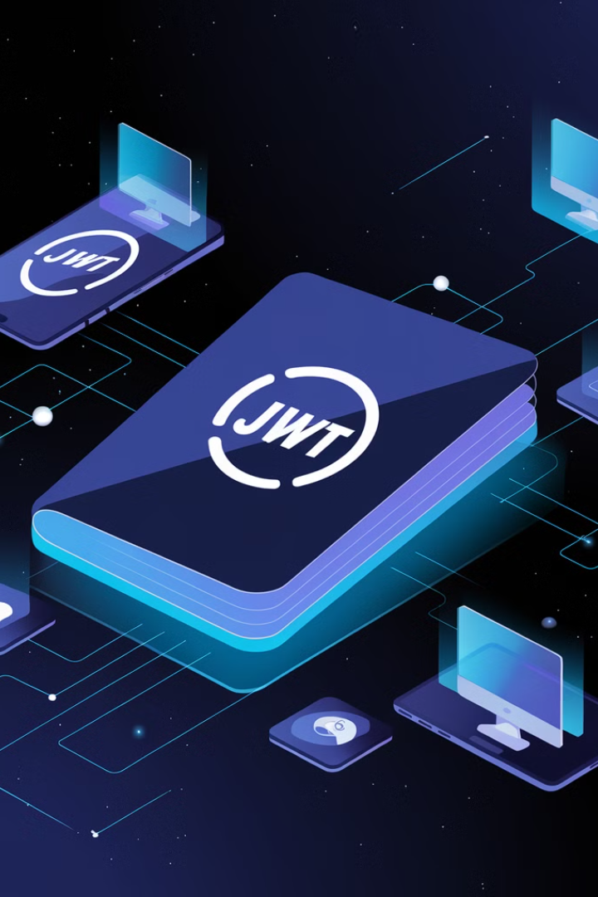


JWT: JSON Web Token
JWT stands for JSON Web Token. It's like a digital passport that proves your identity when you're using an app or website.
Imagine you're going to a theme park. To enter, you show your ticket (the JWT). Once you're inside, you don't have to show it again at every ride; the ticket lets the staff know you're allowed to be there, and they don't have to check you over and over.
by Ram N Java

Slide 2
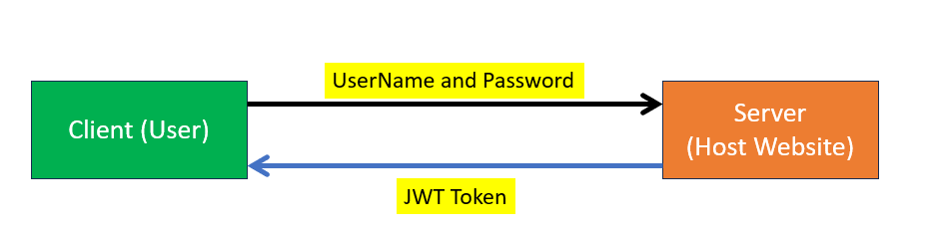
How JWT Works
1
Login
You log in to a website or app
with your username and password.
2
Token Creation
The website creates a special ticket (JWT) that says, "This person is allowed to use the app."
3
Token Storage
The JWT is sent to your device, and you store it.
You use it every time you make a request to the website, so it knows you're still logged in.
4
No Re-Login
You don't need to enter your password again as long as you have the token.
The token works like a key to access different parts of the app.
5
Expiration
Just like your ticket might expire after a certain time, the JWT has an expiration date.
After that, you may need to log in again to get a new token.
So, a JWT is a secure, easy way to prove you're allowed to use something without needing to constantly log in!

