Slide 1

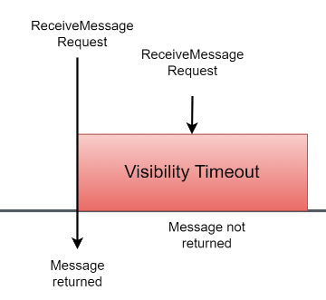
Don't Lose Your Message! How SQS Visibility Timeout Works
What is Amazon SQS Visibility Timeout?
Imagine you have a big box where people can put in their messages, and others can take them out to read and handle them. This box is your Amazon SQS (Simple Queue Service) queue.
Visibility Timeout is like a timer that starts when someone takes a message out of the box to read and handle it. During this time, the message is invisible to everyone else. It's like saying, "Hey, I'm working on this message, so nobody else should touch it right now."
Amazon SQS

Slide 2
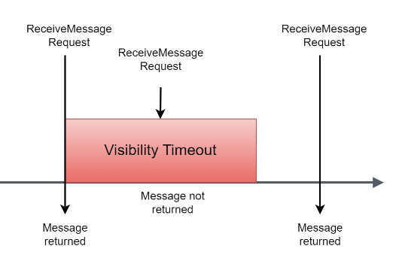
Don't Lose Your Message! How SQS Visibility Timeout Works
How It Works:
Message in the Box: You have a message in the SQS queue (box).
Someone Takes the Message: A worker (a part of your application) takes the message out to process it.
Start the Timer: As soon as the worker takes the message, a timer (visibility timeout) starts.
Message is Invisible: While the timer is running, the message is hidden from other workers so that no one else can take it out and work on it simultaneously.
Processing the Message: The worker processes the message (e.g., sends an email, processes an order).
Delete or Return the Message:
If the worker finishes processing before the timer ends, it deletes the message from the queue. The message is gone for good.
If the worker doesn't finish in time (e.g., it crashes or needs more time), the message becomes visible again when the timer ends. Another worker can then take it and process it.

Slide 3
Don't Lose Your Message! How SQS Visibility Timeout Works
Why is it Useful?
Prevents Duplicate Work: It ensures that only one worker processes a message at a time, avoiding duplication of work.
Handles Failures: If a worker fails to process the message within the time limit, another worker can pick it up and try again, ensuring that the task gets done.

Slide 4
Don't Lose Your Message! How SQS Visibility Timeout Works
Example Scenario:
Imagine you have a team of people handling customer support tickets (messages) from a shared inbox (SQS queue):
New Ticket Arrives: A new customer support ticket is added to the inbox.
Agent John Takes the Ticket: Agent John takes the ticket to work on it. The ticket is now hidden from other agents (visibility timeout starts).
Agent John Handles the Ticket: Agent John resolves the issue and marks the ticket as done (deletes the message) within the time limit.
Agent John Gets Distracted: If Agent John gets distracted and doesn't handle the ticket within the time limit, the ticket reappears in the inbox for someone else to handle.
Agent John Handles the Ticket
Agent John Gets Distracted
Agent John Takes the Ticket
Visibility timeout [1 min]
9.00
9.01

Slide 5
Don't Lose Your Message! How SQS Visibility Timeout Works
Summary
The visibility timeout is a timer that hides a message from others while someone is working on it.
If they finish in time, the message is marked as done. If not, it becomes available again for someone else to pick up. This helps ensure tasks are completed without duplication and allows for recovery from failures.

