Slide 1


Email Basics: How to Send & Receive Emails Like a Pro
What is Email?
Email (short for electronic mail) is a way to send messages using the internet. You can use it to send text, files, and even photos to other people around the world.
by Ram N Java

Slide 2



Choosing an Email Service
Gmail (by Google)
Yahoo Mail
Outlook (by Microsoft)
www.gmail.com
www.yahoo.com
www.outlook.com
Create an account by clicking "Sign Up" or "Create Account" and follow the steps.
Fill in your name, birth date, and a username (e.g., yourname@gmail.com).
Choose a strong password (mix letters, numbers, and symbols).
Follow the steps to verify your account (usually via phone number).
Tip: Your email address is like your digital mailing address—share it only with trusted people.

Slide 3
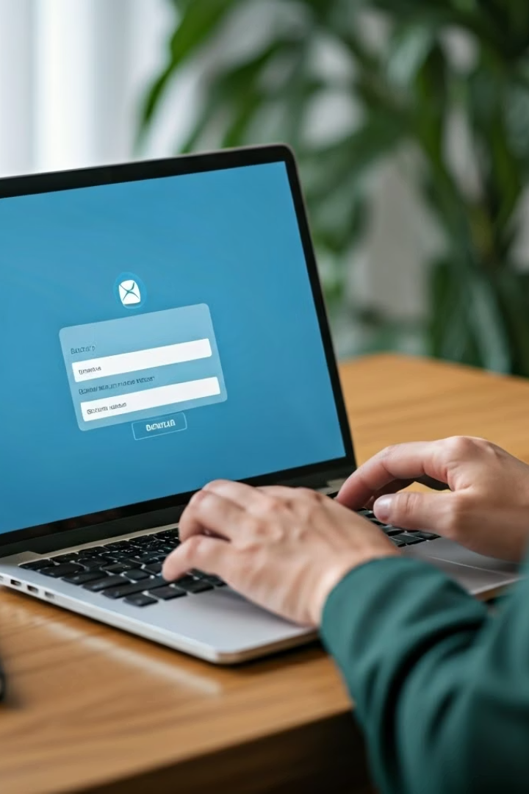
Logging In
Go to your email website
Open your browser and type in the web address of your email provider
Enter your credentials
Type in your email address and password
Access your account
Click "Sign In" or "Log In"

Slide 4
Understanding the Inbox
Inbox
Sent
Drafts
Shows new and old emails you received
Shows emails you have sent
Emails you started writing but didn't send
Trash/Deleted/Bin
Spam
Emails you deleted
Junk or unwanted emails
After logging in, you'll see your Inbox. This is where you receive emails.

Slide 5

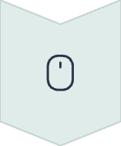



How to Read an Email
Click on the email subject line
Select the email you want to read from your Inbox
View the full message
The full message will open
Check the details
You can see who sent it, when, and what they said
Access attachments
If there is a file attached, click Download or View

Slide 6






How to Send an Email
Start a new email
Click "Compose" or "New Mail"
Add recipient
In the To field, type the email address of the person you want to send to
Create a subject
In the Subject line, type a short title for your email
Write your message
Write your message in the big blank space below
Add attachments (optional)
To attach a file (like a photo), click the paperclip icon and select your file
Send your email
Click "Send"

Slide 7




Replying to an Email
Open the email
Select the message you want to respond to
Click "Reply"
Find and click the reply button
Type your message
Write your response in the message field
Click "Send"
Send your reply to the original sender
Use "Reply All" only when you want to respond to everyone included in the email.

Slide 8







Forwarding an Email
Open the email
Click "Forward"
Select the message you want to forward
Find and select the forward option
4
Add recipient
Click "Send"
Enter the new person's email address
Send the forwarded message

Slide 9





Email Etiquette (How to Email Like a Pro)
Clear subject line
Polite greeting
Concise message
Professional closing
Use a descriptive title that summarizes your message
Start with "Hello" or "Dear Sir/Madam"
Be short and clear in your message
End with "Thanks", "Best regards", or "Sincerely"
Proofread
Always review before clicking send

Slide 10








Staying Safe with Emails
Use strong passwords
Create complex passwords and change them regularly
Be cautious with unknown senders
Do not open emails from people you don't know
Avoid suspicious links
Don't click on suspicious links in emails
Be careful with attachments
Avoid downloading strange attachments

Slide 11


Deleting or Archiving Emails
Deleting Emails
Archiving Emails
To delete an email, click the Trash icon or Delete.
To save it but remove it from your inbox, click Archive.
This removes the email from your inbox and moves it to the Trash/Bin folder, where it will eventually be permanently deleted.
Archiving keeps the email in your account but moves it out of your inbox to reduce clutter. You can still search for and find archived emails later.

Slide 12
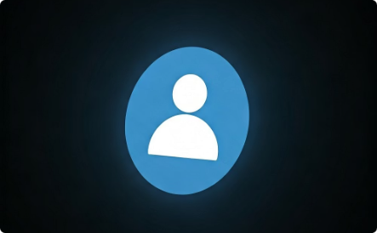
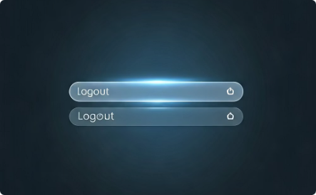
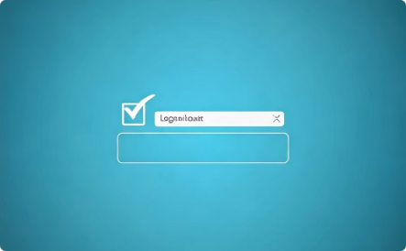
Logging Out
Step 1: Find your account menu
Click your profile or account icon
Step 2: Select logout option
Select "Log Out" or "Sign Out"
Step 3: Ensure security
This keeps your account safe and private

