Slide 1
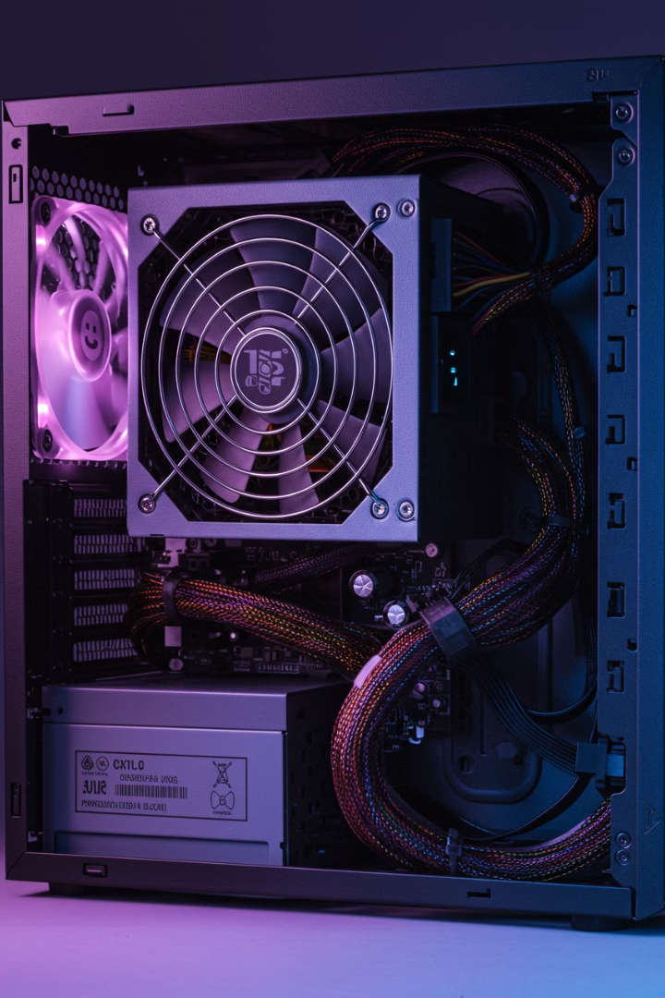

Power Supply Unit (PSU)
A Power Supply Unit (PSU) is like the energy provider for your computer. It's a box inside the computer that takes electricity from your wall outlet and turns it into the right kind of power that your computer parts need to work.
by Ram N Java

Slide 2
What a PSU Does
1
Converts Power
2
Powers All Parts
3
Controls Voltage
The PSU takes the
high-voltage electricity from your wall (which is usually AC power) and converts it into low-voltage DC power that your computer parts can use safely.
The PSU sends power to the motherboard, CPU, RAM, hard drives, graphics card, and other parts through special cables. Without the PSU, none of these parts would turn on.
Different parts of the computer need different amounts of power. The PSU makes sure each part gets the right amount of voltage it needs to work properly.
4
Keeps Things Safe
5
Connects to the Wall
The PSU has safety features to protect your computer from problems like power surges (sudden spikes in electricity) or overheating.
The PSU has a cable that plugs into your wall outlet to get power. It also has a switch to turn the power on or off.

Slide 3
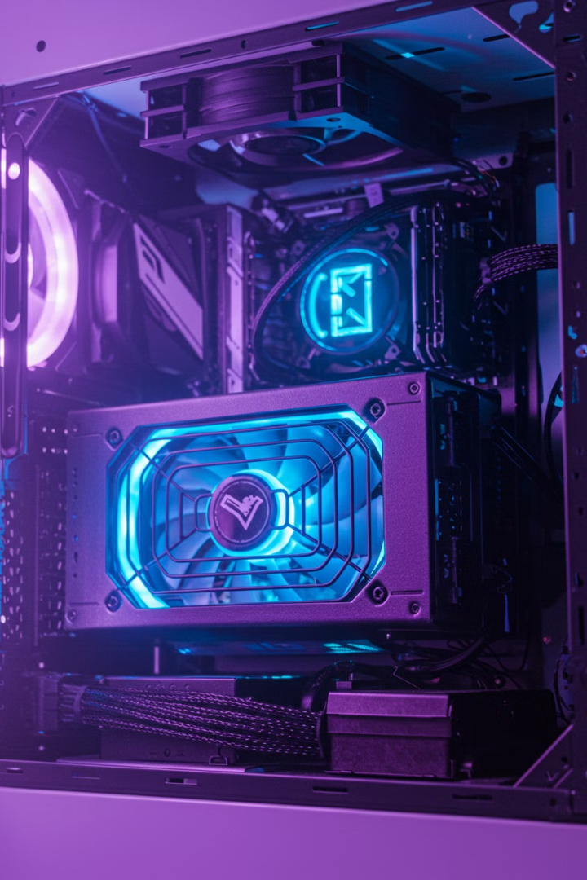



The Energy Heart of Your Computer
Energy Provider
Essential Component
Critical Function
In short, the Power Supply Unit (PSU) is the energy heart of your computer.
Without it, your computer wouldn't even turn on!
It makes sure all the parts get the power they need to run smoothly and safely.

