Slide 1


How Does a Computer Work? A Simple Breakdown
A computer works by taking input, processing it, and then giving output. It's like a smart machine that follows your instructions to get things done.
by Ram N Java

Slide 2

Input
What is Input?
How Does It Work?
Input is the data or commands you give to the computer.
You use input devices (like a keyboard or mouse) to send information to the computer.
Example: Typing on a keyboard, clicking with a mouse, or speaking into a microphone.
Example: You type a letter, and the computer receives it.

Slide 3
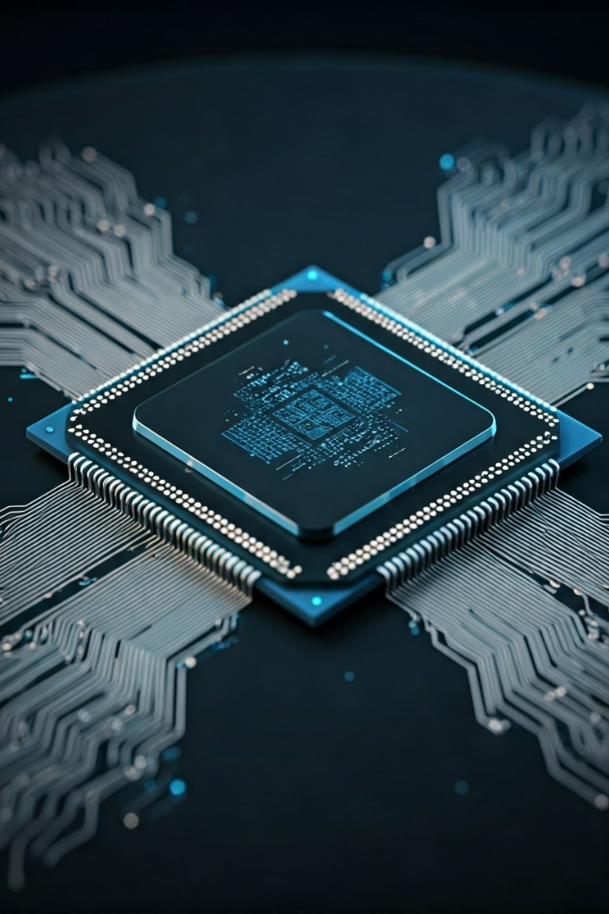


Processing
What is Processing?
Processing is when the computer thinks and works on the input you gave it.
The CPU (Central Processing Unit), which is the brain of the computer, does this work.
How Does It Work?
The CPU follows instructions from the software (programs) to process the input.
Example: If you type "2 + 2", the CPU calculates the answer.

Slide 4
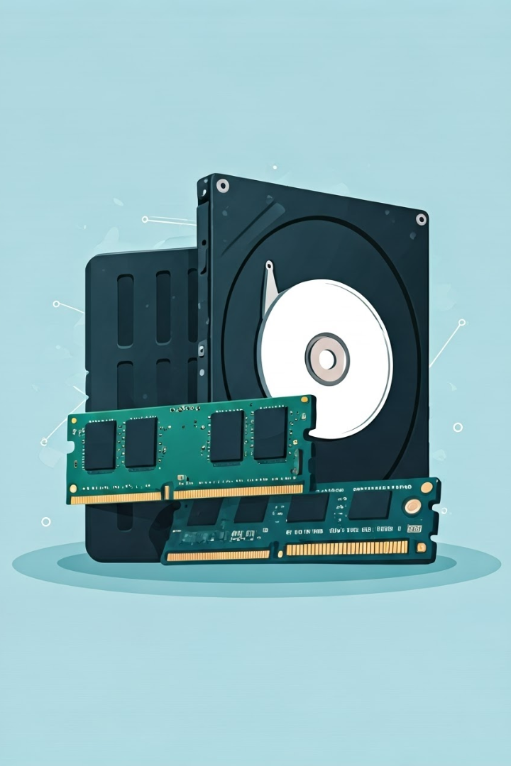
Storage
What is Storage?
Storage is where the computer saves data so it can be used later.
Example: Your photos, documents, and apps are stored on the computer.
How Does It Work?
The computer uses memory (like RAM) for temporary storage and hard drives or SSDs for permanent storage.
Example: When you type a document, it stays in RAM. When you save it, it moves to the hard drive.

Slide 5



Output
What is Output?
How Does It Work?
Output is the result or information the computer gives back to you.
The computer sends the processed data to output devices like a monitor, printer, or speakers.
Example: The answer to a math problem, a printed document, or a picture on the screen.
Example: You see the answer "4" on the screen after typing "2 + 2".

Slide 6
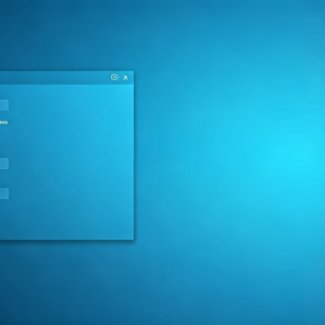

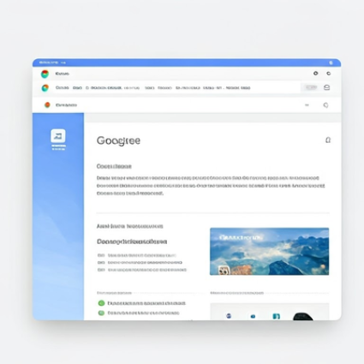
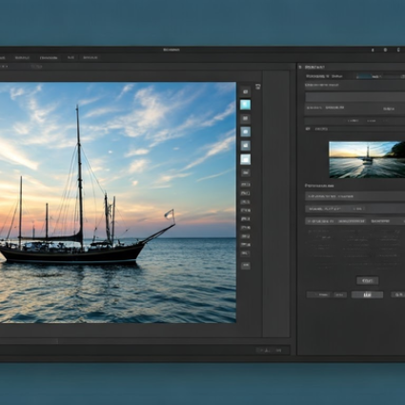
Software
What is Software?
Software is the programs or instructions that tell the computer what to do.
Example: Windows (operating system), Microsoft Word (for writing), or Chrome (for browsing the internet).
How Does It Work?
Software runs on the computer and helps you perform specific tasks.
Example: You use a game app to play or a photo editor to edit pictures.

Slide 7





How It All Comes Together
You Give Input
You type, click, or speak to give the computer instructions.
Example: You type "Hello" on the keyboard.
Computer Processes It
The CPU processes the input and follows the instructions.
Example: The computer saves the word "Hello" in its memory.
Computer Stores It
The data is saved in the computer's storage for later use.
Example: The word "Hello" is saved in a document.
Computer Gives Output
The computer shows or gives you the result.
Example: You see "Hello" on the screen or print it on paper.

Slide 8

Why is This Important?
1000x
1TB+
Saves Time
Stores Information
Computers can do tasks much faster than humans.
You can save thousands of files, like photos, videos, and documents.
Example: Sorting a
list of names takes seconds.
24/7
Makes Life Easier
Computers help with work, learning, and entertainment.
Example: Writing a letter, studying online, or watching a movie.

Slide 9








Summary
Input
Processing
Taking input (like typing or clicking)
Processing the input using the CPU
Output
Storage
Giving output (like showing results on the screen)
Storing the data in memory or storage
It's like a smart helper that follows your instructions to get things done quickly and efficiently!

