Slide 1

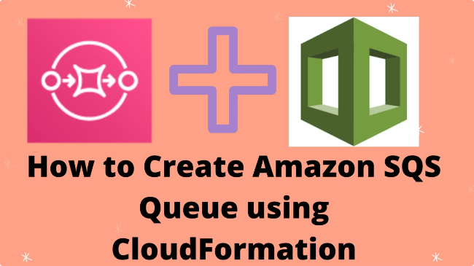

Creating a User and Group with Full Access to Amazon SQS
This guide provides step-by-step instructions for creating a user and group with full access to Amazon Simple Queue Service (SQS) using AWS Identity and Access Management (IAM). It covers the process of setting up IAM groups and users, configuring permissions, and using the AWS CLI to interact with SQS queues. This beginner-friendly guide will help you navigate through the essential steps to get started with Amazon SQS.
by Ram N Java

Slide 2

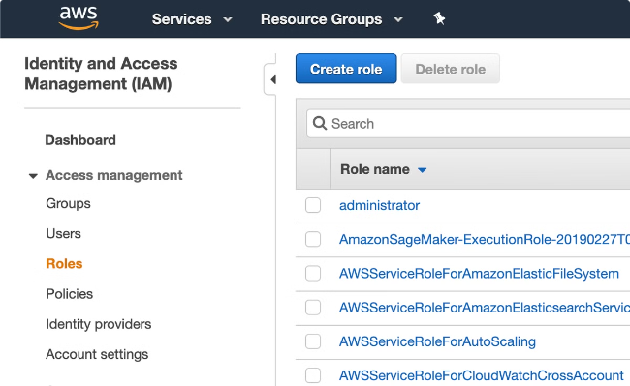
Step 1: Create an IAM Group
1
Sign in to AWS Console
Sign in to the AWS Management Console and open the IAM console at IAM Console.
2
Create a Group
In the navigation pane, choose Groups. Click on Create New Group. Enter a group name (e.g., SQSFullAccessGroup). Click Next Step.
3
Attach Policy to Group
On the Attach Policy page, search for AmazonSQSFullAccess. Select the checkbox next to AmazonSQSFullAccess. Click Next Step, then Create Group.

Slide 3

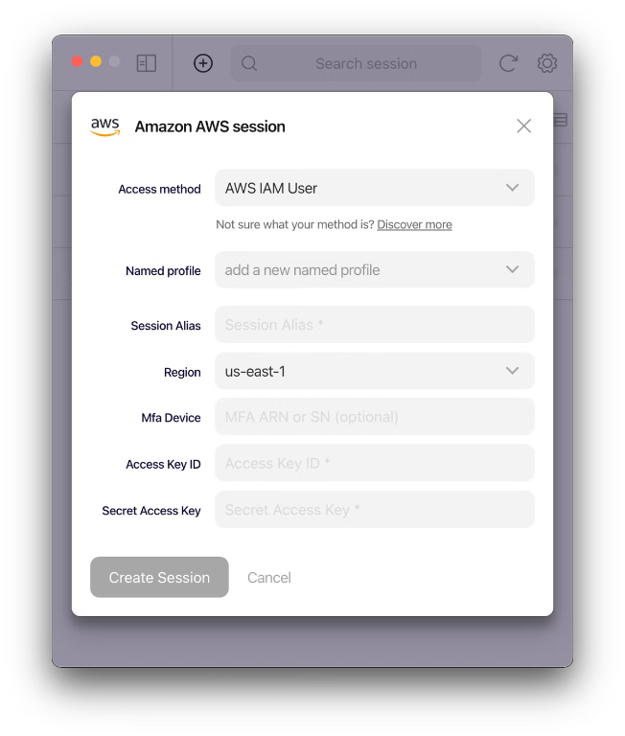
Step 2: Create an IAM User
1
Create a User
In the navigation pane, choose Users. Click on Add user. Enter a user name (e.g., SQSUser). Select the checkbox for Programmatic access to provide an access key for API, CLI, SDK, and other development tools.
2
Set Permissions
Click Next: Permissions. Choose Add user to group. Select the group you created earlier (e.g., SQSFullAccessGroup). Click Next: Tags (optional), then Next: Review.
3
Create User
Click Create user. Note the Access key ID and Secret access key. These credentials are essential for programmatic access (CLI, SDK).

Slide 4

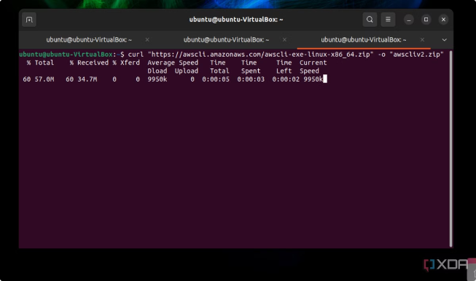
Step 3: Configure AWS CLI for the New User
1
Install AWS CLI
Install AWS CLI (if not already installed). You can find the installation instructions here.
2
Configure AWS CLI
Configure the AWS CLI using the new user's credentials:
aws configure
3
Enter Credentials
When prompted, enter the Access key ID and Secret access key from the new user. Enter the default region name (e.g., us-west-2). Enter the default output format (e.g., json).

Slide 5


Step 4: Create an SQS Queue (Standard Queue)
Create a Standard Queue
Run the following command:
aws sqs create-queue --queue-name MyStandardQueue
Queue Creation Result
This will create a standard SQS queue named MyStandardQueue. You will get a URL for the newly created queue.

Slide 6

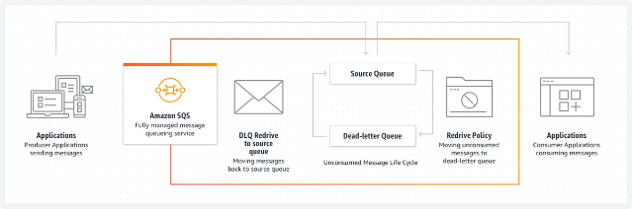
Step 4: Create an SQS Queue (FIFO Queue)
Create a FIFO Queue
FIFO queues have stricter ordering and
exactly-once processing. To create one, use:
aws sqs create-queue --queue-name MyFifoQueue.fifo --attributes FifoQueue=true

Slide 7


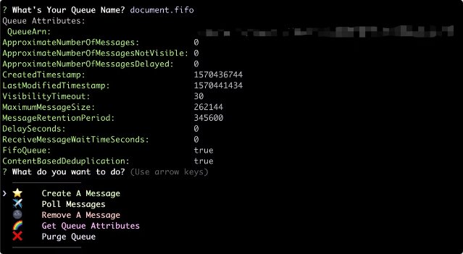

Step 5: List Queues
List All Queues Command
Run the command: aws sqs list-queues
Result
This will display a list of all your SQS queues.

Slide 8

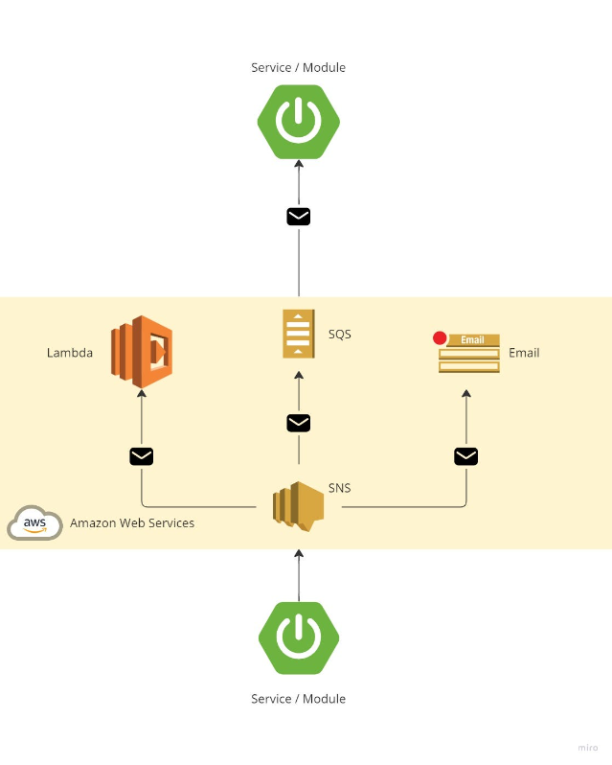
Step 6: Send Messages to the Queue
Send a Message Command
Use the following command to send a message to your queue:
aws sqs send-message --queue-url <YourQueueURL>
--message-body "Hello, this is a test message"
Important Note
Replace <YourQueueURL> with the URL of your queue

Slide 9

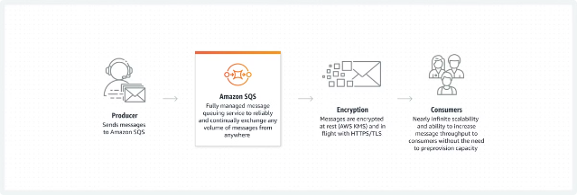
Step 7: Receive Messages from the Queue
Receive a Message Command
Run the command to receive messages from the queue: aws sqs receive-message --queue-url <YourQueueURL>
Result
This will return messages from the queue.

Slide 10
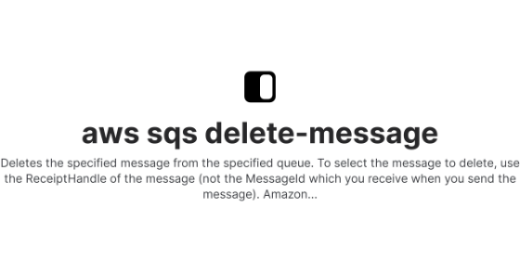
Step 8: Delete Messages from the Queue
1
Delete a Message Command
After processing a message, you should delete it from the queue. Use the receipt handle returned by the receive-message command:
aws sqs delete-message --queue-url <YourQueueURL> --receipt-handle <ReceiptHandle>
2
Important Note
Replace <ReceiptHandle> with the actual receipt handle of the message you received.

Slide 11

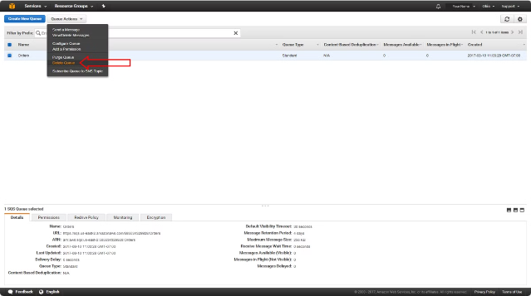
Step 8: Delete the Queue
Delete the Queue Command
When you are done with the queue, you can delete it: aws aws sqs delete-queue --queue-url <YourQueueURL>

Slide 12

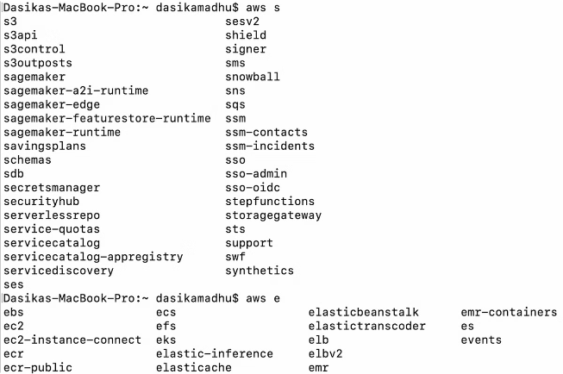
Summary of Commands
Create a Queue
aws sqs create-queue
--queue-name MyStandardQueue
List Queues
aws sqs list-queues
Send a Message
aws sqs send-message --queue-url <YourQueueURL> --message-body "Hello, this is a test message"
Receive Messages
aws sqs receive-message --queue-url <YourQueueURL>
Delete a Message
aws sqs delete-message --queue-url <YourQueueURL> --receipt-handle <ReceiptHandle>
Delete the Queue
aws sqs delete-queue --queue-url
<YourQueueURL>

Slide 13


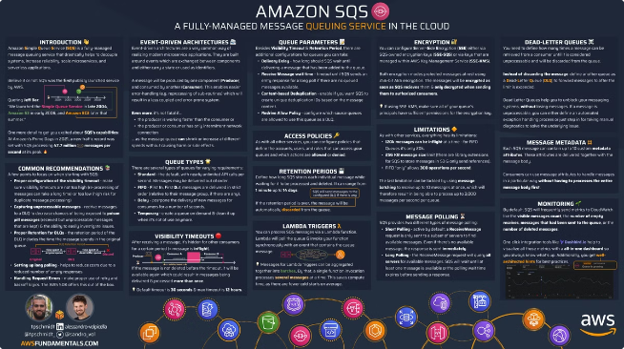


Tips for Queue Management
Use Descriptive Names
Name your queues descriptively to easily identify their purpose.
Access Control
Manage access to your queues using IAM policies to ensure security.
Monitoring
Use CloudWatch to monitor your SQS queues for metrics like the number of messages sent, received, and deleted.

Slide 14

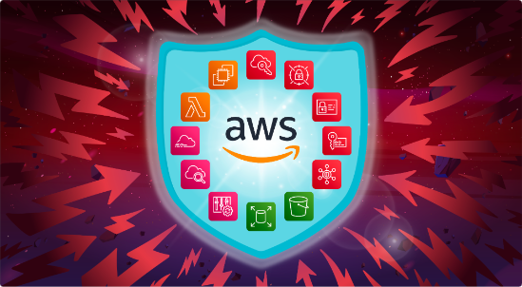
Security Best Practices
1
Keep Credentials Safe
2
Least Privilege Principle
3
Monitoring and Auditing
Never share your AWS credentials. Store them securely.
For real-world applications, always follow the principle of least privilege. Grant only the permissions needed for your users to perform their tasks.
Regularly review IAM policies and audit IAM roles and permissions to ensure they adhere to your security policies.

Slide 15
Conclusion
Comprehensive Setup
Practical Knowledge
Next Steps
This guide has walked you through the process of creating a user and group with full access to Amazon SQS, from setting up IAM to interacting with queues using AWS CLI.
You've learned how to create and manage SQS queues, send and receive messages, and implement basic security practices.
Continue exploring AWS services and integrating SQS into your applications for efficient and scalable message processing.

