Slide 1
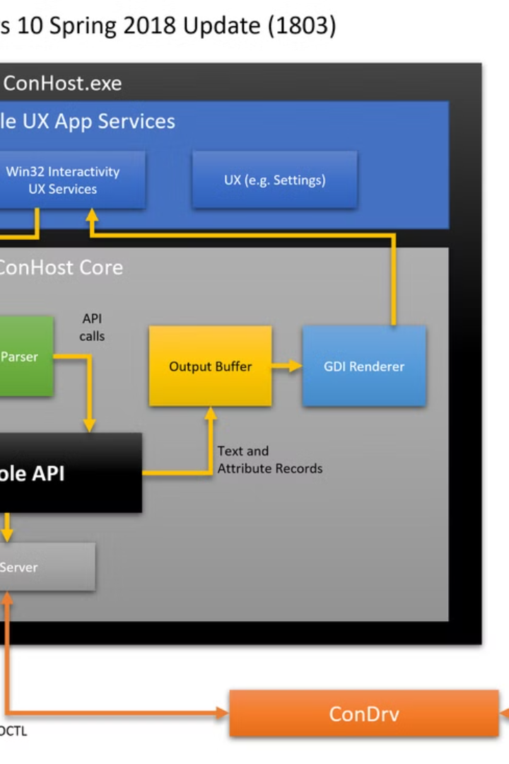

How to Use Command Prompt (CMD): Basic Commands for Beginners
The Command Prompt (also called CMD) is a tool in Windows that lets you type commands to control your computer instead of using your mouse. It is helpful for troubleshooting, file management, and system tasks.
by Ram N Java

Slide 2
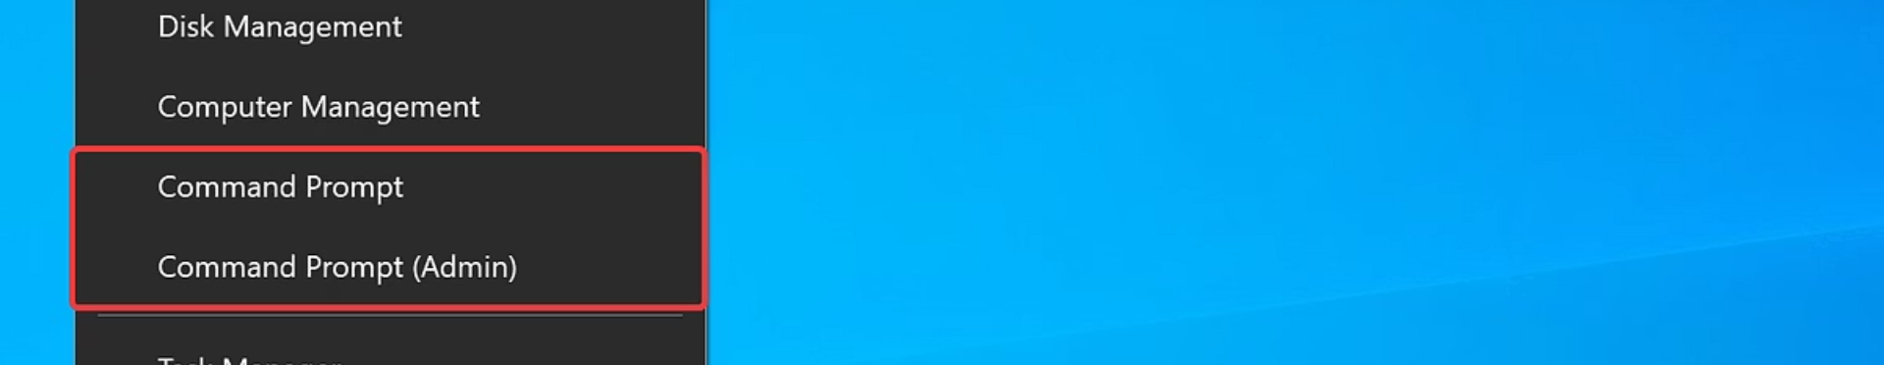


How to Open CMD
Windows Key + R Method
Start Menu Method
Press Windows key + R, type cmd,
then press Enter.
Or click Start, type Command Prompt, and click to open it.

Slide 3
Basic CMD Commands for Beginners
dir
cd
Type: dir
Type: cd foldername
This shows a list of files and folders in the current location.
This means "change directory", or go into a folder.
It helps you see what's inside a folder.
Example: cd Documents goes to the Documents folder.
Use cd .. to go back one level.

Slide 4
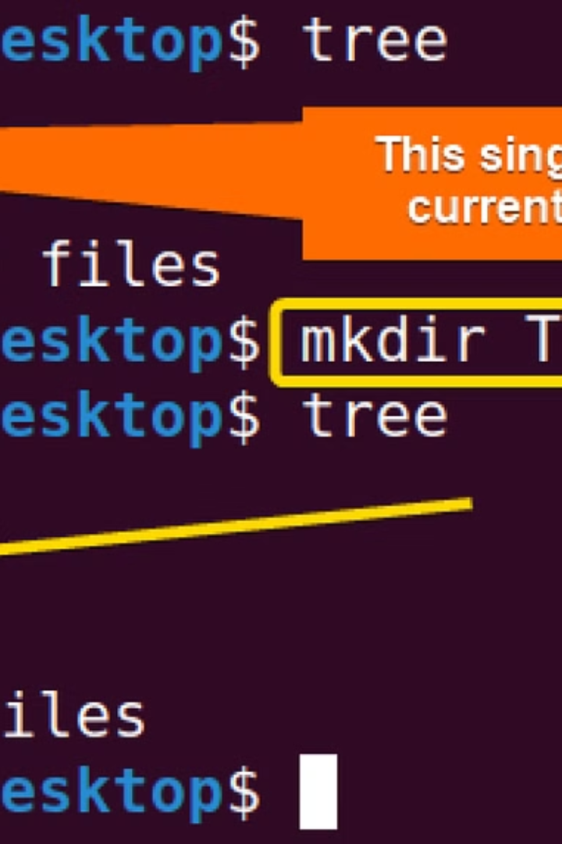
More Basic Commands
cls
Type: cls
This clears the screen and makes it clean again.
mkdir
Type: mkdir newfoldername
This makes a new folder.
Example: mkdir Homework creates a folder named Homework.

Slide 5



Echo and Copy Commands
echo
Type: echo Hello
This shows a message on the screen.
It's useful for testing.
copy
Type: copy file1.txt file2.txt
This copies a file.
Example: copy notes.txt backup.txt makes a copy of notes.txt and names it backup.txt.

Slide 6
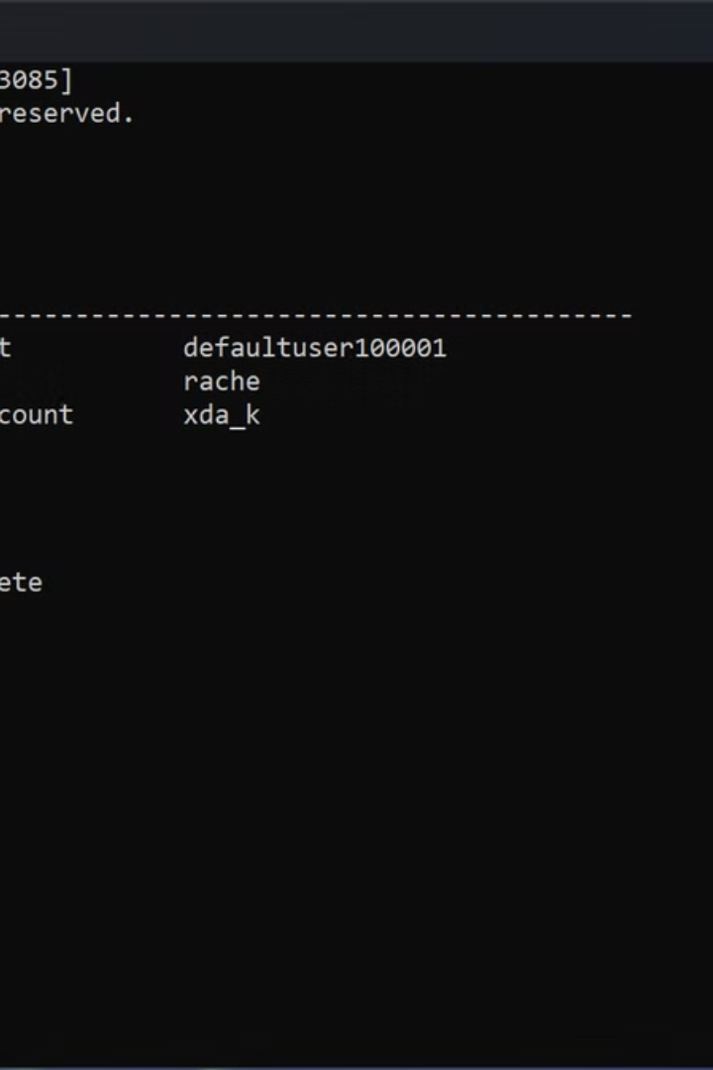


Delete and Exit Commands
del
exit
Type: del filename
Type: exit
This deletes a file.
This closes the Command Prompt.
Example: del oldfile.txt removes that file.
Be careful — once deleted, it may not go to the Recycle Bin.

Slide 7
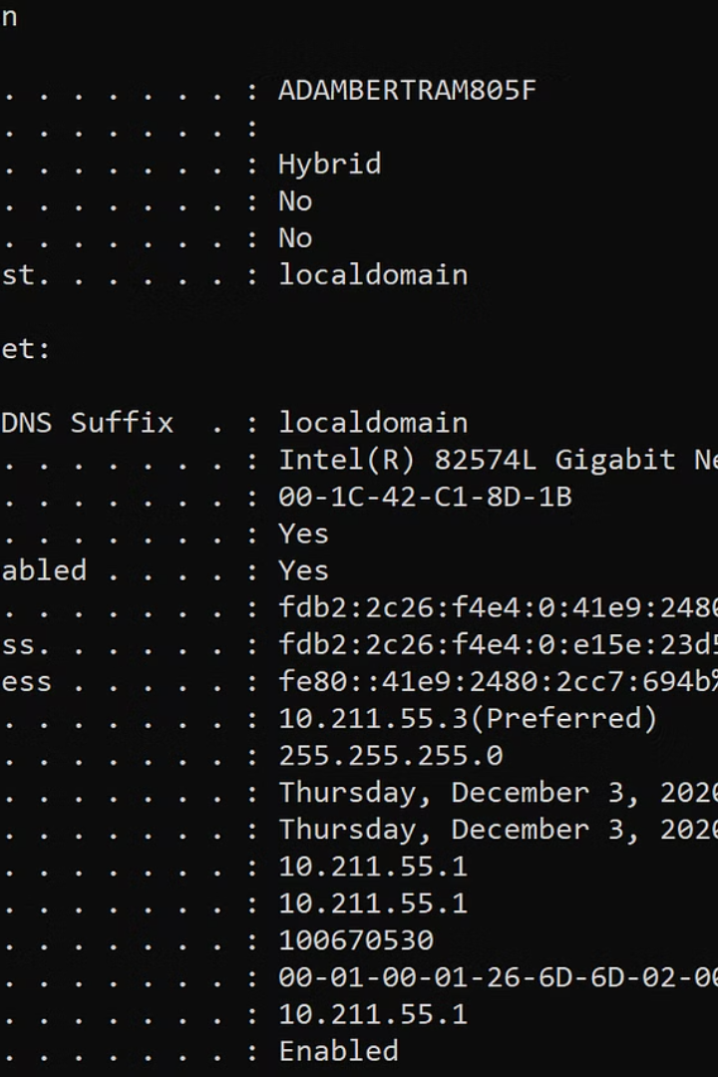
Network & System Info
ipconfig
Shows your Wi-Fi/IP address.
ping [website]
Tests internet connection (e.g., ping google.com).
systeminfo
Displays PC details (RAM, OS version, etc.).

Slide 8





Tips for Beginners
Accurate Typing
Spelling matters – type carefully.
Command History
You can press the up arrow to see and reuse previous commands.
Auto-Complete
Use Tab to auto-complete folder or file names.
Administrator Access
Run as Administrator (for commands needing extra access).

Slide 9





Practice Example
mkdir TestFolder
Create a folder named TestFolder
cd TestFolder
Go inside that folder
echo Hello, CMD! > hello.txt
Create a file named hello.txt with the text Hello, CMD!
dir
Show the list of files (you will see hello.txt)

