Slide 1
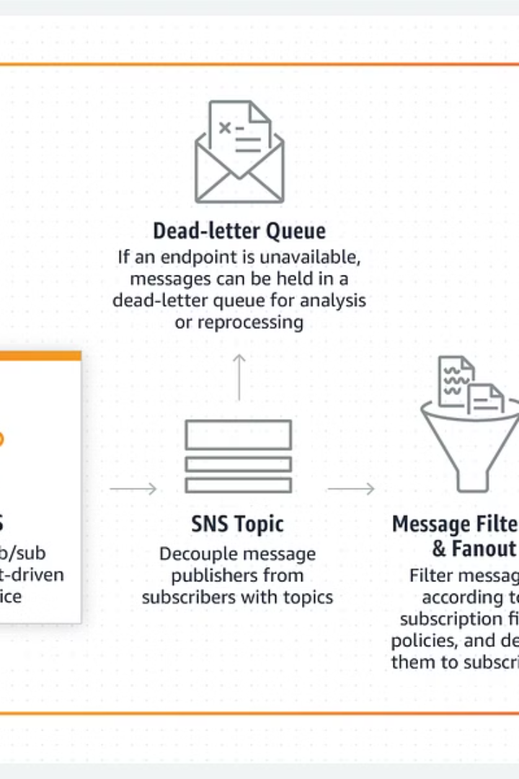

AWS SNS Subscription DLQ (Dead-Letter Queue) –
Simple Explanation
AWS SNS (Simple Notification Service) is used to sends messages to different places like email, SMS, mobile apps, or AWS services. But sometimes, messages fail to be delivered due to issues like network problems, wrong configurations, or unavailable endpoints.
To avoid losing these failed messages, AWS SNS provides a Subscription DLQ (Dead-Letter Queue).
by Ram N Java

Slide 2
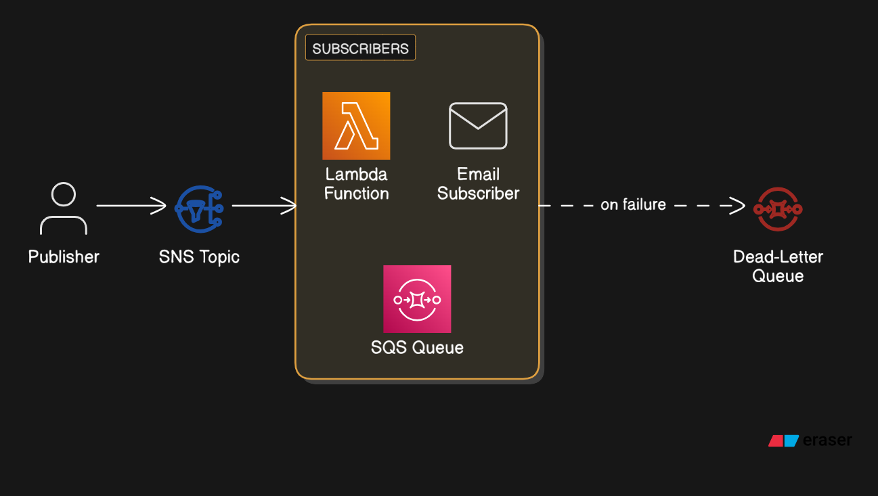

Slide 3
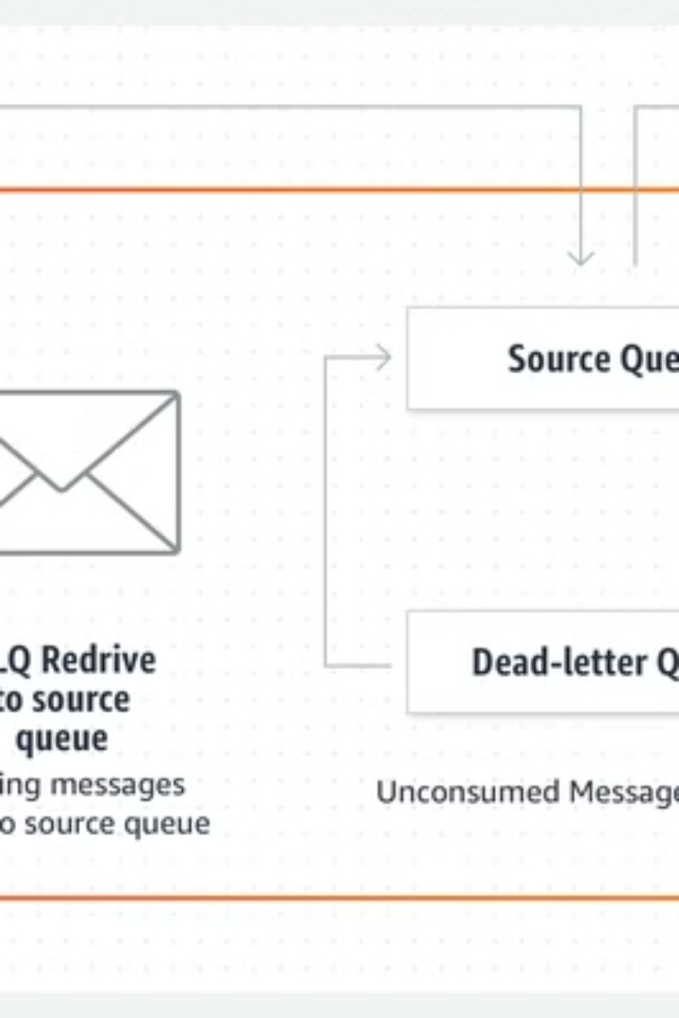
What is a Subscription DLQ?
Definition
Purpose
A Subscription DLQ
(Dead-Letter Queue) is a special Amazon SQS (Simple Queue Service) queue that stores failed SNS messages.
If an SNS message cannot be delivered to a subscriber after multiple retries, it is sent to the DLQ instead of being lost.
Benefits
This helps you analyze failed messages, debug issues, and retry sending them later.

Slide 4
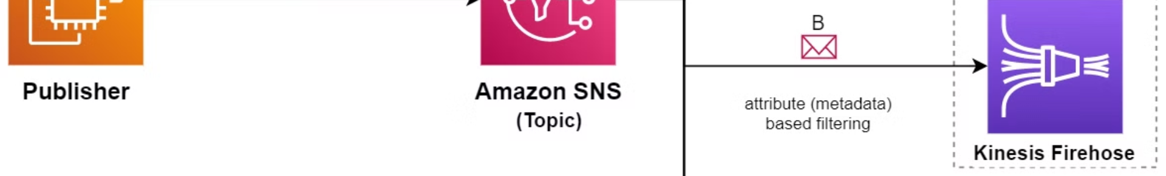




How It Works
A publisher sends a message to an SNS topic.
The SNS topic forwards the message to
its subscribers (like an email, Lambda function, or SQS queue).
If the message fails to be delivered after multiple retries,
it is sent to the DLQ instead of being discarded.
You can check the DLQ to see the failed messages,
find out why they failed, and resend them if needed.

Slide 5
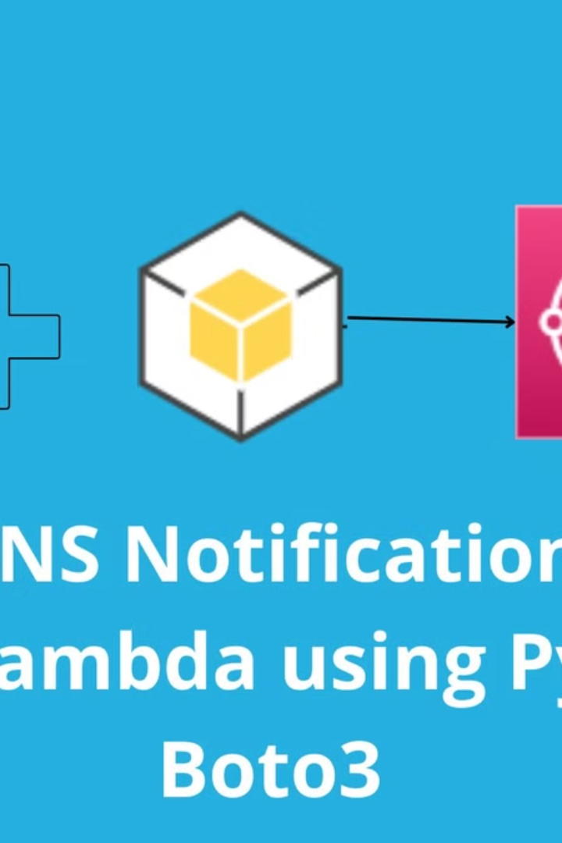
Example Scenario
1
Normal Operation
Imagine you have an SNS topic that sends
order notifications to a Lambda function.
If the Lambda function is working correctly, it will receive and process the SNS messages.
2
Failure Scenario
If the Lambda function is down or misconfigured, SNS will try multiple times but fail to deliver the message.
3
DLQ in Action
Instead of losing the order notification, SNS moves it to the DLQ.
4
Resolution
Later, a developer can check the DLQ, find the failed messages, fix the issue, and retry sending them.

Slide 6
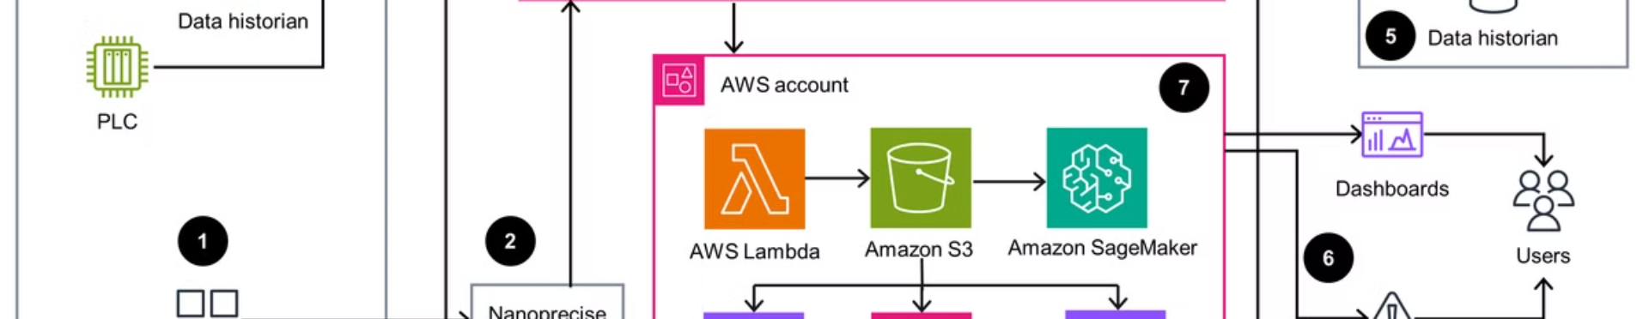




Why Use a Subscription DLQ?
Prevents
Message Loss
Helps Debugging
Allows Message Recovery
Improves System Reliability
You can check why messages failed and fix the problem.
Failed messages are not lost; they are stored for later review.
You can retry sending messages after fixing issues.
Ensures that important notifications are not missed due to temporary issues.

Slide 7
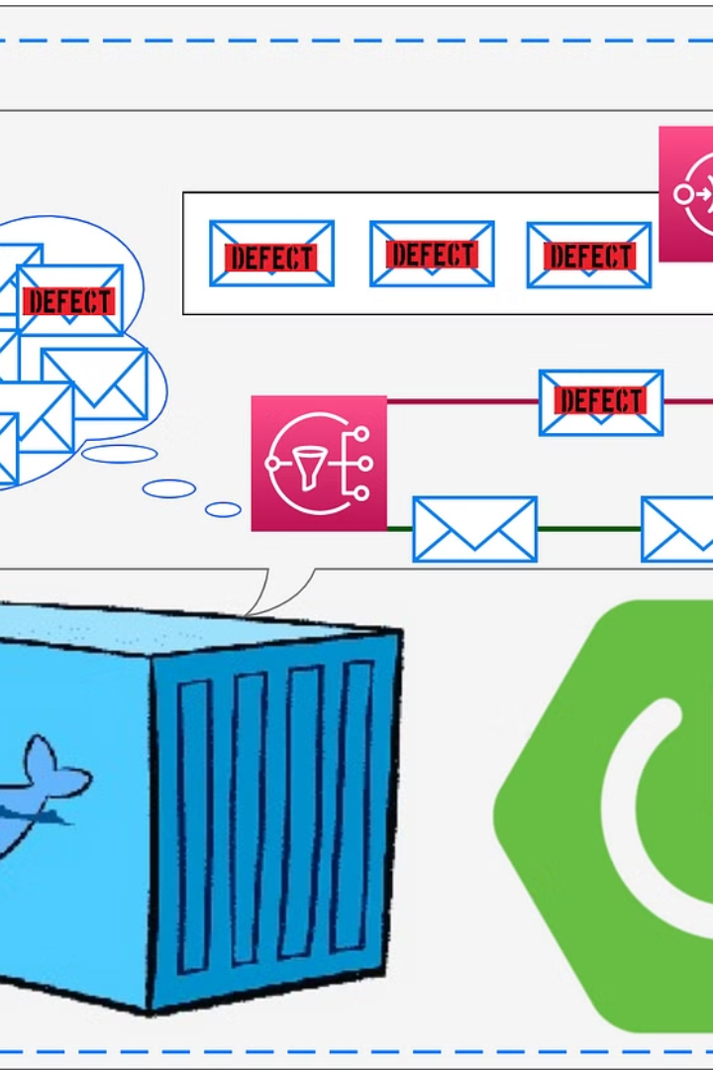
How to Set Up a Subscription DLQ?
Step 1
Create an Amazon SQS Queue (this will be the DLQ).
Step 2
Enable DLQ in the SNS subscription settings by linking the SQS queue.
Step 3
Set a retry policy (for example, try delivering the message 3 times before sending it to the DLQ).
Step 4
Monitor the DLQ to check for failed messages and take action.

Slide 8
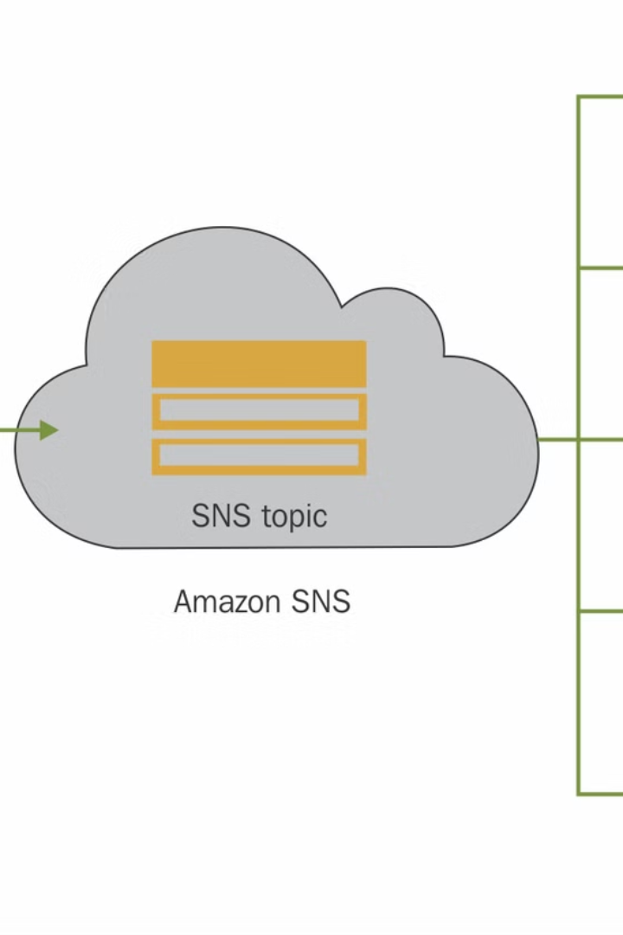
Summary
1
AWS SNS Subscription DLQ is a special queue that stores failed SNS messages.
2
If a message cannot be delivered after retries, SNS moves it to the DLQ.
3
You can review and resend failed messages later to prevent data loss.
4
It helps in debugging and improving reliability of message delivery.
Using a Subscription DLQ is a best practice for handling failures in AWS SNS. 🚀

