Slide 1
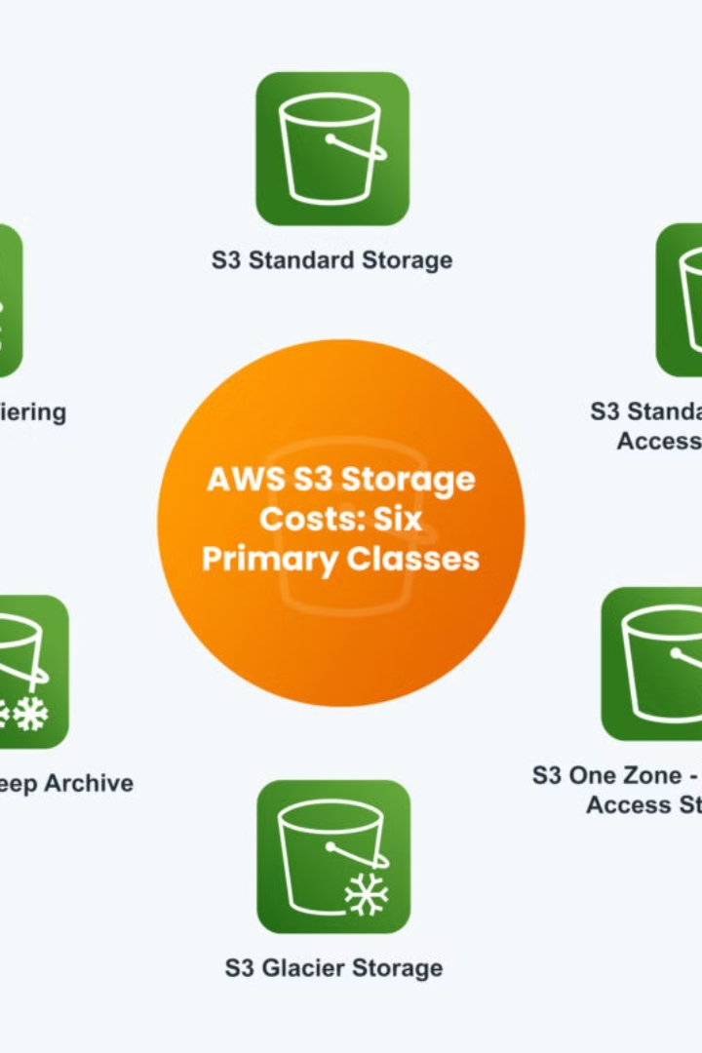

What is AWS S3 Versioning?
AWS S3 (Amazon Simple Storage Service) versioning is a feature that allows you to keep multiple versions of a single file (object) in a bucket. This means every time you update a file with the same name, S3 saves the new version while keeping the old ones. It's like having a backup for each change made to your files.
by Ram N Java

Slide 2

Importance of Versioning
Why is Versioning Important?
1. Data Protection: If a file is accidentally deleted or overwritten, you can recover the previous version.
2. Audit History: Keeps a record of changes to a file over time.
3. Conflict Resolution: Useful when multiple people or systems are working with the same files.

Slide 3
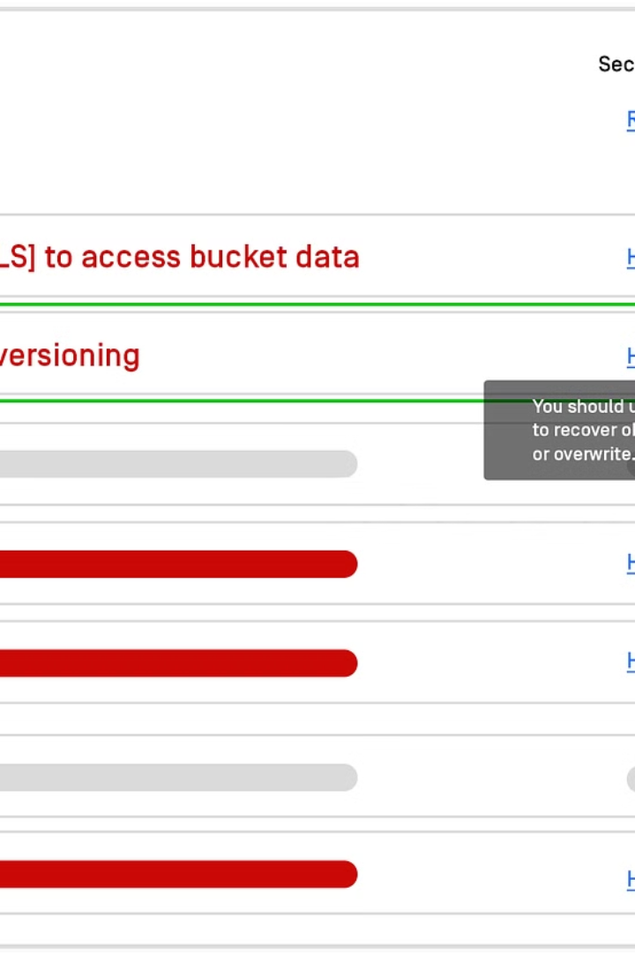
How Does Versioning Work?
Versioning Enabled
Versioning Suspended
Every new upload or modification creates a new version of the file.
If versioning is suspended, no new versions will be created, but the existing versions remain.
Each version is assigned a unique Version ID.

Slide 4




Key Features of Versioning
Multiple Versions
Keeps all versions of an object (file).
Restoration
Allows you to retrieve or restore an older version of a file.
Deletion Markers
If you delete a file, S3 doesn't erase it; instead, it adds a
"delete marker." The file can be restored if needed.

Slide 5
Example Scenario: Without vs With Versioning
1
Upload report.pdf
Without Versioning
2
New file replaces old one forever
With Versioning
3
Creates new version, old version still accessible
• Without Versioning: If you upload a file named report.pdf and then upload another file with the same name, the new file replaces the old one forever.
• With Versioning: Uploading report.pdf again creates a new version. The old version is still there and
can be accessed if needed.

Slide 6
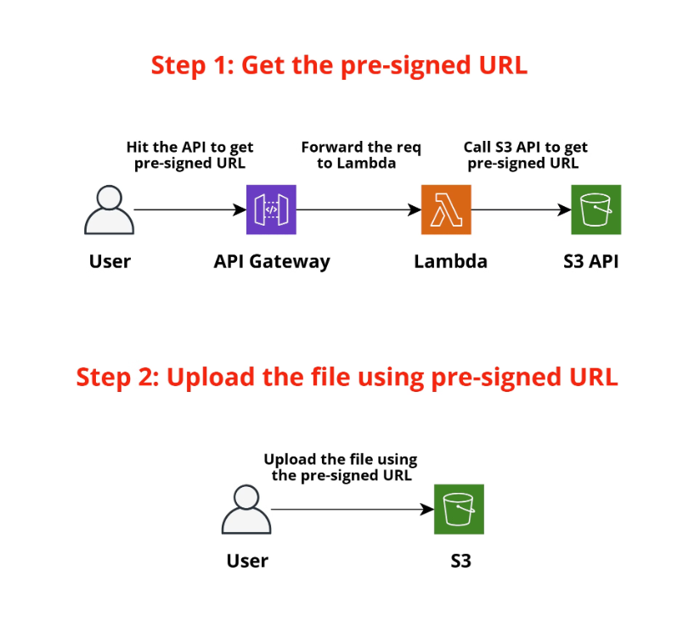
Example Scenario: Version IDs
You upload a file named report.pdf to your bucket.
First Upload: File: report.pdf Version ID: v1.
You upload an updated report.pdf.
Second Upload: File: report.pdf Version ID: v2. Both v1 and v2 exist in the bucket.
You delete report.pdf.
A "delete marker" is created, but both v1 and v2 still exist and can be restored.

Slide 7

Considerations for Versioning
Storage Costs
File Management
Each version of a file uses space, so your storage costs may increase if there are many versions.
Over time, multiple versions can pile up, so you may need to clean up older versions you no longer need.

Slide 8
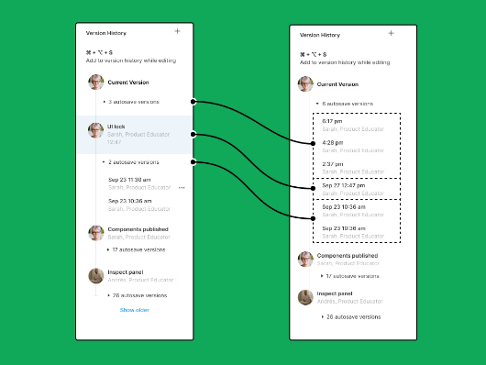


Advantages of S3 Versioning
Accidental Changes Are Safe
Delete without Fear
Team Collaboration
You can restore older versions of files if something goes wrong.
Even if you delete a file, you can restore it by removing the delete marker.
Teams can work on shared files without worrying about losing important versions.

Slide 9



Enabling Versioning
In the Console:
Using AWS CLI:
Go to the S3 bucket.
aws s3api put-bucket-versioning
--bucket <bucket-name>
--versioning-configuration Status=Enabled
Click on "Properties."
Enable the "Bucket Versioning“
option.
You can enable versioning in the S3 management console or via AWS CLI.

