Slide 1
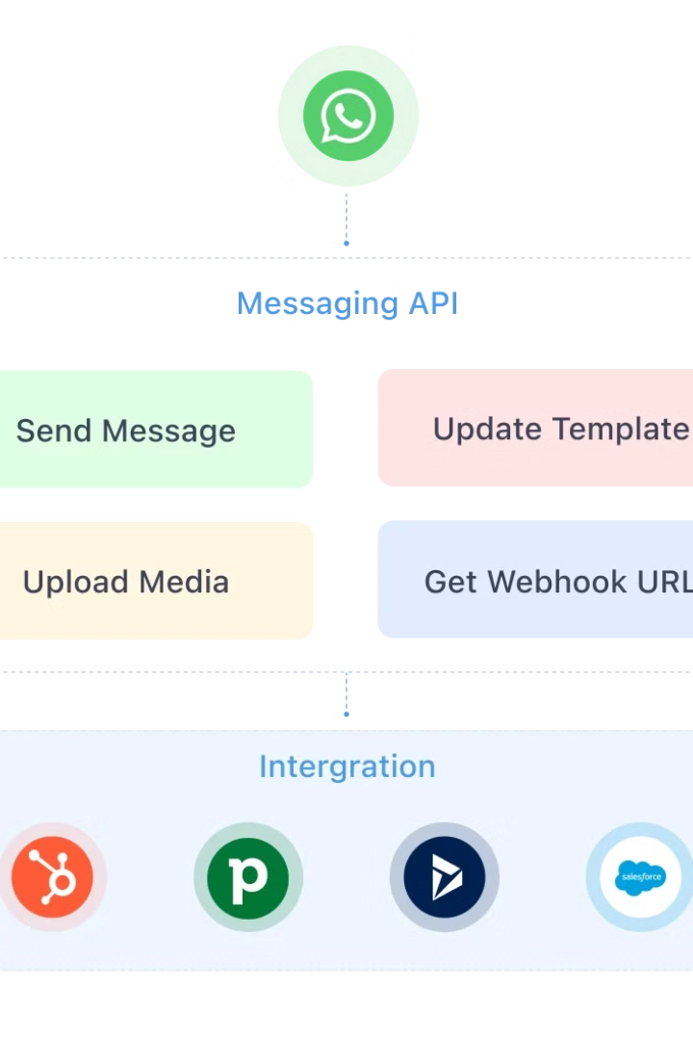

WhatsApp Sequence Diagram Explained for Beginners
A sequence diagram shows how different parts of a system communicate with each other step-by-step. Let's break down the process of sending a message on WhatsApp in an easy-to-understand way:
by Ram N Java

Slide 2
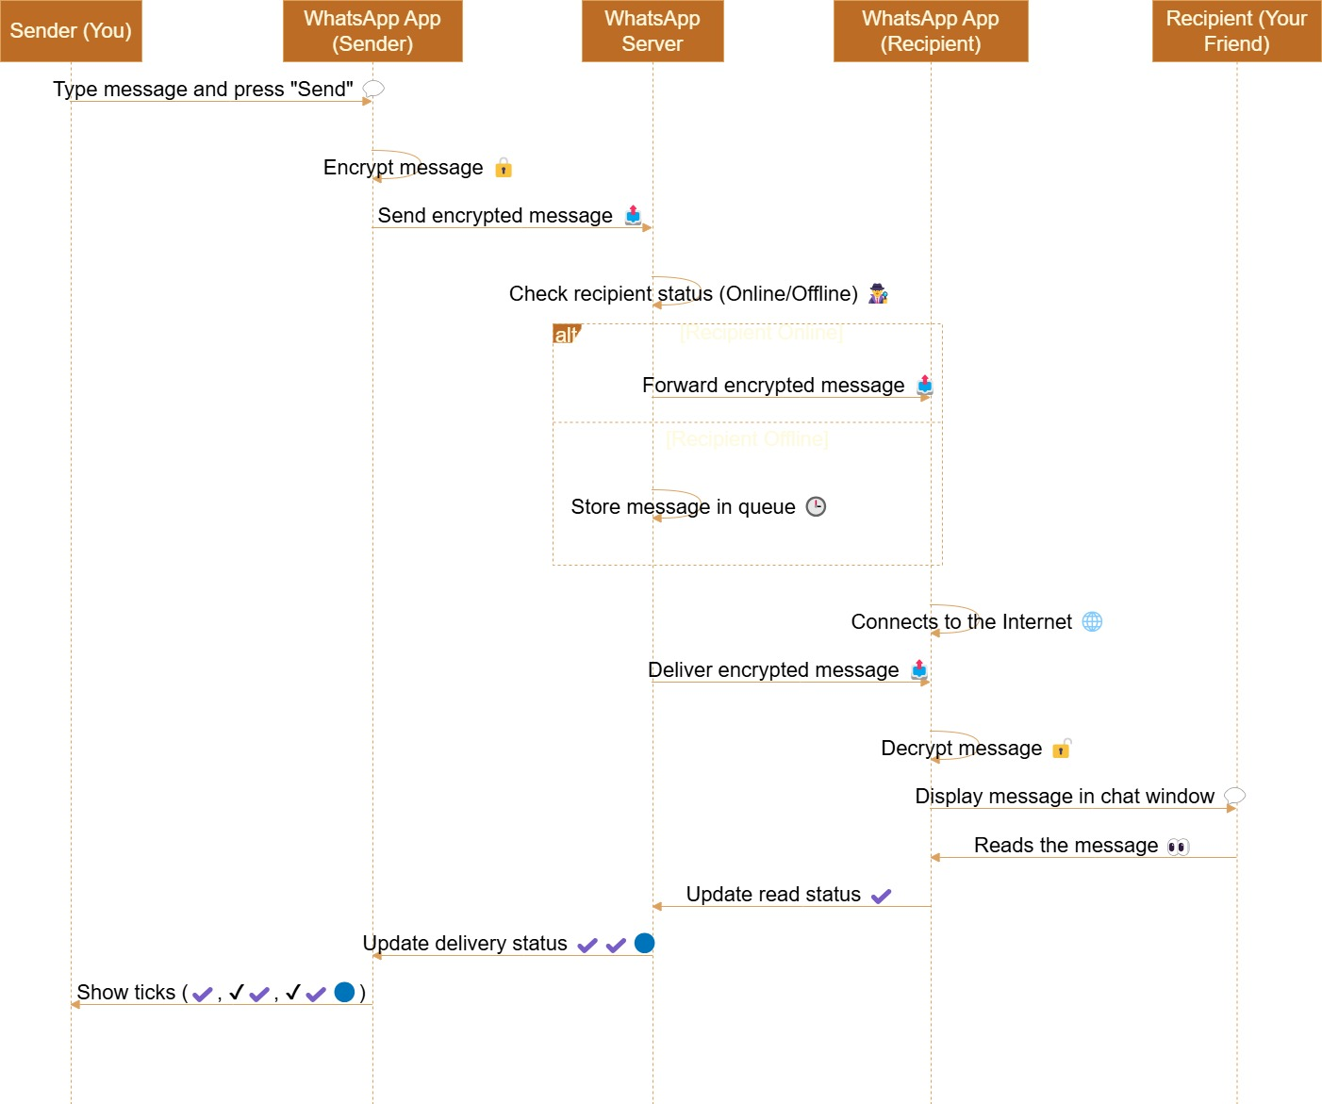

Slide 3
Message Transmission and Server Queuing in WhatsApp
Step 1: User Sends a Message
You (the sender) type a message in the chat window and hit the "Send" button.
As soon as you press send, your phone's WhatsApp app encrypts the message to ensure it is secure and private.
The encrypted message is sent from your phone to WhatsApp's server.
Step 2: Message Queuing
Once the message reaches the WhatsApp server, the server checks if the recipient (the person you're sending the message to) is online or offline.
If the recipient is online, the server immediately forwards the message to their device.
If the recipient is offline, the server stores the message in a queue and waits until the recipient reconnects.

Slide 4
Message Reception and Delivery Confirmation
Step 3: Recipient Receives the Message
When the recipient's phone connects to the internet, the WhatsApp app on their device receives the message from the server.
The message is then decrypted on their phone.
Once decrypted, the message is displayed in their chat window.
Step 4: Message Delivery Confirmation
WhatsApp uses tick marks to show the status of the message:
One tick: The message has been sent to the WhatsApp server.
Two ticks: The message has been delivered to the recipient's device.
Blue ticks: The recipient has read the message.
As these statuses update, your WhatsApp app shows you the latest delivery and read information.

Slide 5
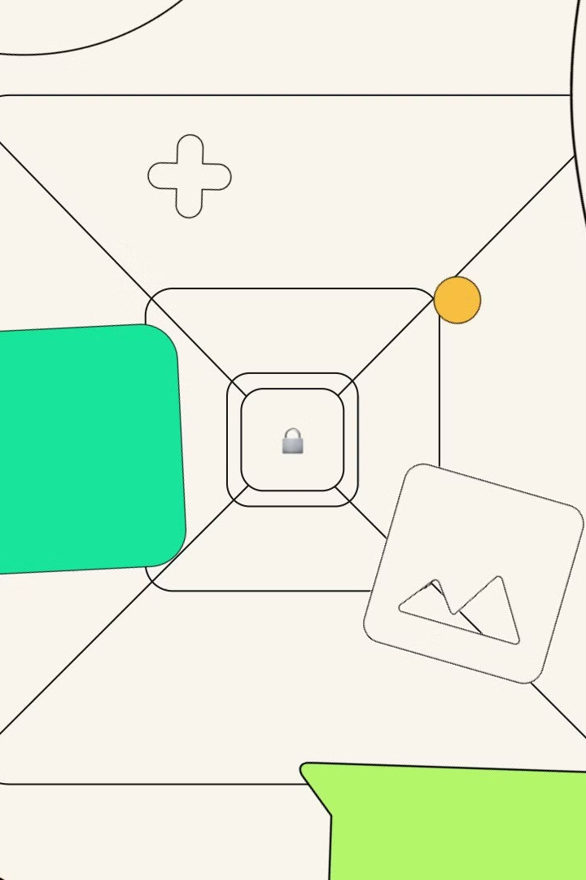
Key Points to Remember
Encryption
Server Role
Messages are encrypted for privacy, so only the sender and recipient can read them.
The WhatsApp server acts as a middleman, forwarding messages and storing them temporarily if needed.
Ticks
The ticks (one, two, or blue) keep you informed about what's happening with your message.
By understanding this sequence, you can see how WhatsApp efficiently handles billions of messages every day while keeping them private and secure.

