Slide 1
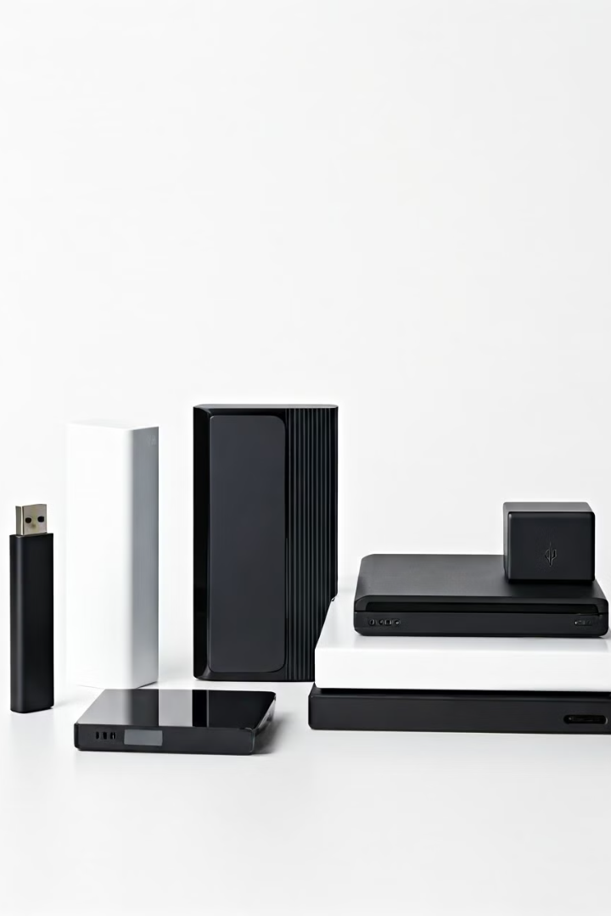

What is External Storage? USB, SSD, HDD Explained
External storage is a way to save and store data outside your computer. It's like having an extra digital filing cabinet where you can keep your files, photos, videos, and more. There are different types of external storage, such as USB drives, SSDs, and HDDs.
by Ram N Java

Slide 2
USB Drives (Flash Drives)
What is it?
How Does It Work?
A USB drive (also called a flash drive or thumb drive) is a small, portable device that plugs into the USB port of your computer.
Plug the USB drive into your computer's USB port.
The computer recognizes it as a storage device.
You can copy, paste, or save files directly to the USB drive.
It's like a tiny storage box you can carry in your pocket.
When you're done, safely remove the USB drive and take it with you.

Slide 3
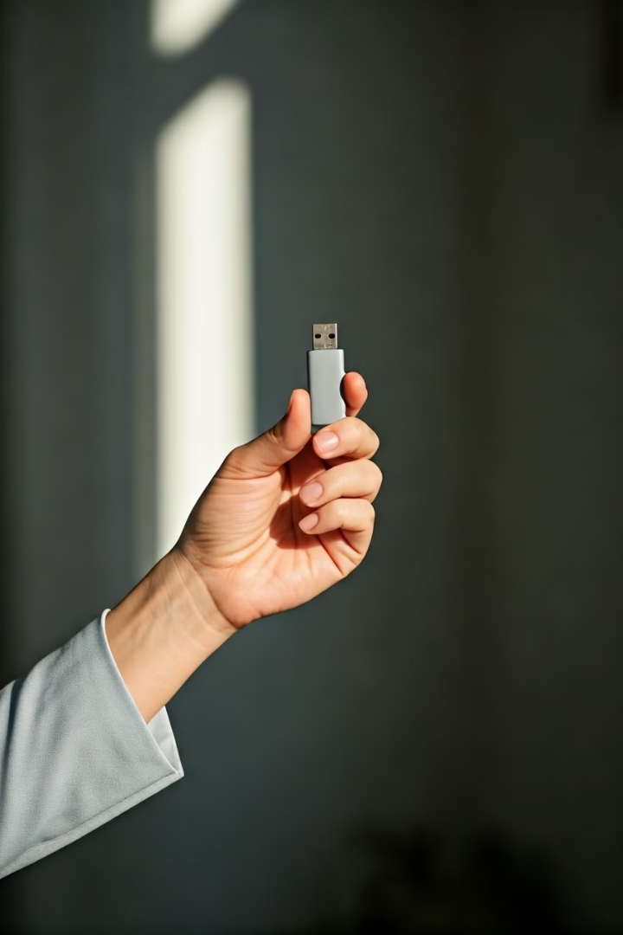
USB Drives (Flash Drives)
Pros
Cons
Portable: Small and easy to carry.
Limited Storage: Typically holds less data compared to SSDs or HDDs (Common sizes: 16GB, 32GB, 64GB, 128GB, or more).
Affordable: Usually inexpensive.
Plug-and-Play: No need for extra power or software.
Less Durable: Can be easily lost or damaged.
Best For
Storing small files like documents, photos, or presentations.
Transferring files between computers.

Slide 4
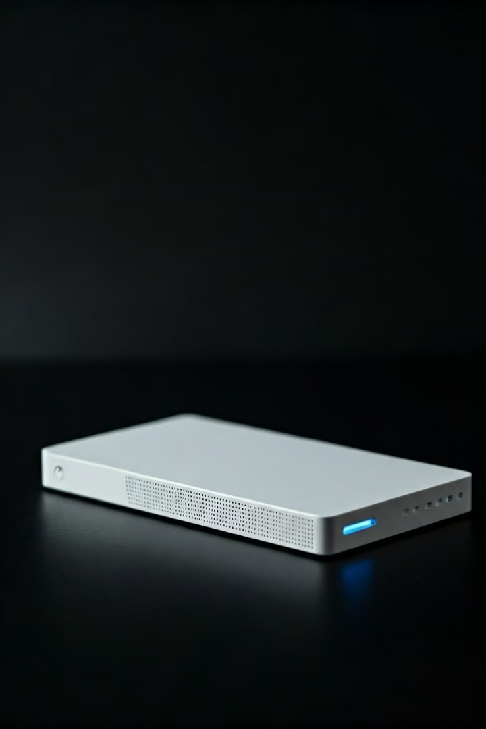


SSD (Solid State Drive)
What is it?
An SSD is a fast and modern type of storage device. It has no moving parts, which makes it faster and more durable than traditional hard drives.
It's like a supercharged version of a USB drive but bigger and faster.
How Does It Work?
SSDs use flash memory (like USB drives) to store data.
They connect to your computer via USB, Thunderbolt, or SATA ports.
You can store large amounts of data, like movies, games, or software.

Slide 5
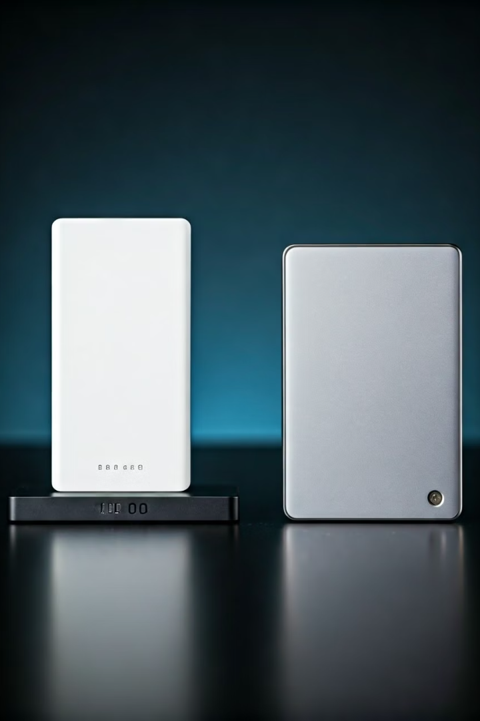



SSD (Solid State Drive)
Pros
Cons
Fast: Much faster than HDDs and USB drives.
Expensive: Costs more than HDDs and USB drives.
Durable: No moving parts, so it's less likely to break.
Limited Lifespan: Flash memory can wear out over time.
Compact: Smaller and lighter than HDDs.
Best For
Storing large files like videos, games, or backups.
Speeding up your computer if used as an internal drive.

Slide 6
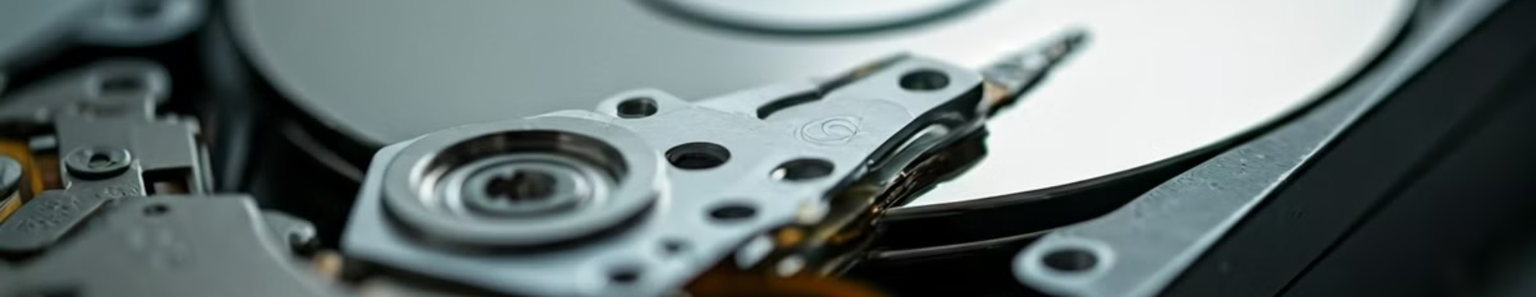


HDD (Hard Disk Drive)
What is it?
How Does It Work?
An HDD is a traditional storage device that uses spinning disks to store data. It's larger and slower than an SSD but can hold a lot of data.
HDDs have spinning disks (platters) that store data.
A mechanical arm reads and writes data on the disks.
It's like a big, sturdy filing cabinet for your files.
They connect to your computer via USB or SATA ports.

Slide 7






HDD (Hard Disk Drive)
Cons
Slower: Takes longer to read and write data compared to SSDs.
Pros
Fragile: Moving parts make it more prone to damage if dropped.
Large Storage: Can hold a lot of data (up to several terabytes).
Best For
Storing large amounts of data like movies, music, or backups.
Affordable: Cheaper than SSDs for the same amount of storage.
Budget-friendly storage for big files.

Slide 8
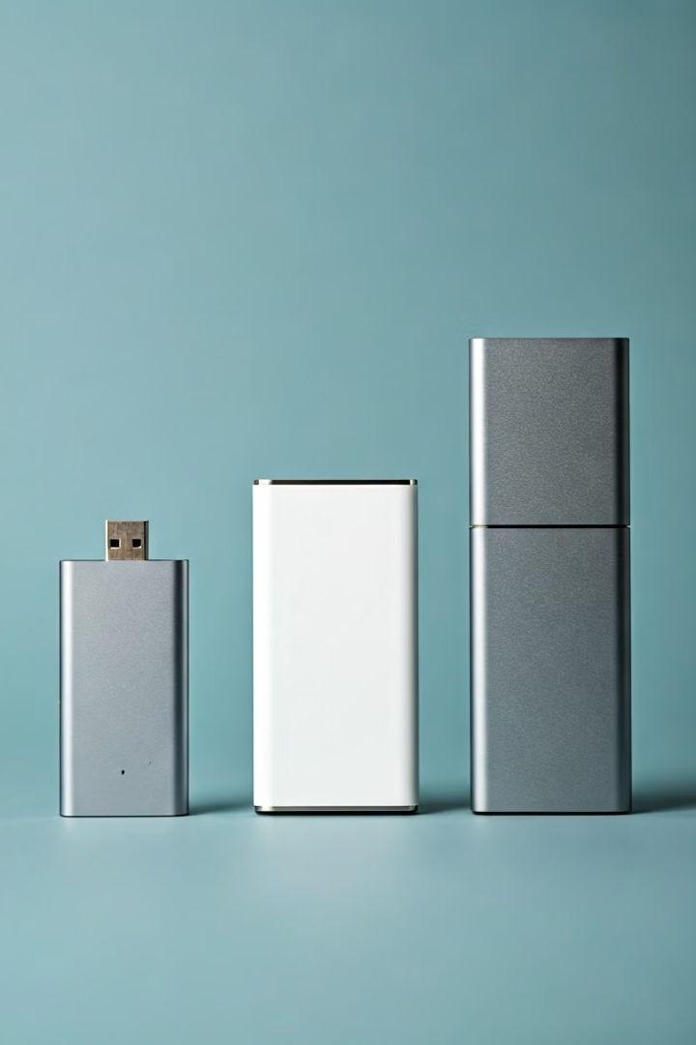
Comparison Table
Feature
USB Drive
SSD
HDD
Size
Small and portable.
Compact and lightweight.
Larger and bulkier.
Speed
Slower than SSD.
Very fast.
Slower than SSD.
Storage
Limited.
Medium to large.
Large.
Durability
Less durable.
Very durable (no moving parts).
Less durable (moving parts).
Cost
Affordable.
Expensive.
Affordable for large storage.
Best For
Small files, portability.
Speed, performance, and portability.
Large storage on a budget.

Slide 9
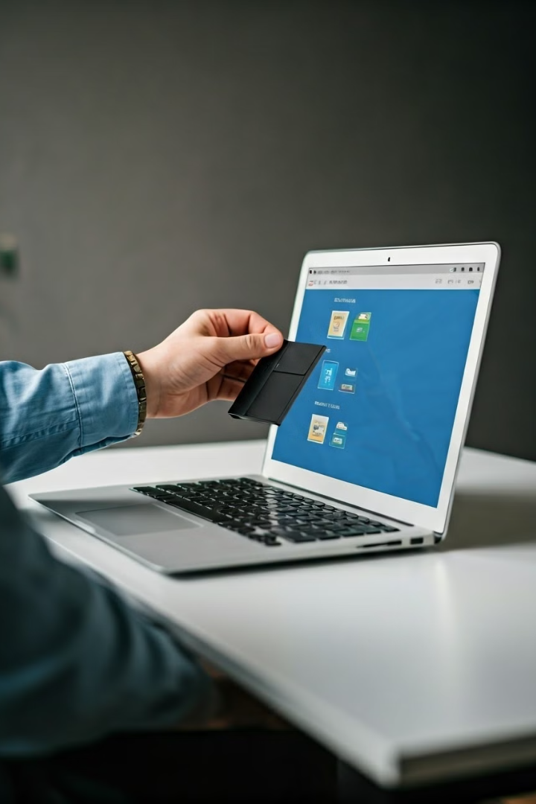
How to Use External Storage
Connect the Device
Plug the USB drive, SSD, or HDD into your computer's USB port.
Example: Insert a USB drive into the USB slot.
Transfer Files
Open the device on your computer (it will appear as a drive, like "D:" or "E:").
Drag and drop files to copy them to the external storage.
Example: Copy photos from your computer to the USB drive.
Safely Remove
Always safely eject the device before unplugging it to avoid data loss.
Example: Right-click the drive and select "Eject".

Slide 10






Summary
USB Drives
Small, portable, and great for transferring small files.
SSDs
Fast, durable, and ideal for large files and performance.
HDDs
Affordable and perfect for storing large amounts of data.
Choose the type of external storage that fits your needs, and you'll have a reliable way to save, transfer, and back up your files!

