Slide 1


AWS S3 Batch Operations – Explained for Beginners
AWS S3 Batch Operations allow you to perform actions on millions or even billions of S3 objects at once. Instead of processing files one by one, you can run a single job to apply changes to many files at the same time.
by Ram N Java

Slide 2
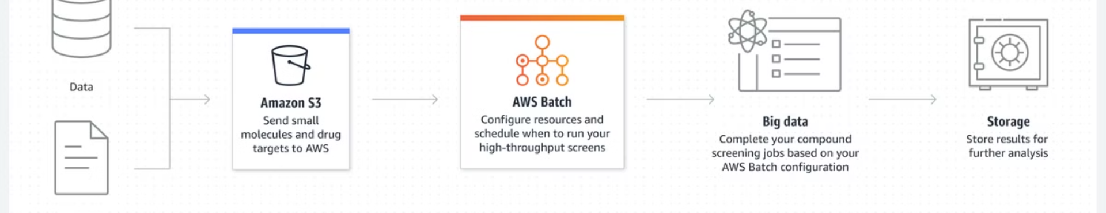
🔹 Why Use S3 Batch Operations?
Saves Time – No need to process files
individually.
Automates Bulk Tasks – Run the same action on many files.
Supports Large-Scale Operations – Works on millions of objects in S3.
Integrates with AWS Services – Works with Lambda, Glacier, Object Tags, ACLs, and more.

Slide 3
🔹 What Can You Do with S3 Batch Operations?
1️⃣ Copy Multiple Files – Move or duplicate objects across buckets.
3️⃣ Restore Archived Files – Bring back objects stored in
S3 Glacier.
5️⃣ Update Object Tags & Metadata – Add or remove tags on multiple files.
2️⃣ Delete Many Files – Remove large numbers of objects quickly.
4️⃣ Change Object Permissions – Modify ACLs (Access Control Lists).
6️⃣ Run AWS Lambda on Objects – Apply custom processing (e.g., resize images).

Slide 4
🔹 How S3 Batch Operations Work?
Create a CSV File – List the S3 objects (files) you want to process.
1
2
Upload the CSV to S3 – The file should contain the bucket name and object keys.
Create a Batch Job in S3 – Select the action (copy, delete, restore, etc.).
3
4
Run the Job – AWS processes all the objects in the list.
Check Job Status – View reports and logs in the S3 Console.
5

Slide 5
🔹 Example Use Case – Bulk Image Processing
📌 Scenario: You have 10,000 images in S3 and want to resize them automatically.
1️⃣ Upload a CSV file listing all image files.
2️⃣ Create a Batch Job to run an AWS Lambda function on each file.
3️⃣ Lambda resizes the images and saves them back to S3.
✅ Now, all images are processed automatically!

Slide 6
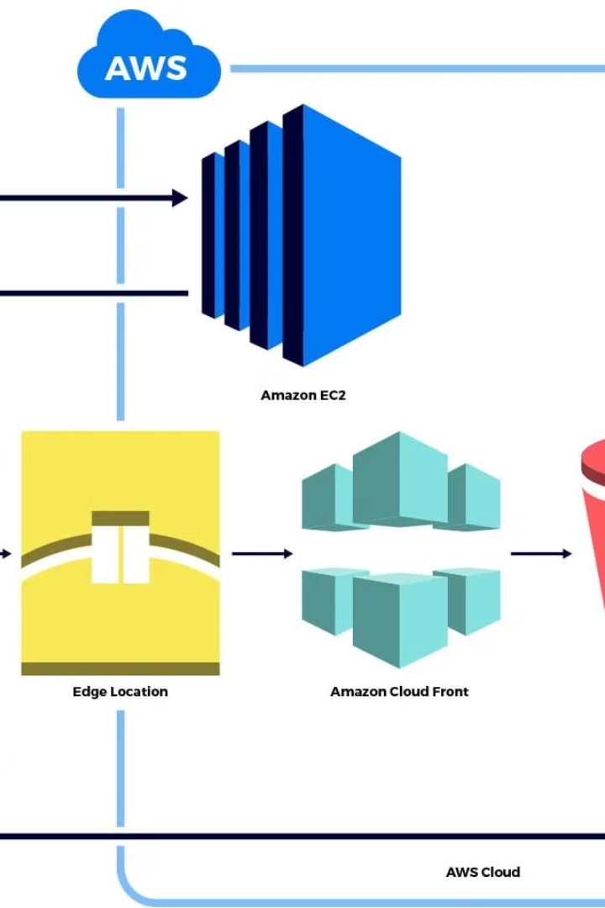




🔹 Things to Keep in Mind
✅ Batch Jobs are Asynchronous – They run in the background.
✅ Supports Large Datasets – Can process billions of objects.
✅ Requires IAM Permissions – You need proper S3 and Batch Operations permissions.
✅ Costs Apply – Based on number of objects and actions performed.

Slide 7
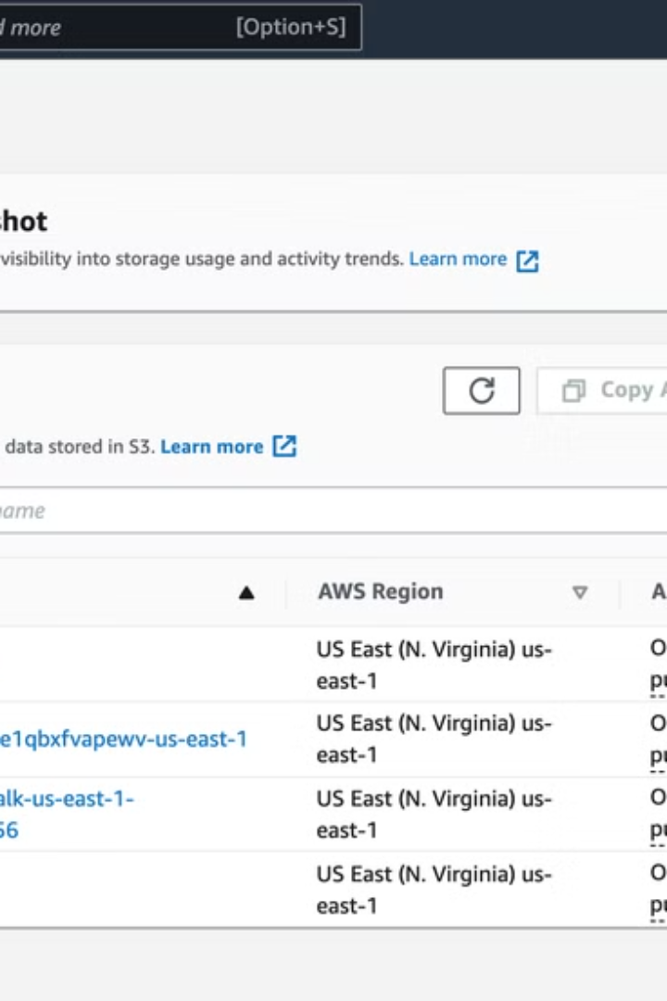
🔹 How to Use
S3 Batch Operations?
Using AWS Console
1️⃣ Go to AWS S3 Console
2️⃣ Click "Batch Operations" in the left menu
3️⃣ Create a new job
4️⃣ Upload a CSV file with object details
5️⃣ Select the operation (Copy, Delete, etc.)
6️⃣ Choose a target bucket (if needed)
7️⃣ Start the job and monitor progress

Slide 8

Using AWS CLI (Example for Deleting Objects)
aws s3 batch-operations create-job \
--account-id 123456789012 \
--operation '{"S3PutObjectAcl":{"AccessControlPolicy":{"Grants":[],"Owner":{}}}}' \
--report '{"Bucket":"arn:aws:s3:::my-bucket","Format":"CSV","Enabled":true}' \
--manifest '{"Spec":{"Format":"S3BatchOperations_CSV_20180820","Fields":["Bucket","Key"]},"Location":{"ObjectArn":"arn:aws:s3:::my-bucket/manifest.csv","ETag":"example-etag"}}'

Slide 9




🔹 Final Thoughts
Efficiency
Bulk Actions
AWS S3 Batch Operations help you manage large-scale data tasks efficiently.
1
Instead of processing objects one by one, you can run bulk operations with just a few clicks.
2
Versatility
Speed
4
Whether you're copying, deleting, tagging, or processing objects with Lambda, S3 Batch Operations save time and effort.
🚀
3

