Slide 1
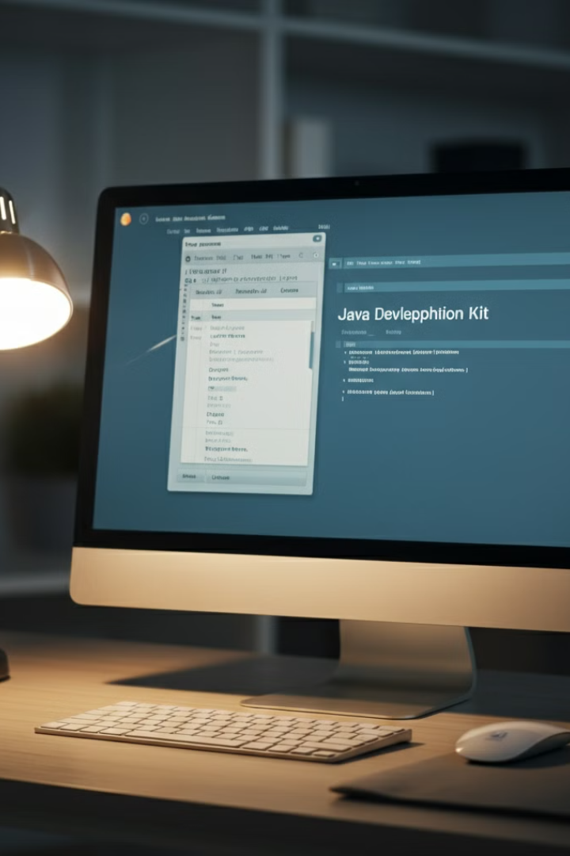

Installing JDK 17 on Windows 11: A Step-by-Step Guide
Installing the Java Development Kit (JDK) 17 on Windows 11 is an essential step for Java developers. This guide will walk you through the process of downloading, installing, and setting up JDK 17 on your Windows 11 system. By following these steps, you'll be ready to start developing Java applications with the latest features and improvements offered by JDK 17.
by Ram N Java

Slide 2


Step 1: Download JDK 17
1
Visit the Oracle Website
Open your web browser and go to the official Oracle website's JDK download page: https://www.oracle.com/java/technologies/javase/jdk17-archive-downloads.html.
2
Download JDK 17 for Windows
Scroll down to find the section labeled JDK 17 and look for the Windows x64 Installer (usually ends with .exe). Click the download link next to it.
3
Accept License Agreement
Before downloading, you might need to accept the Oracle license agreement. Check the box if prompted.

Slide 3

Step 2: Install JDK 17
1
Run the Installer
Once the file has been downloaded, navigate to your downloads folder
and double-click the JDK 17 installer (.exe file) to run it.
2
Follow the Installation Wizard
The installation wizard will open. Click Next to begin. By default, the JDK
will be installed in C:\Program Files\Java\jdk-17. You can change this location
if you wish, but it's fine to leave it as is. Click Next.
3
Wait for Installation to Complete
The installer will copy files and set up everything for you. Once complete,
click Close to finish the installation.

Slide 4
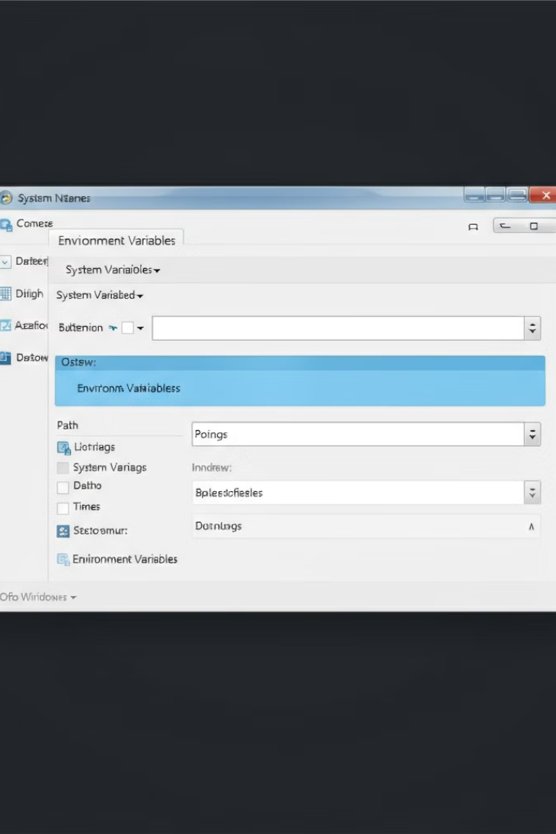


Step 3: Set Up Environment Variables (Part 1)
Open Environment Variables Settings
Right-click the Start button and select System. Scroll down and click Advanced system settings on the right. In the System Properties window, click Environment Variables.
Add the JDK Path to System Variables
In the Environment Variables window, under the
System variables section, scroll down and find the
Path variable. Select it and click Edit. In the Edit window, click New and paste the path to the JDK 17 bin folder. By default, this path is: C:\Program Files\Java\jdk-17\bin

Slide 5
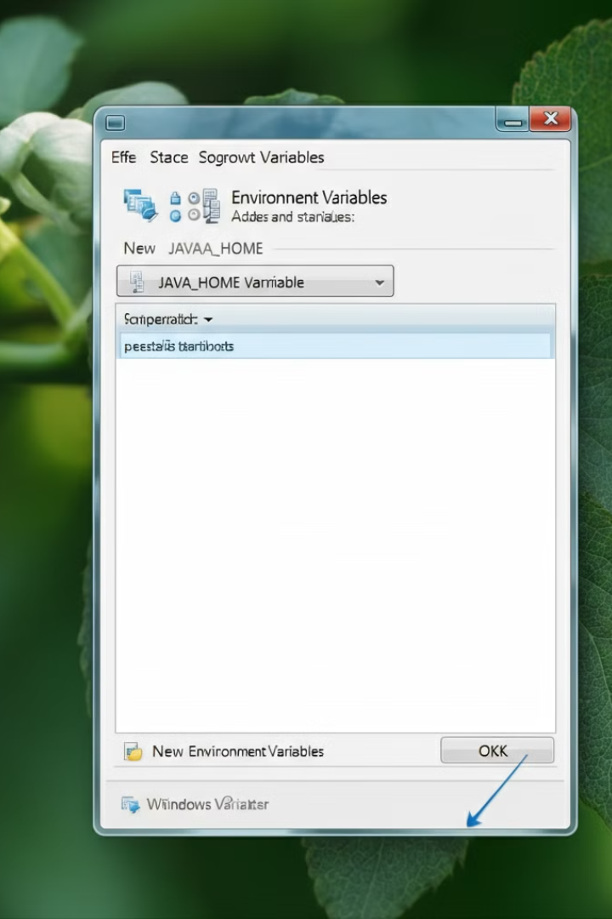


Step 3: Set Up Environment Variables (Part 2)
Create JAVA_HOME Variable
In the Environment Variables window, click New under the System variables section. In the Variable name field, enter JAVA_HOME. In the Variable value field, paste the path to the main JDK folder (without the bin). By default, this is: C:\Program Files\Java\jdk-17
Save and Close
Click OK to save it. Click OK to close all windows and apply the changes.

Slide 6
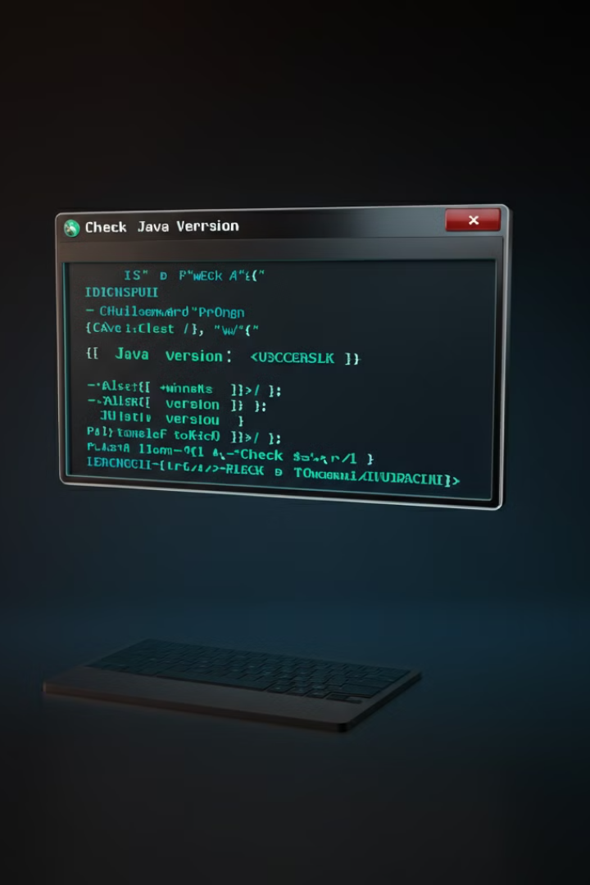
Step 4: Verify the Installation (Part 1)
1
Open Command Prompt
Press Win + R, type cmd, and hit Enter to open the Command Prompt.
2
Check Java Version
In the Command Prompt, type the following command and press Enter: java -version
3
Verify Output
You should see output similar to this if the installation was successful:
java version “17"
Java(TM) SE Runtime Environment (build 17)
Java HotSpot(TM) 64-Bit Server VM (build 17)

Slide 7

Step 4: Verify the Installation (Part 2)
Check the JDK Compiler
Expected Output
To check if the JDK compiler (javac) is working, type: javac -version
You should see: javac 17

Slide 8

Conclusion
1
Successful Installation
You've successfully installed JDK 17 on Windows 11!
2
Ready for Development
Now you're ready to start developing Java applications.
3
Configure Development Environment
Make sure to configure your development environment (like IntelliJ IDEA, Eclipse, or Visual Studio Code) to use JDK 17.

