Slide 1


AWS S3 Object Lambda – Explained for Beginners
AWS S3 Object Lambda allows you to modify and process files in S3 when they are requested, without storing extra copies. Instead of keeping multiple versions of a file, S3 Object Lambda automatically changes the file before sending it to the user.
For example, if you store high-resolution images in S3, you can use S3 Object Lambda to resize them on the fly when users request them.
by Ram N Java

Slide 2
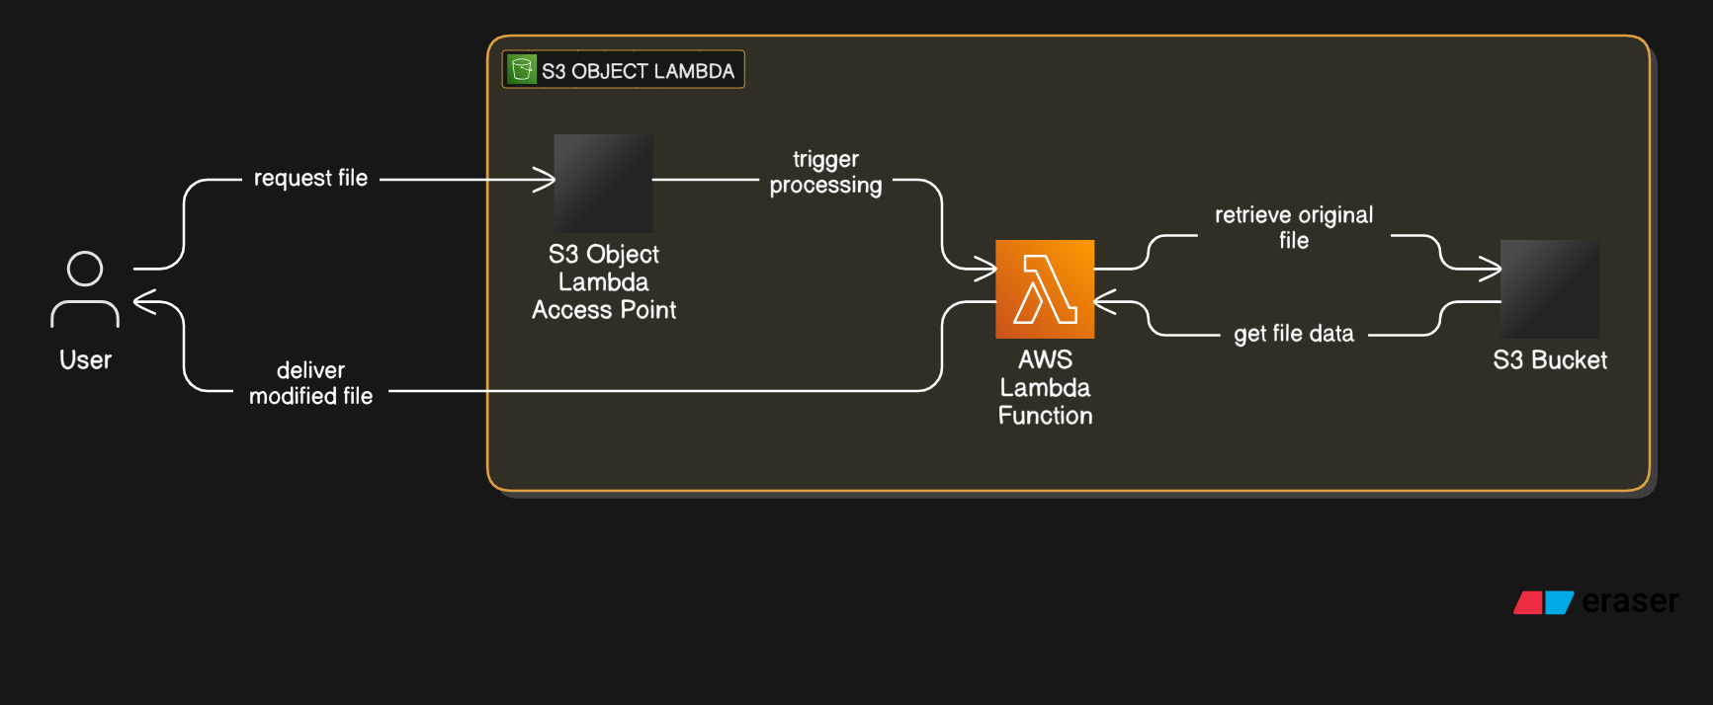

Slide 3

How Does S3 Object Lambda Work?
1
A user requests a file from S3
2
S3 Object Lambda runs an AWS Lambda function to process the file
3
Lambda modifies the file (for example, resizing an image or filtering sensitive data)
4
The modified file is returned to the user instead of the original file
The original file remains unchanged in S3.

Slide 4

Why Use S3 Object Lambda?
Saves Storage Space – No need to store different versions of the same file.
Customizes Data Per User – Different users can see different versions of the same file based on rules.
Works with Existing Applications – No need to change how your application accesses S3.
Supports Various Use Cases – You can filter, format, modify, or convert data before delivering it.

Slide 5




Use Cases for S3 Object Lambda
Watermarking Images
Resizing Images
Add a watermark to images without storing separate watermarked versions.
1
Provide different image sizes for different devices without keeping extra copies.
2
Format Conversion
4
Filtering Data
Convert files on demand, such as converting a JSON file into a CSV file before download.
3
Hide sensitive information, such as masking personal data in documents.

Slide 6

How to Set Up S3 Object Lambda?
Step 1
Create an AWS Lambda Function
1. Go to AWS Lambda Console
2. Click Create Function and choose Author from scratch
3. Select a Runtime (such as Python, Node.js, or Java)
4. Write code that processes the requested file
5. Deploy the Lambda function

Slide 7
Step 2: Create an S3 Object Lambda Access Point
1. Go to AWS S3 Console
2. Click Access Points and choose Create Object Lambda Access Point
3. Select your S3 bucket
4. Attach the Lambda function that will process the files
5. Click Create Access Point
Now, whenever a file is requested through this access point, the Lambda function will
modify it before delivering it to the user.

Slide 8

Things to Keep in Mind
No Extra Storage Costs – You do not need to store modified versions of files.
Lambda Processing Costs Apply – You are charged for the execution time of the Lambda function.
Limited to GET Requests – S3 Object Lambda only works when retrieving files, not modifying them directly.
Requires IAM Permissions – Lambda needs permission to read files from S3.

Slide 9




Final Thoughts
Flexibility
1
Process and modify files in real time
Efficiency
2
No extra storage required
Cost
3
Pay for Lambda execution only
Usability
4
Works with existing applications
AWS S3 Object Lambda is a powerful tool that allows you to process and modify files in real time without storing extra versions. Whether you need to resize images, filter sensitive information, or convert file formats, S3 Object Lambda can do it on demand, saving storage space and improving flexibility.
Would you like help setting up an S3 Object Lambda function for your specific needs?

